Slide 1
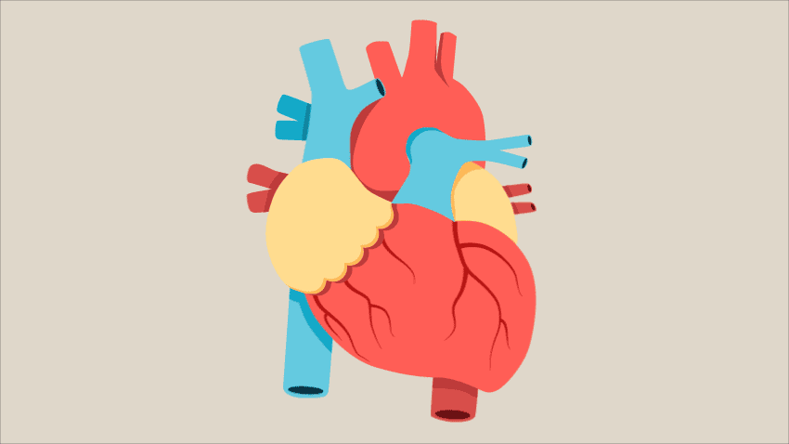
CRATAEGUS AND OTHER HEART REMEDIES
Presented by :
Dr. Parul Singh B.H.M.S , MD(Hom.)
Assistant Professor
Department of Community Medicine

Slide 2
CRATAEGUS OXYACANTHA
Common name- HAWTHORN BERRIES, THORN APPLE, MAY BLOSSOM
Family – ROSACEAE
Part used - BERRY
Hindi Name – Vansangali, वानसंगली
Proving- Dr. JENNINGS

Slide 3
CONT….
PATHOPHYSIOLOGY: Produces giddiness, lowered pulse, and air hunger and reduction in blood-pressure.
Acts on muscle of heart, and is a heart tonic. No influence on the endocardium
Is a sedative in cross, irritable patients with cardiac symptoms.
Arteriosclerosis. Said to have a solvent power upon crustaceous and calcareous deposits in arteries.
Cardiac dropsy. Fatty degeneration. Aortic disease.
Extreme dyspnoea on least exertion, without much increase of pulse.
Pain in region of heart and under left clavicle.
Heart muscles seem flabby, worn out. Cough.
Heart dilated; first sound weak.
Pulse accelerated, irregular, feeble, intermittent. Valvular murmurs, angina pectoris.

Slide 4
CONT….
Extreme weakness, general anasarca, insomnia, anaemia, cutaneous chilliness with heart disease.
Air hunger
Apprehensive, despondent. Very nervous and irritable, with pain in back of head and neck
Diabetes, especially in children.
Excessive perspiration.
Modalities.--Worse, in warm room, exertion,
and excitement.
Better, fresh air, quiet and rest

Slide 5
Clinical utilities
Chronic heart disease
Collapse of typhoid. Haemorrhage from bowels, Dyspepsia and nervous prostration, with heart failure.
Angina pectoris
Arteriosclerosis, atherosclerosis
hypotensive activity via vasorelaxation, significant antioxidant activity and a tonic action on cardiac myocytes

Slide 6
OTHER HEART REMEDIES
DIGITALIS
KALMIA
ADONIS VERNALIS
NAJA
CACTUS G
LACHESIS
GELSEMIUM
SYPHILINUM ( MED. , SPIG.)

Slide 7
DIGITALIS PURPUREA
Sudden flushes of heat, followed by great nervous weakness and irregular intermitting pulse, occurring at the climacteric; < by least motion.
Weak heart without valvular complications.
Sensation as if heart would stop beating if she moved (Cocaine - fears that unless constantly on the move, heart will cease beating, Gels.).
Pulse full, irregular, very slow and weak; intermitting every third, fifth or seventh beat.
Face pale, deathlike appearance and bluish-red.
The fingers "go to sleep" frequently and easily
Fatal syncope may occur when being raised to upright position
< When sitting, especially when sitting erect; motion.

Slide 8
KALMIA LATIFOLIA
In heart diseases that have developed from rheumatism, or alternate with it.
Pains sticking, darting, pressing, shooting in a downward direction ; attended or succeeded by numbness of affected part
Pulse slow, scarcely perceptible (35 to 40 per minute); pale face and cold extremities.

Slide 9
CACTUS GRANDIFLORUS
Heart feels as if clasped and unclasped rapidly by an iron hand; as if bound, "had no room to beat.".
Palpitation: day and night; worse when walking and lying on left side (Lach.); at approach of menses
Fear of death; believes disease incurable (Ars.)
Whole body feels as if caged, each wire being twisted tighter and tighter.
Constriction

Slide 10
GELSEMIUM SEMPERVIRENS
Fears that unless on the move heart will cease beating (fears it would cease beating if she moved, Dig.).
Slow pulse of old age.
Great heaviness of the eyelids; cannot keep them open
Bad effects from fright, fear, exciting news and sudden motions (Ign. - from pleasant surprise, Coff.).
Fear of death (Ars.); utter lack of courage.
The anticipation of any unusual ordeal, preparing for church, theatre, or to meet an engagement, brings on diarrhoea; stage fright, nervous dread of appearing in public (Arg. n.). General depression from heat of sun or summer. Weakness and trembling; of tongue, hands, legs; of the entire body. Desire to be quiet, to be let alone; does not wish to speak or have any one near her, even if the person be silent (Ign.)

Slide 11
LACHESIS MUTUS
Palpitation, with fainting spells, especially during climacteric.
Constricted feeling causing palpitation, with anxiety. Cyanosis. Irregular beats.

Slide 12
NAJA TRIPUDIANS
Simple hypertrophy of heart. RHD, chronic organic lesions
For restoring a heart damaged by acute inflammation, or from relief of sufferings of chronic hypertrophy and valvular lesions.
Irritating, dry, sympathetic cough in the acute stage of rheumatic carditis
Threatened paralysis of heart, post-diphtheritic.
Pulse irregular in force, but regular in rhythm.
Inability to speak with choking, nervous, chronic palpitation, especially after public speaking; pain < by carriage riding or lying on side.
Severe stitching pain in region of heart.
MENTALS: Suicidal insanity, broods constantly over imaginary troubles
Anxiety, fear of death, depress, desire to be left alone. Fear of rain.

Slide 13
ADONIS VERNALIS
Adonidin is a cardiac tonic and diuretic
A heart medicine, after rheumatism or influenza, or Bright's disease, where the muscles of the heart are in stage of fatty degeneration, regulating the pulse and increasing the power of contractions of heart, with increased urinary secretions
Mitral and aortic regurgitation. Chronic aortitis, Fatty heart pericarditis. Rheumatic Endocarditis (Kalmia). Prećcordial pain, palpitation, and dyspnśa.
Marked venous engorgement.
Cardiac asthma.
Fatty heart. Myocarditis, irregular cardiac action, constriction and vertigo.
Pulse rapid, irregular.

Slide 14
SYPHILINUM
Severe lancinating pain from base to apex, at night
MEDORRHINUM – from apex to base
SPIGELIA - from base to clavicle or shoulder < from motion, < cold, wet weather.
Palpitaion – violent, visible and audible; from least motion, bending forward,
Rheumatic affections of heart, aneurysm, valvular affection.

Slide 15
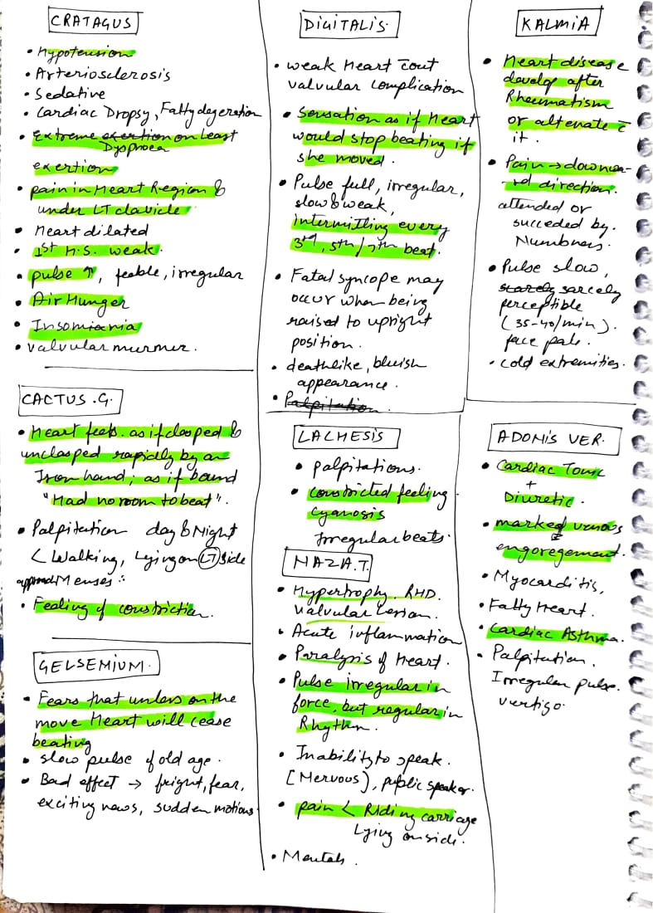

Slide 16
References
Hawthorn (Crataegus spp.) in the treatment of cardiovascular disease Mary C. Tassell, Rosari Kingston,¹ Deirdre Gilroy,² Mary Lehane,³ and Ambrose Furey
Allen’s Keynotes Rearranged and classified with leading remedies of MATERIA MEDICA and Bowel Nosodes by H.C. Allen
Boericke’s new manual of homoeopathic Materia Medica with Repertory by William Boericke
Lectures on Homoeopathic Materia Medica by Kent

