Slide 1
Comparative study of Child of Calc.carb. , Cal.p. ,Silicea, Antim. Crud. , Aethusa
Presented by :
Dr. Parul Singh B.H.M.S , MD(Hom.)
Assistant Professor
Department of Community Medicine

Slide 2
AETHUSA CYNAPIUM
FOOL’S PARSLEY
UMBELLIFERAE

Slide 3
Aethusa
Ailments from- dentition period, hot summer weather, milk or milk in any form, error of diet, bad hygienic surroundings
Especially for children during dentition in hot summer weather; children who cannot bear milk.
idiocy, incapacity to think, confused
Great weakness: cannot stand, unable to hold up his head.
prostration with sleepiness, after vomiting, stool or spasm.
complete absence of thirst
Expression of great anxiety and pain on face
Well marked linea nasalis
Herpetic eruptions on end of nose

Slide 4
Cont….
MILK INTOLERANCE
intolerance of milk, cannot bear milk in any form; it is vomited in large curds as soon as taken; then weakness causes drowsiness.
INDIDESTION
Violent sudden vomiting of a froathy; milky white substance, or yellow fluid followed by curdled milk and cheesy matter
Regurgitation of food an hour or so after eating, copious greenish vomiting
EPILEPSY
Epileptic spasm, with clenched thumbs, red face, eyes turned downwards, pupil fixed and dilated; foam at the mouth, jaws locked, pulse small, hard, quick

Slide 5
Calcarea Phosphorica
Phosphate of lime

Slide 6
Calcarea Phosphorica
Children; emaciated, unable to stand, slow in learning to walk, sunken, flabby abdomen.
Especially suited during first and second dentition of scrofulous children, diarrhoea and great flatulence.
Rachitis child : cranial bones thin and brittle; fontanelles and suture remain open too long, or close and reopen; delayed or complicated teething
Spine weak; disposed to curvature esp. to left, unable to support head
Oozing of bloody fluid from navel of infants
Diarrhoea ; at every attempt to eat colicky pain in abdomen.
Chilly
Miasm – psora

Slide 7
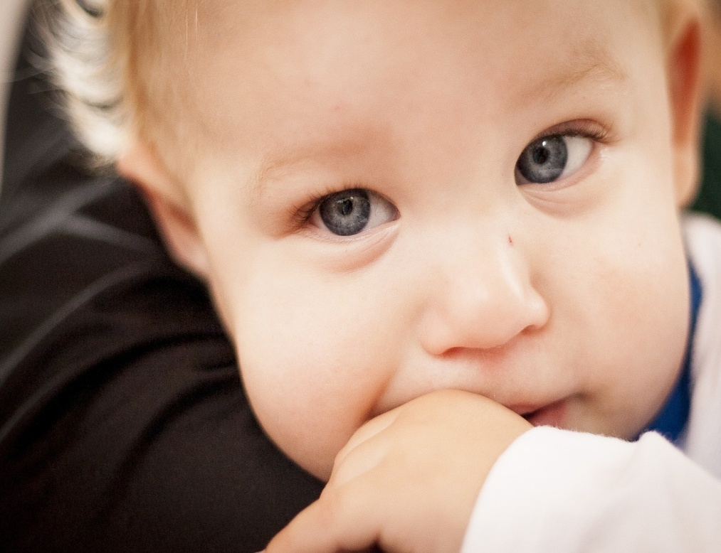
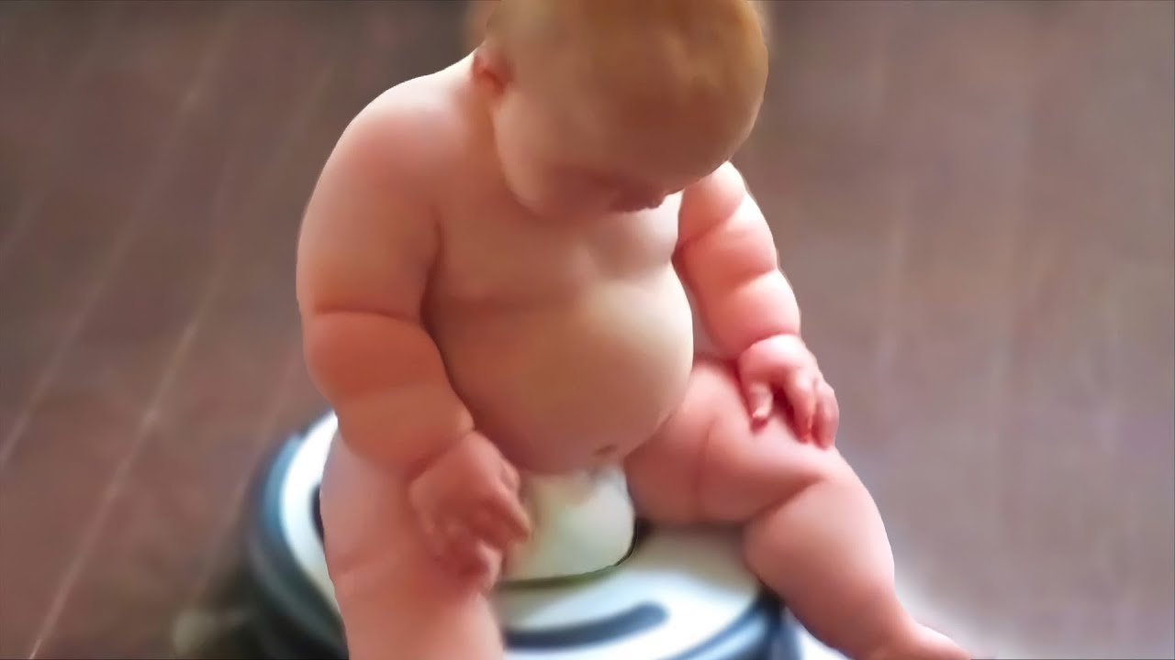
CALCAREA CARB
Calcarea ostrearum
Middle layer of oyster shell

Slide 8
Calcarea carb.
Leucophlegmatic, blond hair, light complexion, blue eyes, fair skin; tendency to obesity in youth.
Psoric constitutions; pale, weak, timid, easily tired when walking.
Disposed to grow fat
Children with red face, flabby muscles, who sweat easily and take cold readily in consequence. Large heads and abdomens; fontanelles and sutures open; bones soft, develop very slowly
Curvature of bones, especially spine and long bones; extremities crooked, deformed; bone irregularly developed. Head sweats profusely while sleeping, wetting pillow far around
Difficult and delayed dentition with characteristic head sweats, and open fontanelles
great longing for eggs; craves indigestible things

Slide 9
aversion to meat.
Acidity of digestive tract; sour eructations, sour vomiting, sour stool; sour odor of the whole body
Diseases: arising from defective assimilation; imperfect ossification; difficulty in learning to walk or stand; children have no disposition to walk and will not try; suppressed sweat.
Constipation ; stool has to be removed mechanically
Feels better in every way when constipated
Coldness of single parts.

Slide 10
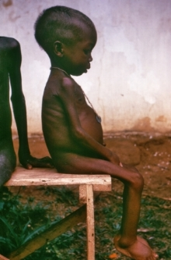
SILICEA TERRA
PURE SILICA

Slide 11
SILICEA
MALNOURISHED, poor assimilation of food
Baby is psoric, highly chilly , large head, open fontanelles and suture, pot bellied abdomen.
Suffer from bad effect of vaccination
SLOW: slow learning to walk, weak ankles
Scrofulous, rachitic children with large heads; open fontanelles and sutures; much sweating about the head (lower than Cal.) which must be kept warm by external covering (Sanic.); distended abdomen; weak ankles; slow in learning to walk.
Children are obstinate, headstrong, cry when spoken kindly to
Offensive sweat – foot axilla hands. Sweating behind the neck and occiput
Skin troubles- bad effect of vaccination, every injury suppurate. Inflammation swelling abscess formation after vaccination.

Slide 12
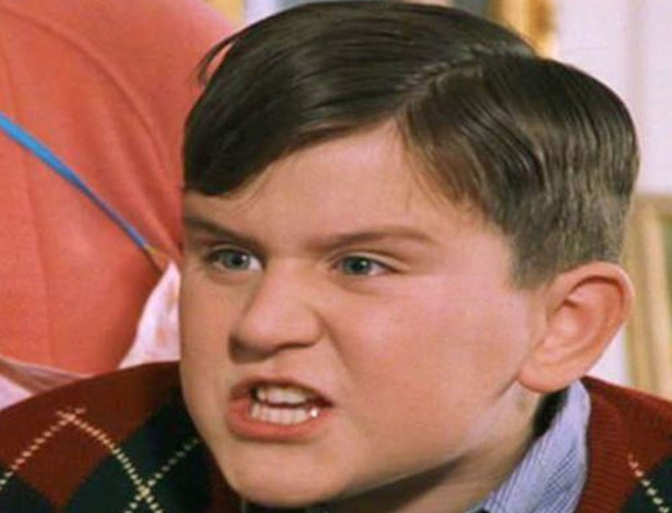
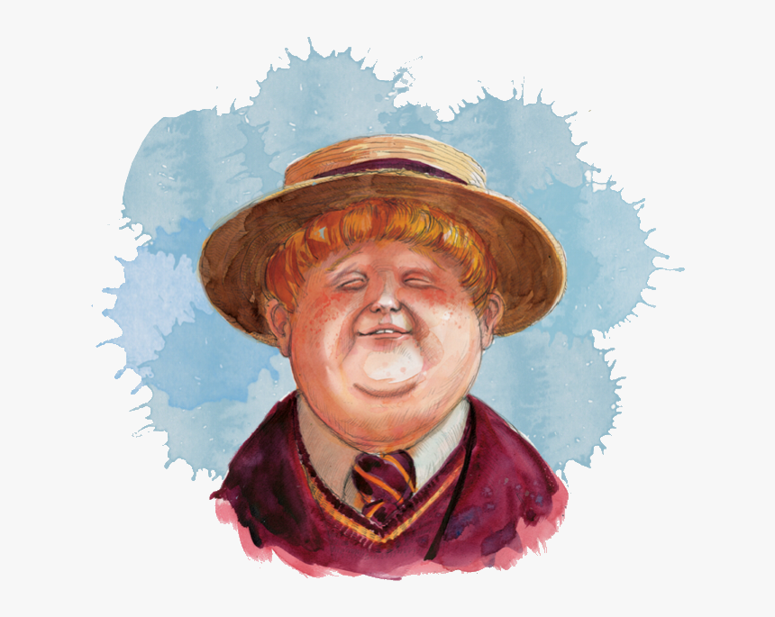
ANTIMONIUM CRUDUM
SULPHATE OF ANTIMONY

Slide 13
ANTIMONIUM CRUDUM
Compared to swine
Obese, thick skin
Fretful, peevish, cannot bear to be touched or looked at.
Very angry at liitle attention, does not wish to speak or to be spoken to.
Child is very sad, weeping, peevish irritable.
Thick milky white coating on tongue
Gastric troubles due to over eating , weak stomach, from bread and pastry, acids esp. vinegar
Craving for acids and pickles
Great aversion to cold bathing . Child cries when washed or bathed with cold water, it causes violent headache

