Slide 1
Madhav homoeopathic medical College and hospital
( A constituent unit of Madhav University , pindwara ,Dist- sirohi (Raj))

Slide 2
DEPARTMENT OF PRACTICE OF MEDICINE

Slide 4
Anaemia
Dr. Nipun Singh Dabi
Assistant Professor
Department of Practice of Medicine

Slide 5
Introduction
Anaemia is defined as reduced haemoglobin concentration in blood below the lower limit of the normal range for the age and sex of the individual.
Range of haemoglobin value according to gender and age is as follows:-
At birth – 16-18g/dl
Children – 11-12.5g/dl
Adult men – 14-18g/dl
Adult women (menstruating) – 11-15g/dl
Adult women(post menopausal)- 12-16g/dl
Women during pregnancy – 10-12g/dl

Slide 6
An alternate means of determining whether or not anaemia is present and it’s severity,is by red cell counts ,hematocrit(PCV) and absolute values (MCV,MCH& MCHC).
Normal values are-
MCV(Mean corpuscular volume)- average volume of single RBC .It is 90 cubic microns.
MCH(Mean corpuscular haemoglobin) – is the quantity or amount of haemoglobin present in one RBC. It is 30 picogram.

Slide 7
3.Mean corpuscular haemoglobin concentration – concentration of hemoglobin expressed in relation to the volume of one RBC . So the unit of expression is percentage and it is 30%.(30-80%).

Slide 8
Classification
Two widely accepted classifications of anaemia.
Morphological classification
Etiological classification

Slide 9
Morphological classification
It depends on the size and the color of RBCs .
Size is determined by – MCV
Color is determined by – MCHC
By this method of classification anaemias are classified into 3 types.

Slide 10
1. Normocytic normochromic anaemia
In this –
Size of RBC- normal
MCV- 90
Color of RBC- normal
MCHC- 30%
E.g after acute blood loss, hemolytic anaemias,bonemarrow failure,anaemia of chronic disorders.

Slide 12
2.Macrocytic normochromic anaemia
In this-
Size of RBC – large
MCV – More than 90
Color of RBC – normal
MCHC – 30%
E.g in megaloblastic anaemia due to deficiency of vitamin B12 or folic acid.

Slide 14
3.Microcytic hypochromic anaemia
In this-
Size of RBC- small
MCV- less than 78
Color of RBC – reduced
MCHC- less than 30
E g- in iron deficiency anaemia,thalassaemia etc.

Slide 16
Etiological classification
On the basis of etiology, i.e.the study of cause and origin.
Anaemia classified into five types-
Haemorrhagic anaemia
Hemolytic anaemia
Nutrition deficiency anaemia
Aplastic anaemia
Anaemia of chronic diseases

Slide 17
- Haemorrhagic anaemia
Haemorrhage refers to excessive loss of blood.
It can occurs both in acute and chronic haemorrhagic conditions.
Acute haemorrhage – refers to the sudden loss of a larg quantity of blood as in the case of accident.
Within 24 hrs after the haemorrhage the plasma portion of blood is replaced. However the replacement of RBCs does not occur quickly and it takes at least 4-6 weeks.
So with decreased number of RBCs,haemodilution occurs.
Laboratory findings – normocytic and normochromic anaemia ,low haematocrit , increased reticulocyte in peripheral blood.

Slide 18
2. Chronic haemorrhage – refers to the loss of blood by internal or external bleeding ,over a long period of time .
It occurs in conditions likes Peptic ulcer ,purpura , haemophilia and menorrhagia.
Due to continuous loss of blood ,lot of iron is lost from the body causing iron deficiency.
This affects the synthesis of haemoglobin resulting in less haemoglobin content in the cells ,hence the RBCs become microcytic and hypochromic.

Slide 19
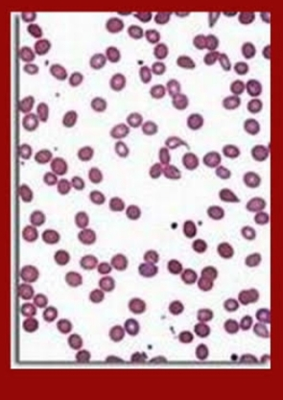

Slide 20
2.Nutritional deficiency anaemia
Anaemia that occurs due to deficiency of a nutritive substance necessary for eythropoiesis is called nutrition deficiency anaemia.
The substances which are necessary for erythropoiesis are iron, protiens,and vitamins like C, B12 and folic acid.

Slide 21
Iron deficiency anaemia
The commonest nutritional deficiency disorder present throughout the world is iron deficiency.
Iron metabolism – the amount of iron obtained from the diet should replace the losses from the skin, bowel , genitourinary tract.
These losses together are about 1 mg daily in an adult male or in a non – menstruating female, while in a menstruating women ,there is a additional loss of 0.5-1 mg daily.
The iron required for Hb synthesis is derived from 2 primary sources- ingestion of foods containing iron and recycling of iron from senescent red cells.
Absorption - the average western diet contains 10-15 mg of iron,out of which 5-10% is normally absorbed.
It is absorbed mainly in duodenum and proximal jejunum.

Slide 22
Transport - iron is transported in plasma bound to a beta –globulin,transferrin.
Excretion - the body is unable to regulate it’s iron content by excretion alone.
The amount of iron lost per day is 0.5 – 1mg which is independent of iron intake.
It is lost from the body ,as a result of desquamation of epithelial cells from the gastro intestinal tract ,from urine,sweat and loss via hair and nails.

Slide 23
Distribution – Iron is distributed in the body as under-
Haemoglobin – present in the red cells,contains most of the body iron.
Myoglobin – comprises a small amount of iron in the muscles.
Haem and non– haem enzymes- e.g cytochrome, catalase, peroxidases, succinic dehydrogenase – 0.5%.
Transferrin bound iron – circulates in the plasma constitutes another fraction of total body iron (0.5 %).
Ferritin and haemosiderin – are storage form of excess iron (30%).

Slide 24
Pathogenesis -
Iron deficiency anaemia develops when the supply of iron is inadequate for the requirement of haemoglobin synthesis.
The development of its deficiency depends upon one or more factors-
Increased blood loss
Increased requirements
Inadequate dietary intake
Decreased intestinal absorption

Slide 25
Clinical features -
Fatigue ,weakness
Dysponea ,dysphagia
Palpitations
Pallor of skin ,mucous membranes
Sclerae
Angina and congestive heart failure (older patients)
Unusual dietary cravings
Menorrhagia
Spoon shaped nails , atrophic glossitis
Angular stomatitis

Slide 26
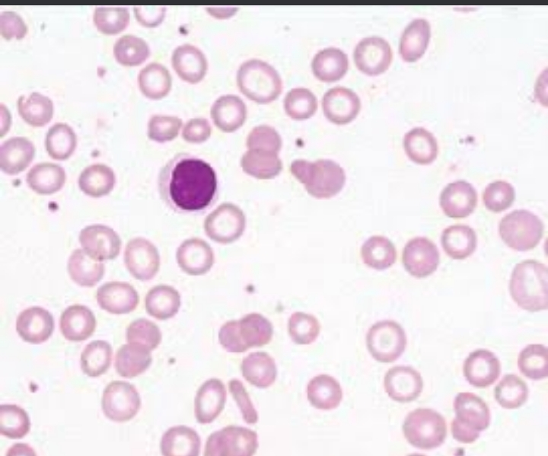

Slide 27
Laboratory findings –
Blood smear and red cell indices – HB fall, red cells are hypochromic, diminished MCV .
Bone marrow findings – marrow cellularity is increased,normoblastic erythropoiesis with predominance of small polychromatic erythroblasts.
Biochemical findings – serum level is low , serum ferritin is very low .etc.

Slide 28
Megaloblastic anaemia
Are associated with macrocytic blood picture and megaloblastic marrow erythropoiesis.
Includes megaloblastic picture from two types of etiologies-
Nutritional deficiency of vitamin B12 or folate.
Deficiency of intrinsic factor ,causing impaired absorption of vitamin B 12 called pernicious anaemia.

Slide 29
Megaloblastic anaemia are disorders caused by impaired DNA synthesis and are characterized by a distinctive abnormality in the haemopoietic precursors in the bone marrow in which the maturation of the nucleus is delayed relative to that of the cytoplasm.
Megaloblasts are both functionally and morphologically abnormal with the result that the mature red cells formed from them and released into the peripheral blood are also abnormal in shape and size .
The defective DNA synthesis due to deficiency of VitaminB12 or folic acid .

Slide 30
Vitamin B 12 Metabolism – Vitamin B12 is a complex organometallic compound having a cobalt atom situated within a Corrine ring ,simlar to the structure of porphyrin from which haem is formed .
In humans there are two metabolically active forms of
Cobalamin which act as coenzymes.
Sources- only dietary sources of vitamin B12 are foods of animal protein origin such as kidney ,liver ,heart,muscle meats,fish eggs,cheese and milk.
Absorption – R- binder is a from of glycoprotein found in various secretions ( e.g saliva gastric juice,bile ,plasma).
Vitamin B12 forms a stable compound with gastric R- binder .
And on entering in duodenum ,the complex is digested releasing vitamin B12 which then binds to intrinsic factor.

Slide 31
Folate metabolism - it is a member of water soluble –B complex vitamins .
It does not exists as such in nature but exists as folates in polyglutamate form (conjugated folates).
For it’s metabolic action as co- enzyme,polyglutamates must be reduced to dihyrdo and tetrahydrofolate forms.
Sources- exists in different plants, bacteria and animals.its Maine dietary sources are fresh green leafy vegetables,fruits,liver,kidney etc.
Absorption and transport – Normally absorbed from the duodenum and jejunum .
THF (tetrahydrofolate), a monoglutamate , circulates in the blood as methylated compound , methyl THF bound to a protein , and once it is transported into the cell by a carrier protein, it is converted to polyglutamate.

Slide 32
Clinical features
Anaemia
Glossitis
Neurologic manifestations
Mild jaundice
Angular stomatitis
Purpura
Melanin pigmentation
Weight loss
Anorexia

Slide 33
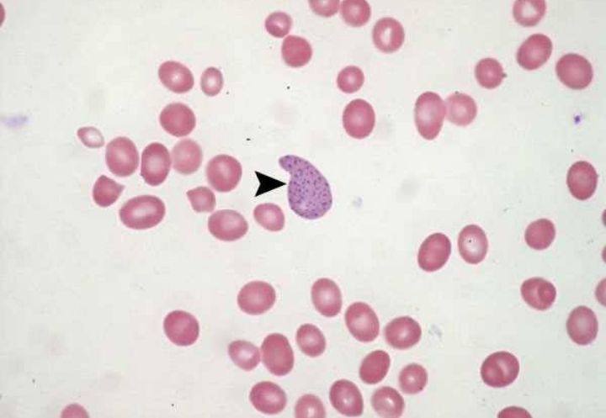

Slide 34
Laboratory findings
Blood picture –
HB below the normal range
Red cells show macrocytosis
Reticulocyte count generally low
MCV elevated
Bone marrow findings –
Marrow is hyper cellular
Erythroid hyperplasia
Megakaryocytes are present
Show variety of random chromosomal abnormalities.
Biochemical findings –
Rise in serum unconjugated bilirubin and LDH

Slide 35
Pernicious anaemia
Also called as Addisonian megaloblastic anaemia.
The average age at presentation is 60 yrs but rarely it can be seen in children under 10 years of age (juvenile pernicious anaemia) .
Occurs in close relatives of persons with organ – specific autoimmune disease.
It is due to atrophy of the gastric mucosa because of autoimmune destruction of parietal cells.
The gastric atrophy results in decreased prduction of intrinsic factors and poor absorption of vitamin B12.

Slide 36
It has an autoimmune basis as seen by disease associations and by detection of antibodies against IF and parietal cells of stomach .
Disease association – the incidence of PA is high in patients with other autoimmune disease such as Graves disease,myxoedema,thyroiditis, vitiligo, diabetes and idiopathic adrenocorticol in sufficiency.
Serum antibodies in PA – definite evidence of autoimmune phenomena in PA is supported by detection of serum autoantibodies against IF and parietal cells.

Slide 37
Clinical features
Disease has insidious onset and progress slowly.
Clinical manifestations include- anaemia
Glossitis
Neurological abnormalities
Gastrointestinal manifestations
Hepatospleenomegaly
Congestive heart failure
Haemorrhagic manifestations.

Slide 38
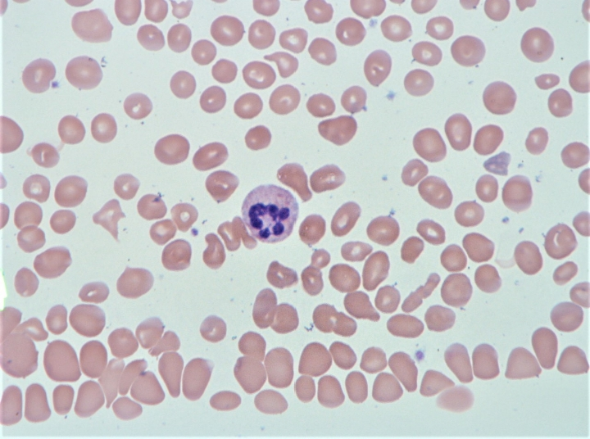

Slide 39
Anaemia of chronic disorders
One of the commonly encountered anaemia is in patients of a variety of chronic systemic diseases in which anaemia develops secondary to a disease process but there is no actual invasion of the bone marrow.
In general,it is normocytic normochromic .
The anaemia is corrected only if the primary disease is elevated.

Slide 40
Pathogenesis –
A number of factors may contribute to the development of anaemia in chronic systemic disorders,and in many conditions,it is complicated by other causes such as iron ,B12 and folate deficiency,hypersplenism ,renal failure,etc.
2 factors play significant role in the pathogenesis –
Defective red cell production
Reduced red cell lifespan

Slide 41
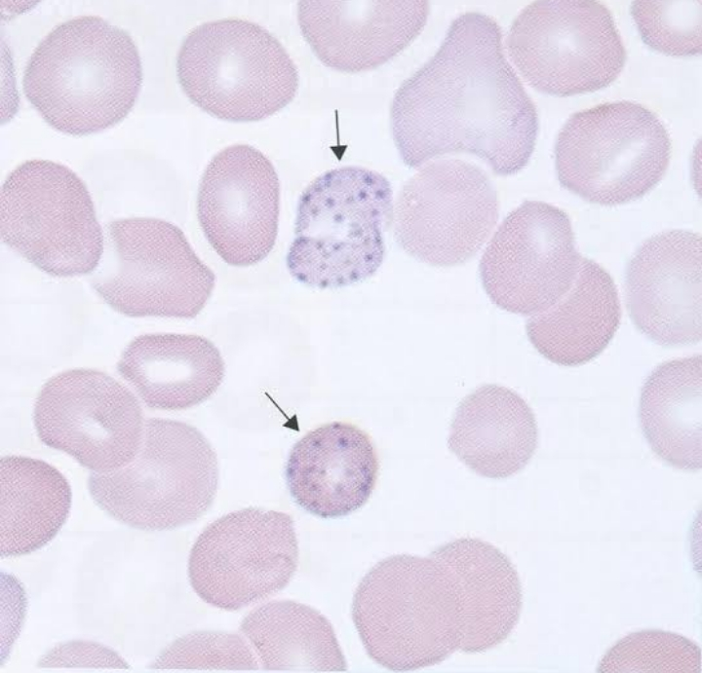

Slide 42
Laboratory findings –
Hemoglobin value less than 8g/dl
Generally normocytic normochromic but may have slight microcytosis and hypochromia.
MCHC is slightly low.
Serum iron is generally reduced
Serum ferritin levels are increased.
Other plasma proteins are raised which are called phase reactants ( gamma globulin, haptoglobin fibrinogen etc.)

Slide 43
Aplastic anaemia
It is defined as pancytopenia (i.e simultaneous presence of anaemia , leucopenia and thrombocytopenia) resulting from aplasia of the bone marrow.
There are two types of aplastic anaemia –
Primary aplastic anaemia
Secondary aplastic anaemia

Slide 44
Primary aplastic anaemia
It includes two forms –
Fanconi’s anaemia- this has an autosomal recessive inheritance and is often associated with other congenital anomalies such as skeletal and renal abnormalities and sometime mental retardation.
Immunologically –mediated acquired form – in many cases , suppression of haematopoietic stem cells by immunologic mechanisms may cause aplastic anaemia.

Slide 45
Secondary aplastic anaemia
Secondary causes are more common than primary and include a variety of industrial, physical,chemical ,and infectious causes.
Like drugs , toxic chemicals , infections , miscellaneous.

Slide 46
Clinical features –
Mild progressive weakness
Fatigue
Haemorrhage from various sites due to thrombocytopenia
Infections of the mouth and throat
Laboratory findings –
Hemoglobin levels are moderately reduced.
Absolute granulocyte count is particularly low.
Platelet count is always reduced.

Slide 47
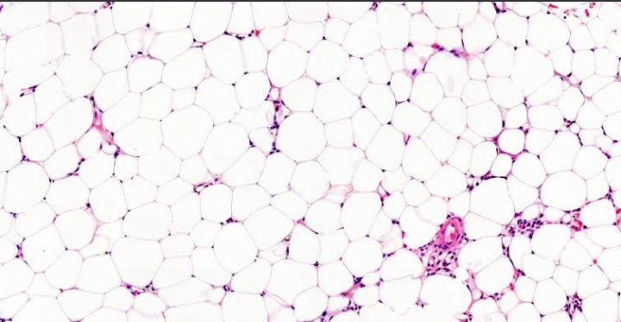

Slide 48
Haemolytic anaemia
Are defined as anaemias resulting from an increase in the rate of red cell destruction.
The red cell life span is shortened in haemolytic anaemia i.e there is accelerated haemolysis .
The premature destruction of red cells in haemolytic anaemia may occur at either of the following 2 sites –
Firstly,the red cells undergo lysis in the circulation and release their contents into plasma (intravascular haemolysis)
Secondly, the red cells are taken up by cells of the RE system where they are destroyed and digested (extravascular haemolysis ) .

Slide 49
General clinical features
Presence of pallor of mucous membrane.
Mild fluctuating jaundice due to unconjugated hyperbilirubinaemia.
Dark urine
Splenomegaly
Pigment gallstones

Slide 50
Classification
Broadly divided in Acquired and Hereditary –
Acquired-
Immunohaemolytic anaemias
Mechanical trauma
Direct toxic effects
Acquired cell membrane abnormalities
Splenomegaly
Hereditary-
Abnormalities of red cell membrane
Disorders of red cell interior- sickle cell anaemia ,thalassaemias.

Slide 51
Sickle syndrome
Most important and widely prevalent type of haemoglobinopathy is due to the presence of sickle haemoglobin .
The red cell with Hbs develop 'sickling’ when they exposed to low oxygen tension.
Sickle syndrome occur in 3 different forms-

Slide 52
Heterozygous state- Sickle cell trait
Sickle cell trait is a benign heterozygous state of HbS in which only one abnormal gene is inherited
Patient with AS develop no significant clinical problems except when they become severely hypoxic and may develop sickle cell crises.
2 . Homozygous state – sickle cell anaemia.
It is a homozygous state of HbS in the red cells in which an abnormal gene is inherited from each parent .SS is a severe disorder associated with protean clinical manifestations and decreased life expectancy.

Slide 53
Sickle cell anaemia
Is an inherited blood disorder,characterized by sickle shaped red blood cells which contain abnormal haemoglobin, haemoglobin S.
Pathogenesis-
Basic genetic defect is the single point mutation in one amino acid out of 146 in haemoglobin molecule – substitution of valine for glutamic acid at 6-residue position of beta –globin.
During deoxygenation ,the red cells containing HbS change from biconcave disc shape to an elongated crescent shape or sickle shape.

Slide 54
Clinical features –
Anaemia
Vaso-occlusive phenomena ( microinfarcts and macroinfarcts)
Microinfarcts particularly affect the abdomen,chest,back and joints .
Macroinfarcts involving,spleen ,bone marrow ,bones ,lungs ,CNS , retina ,skin .
Impaired growth
Impaired apenic function

Slide 55
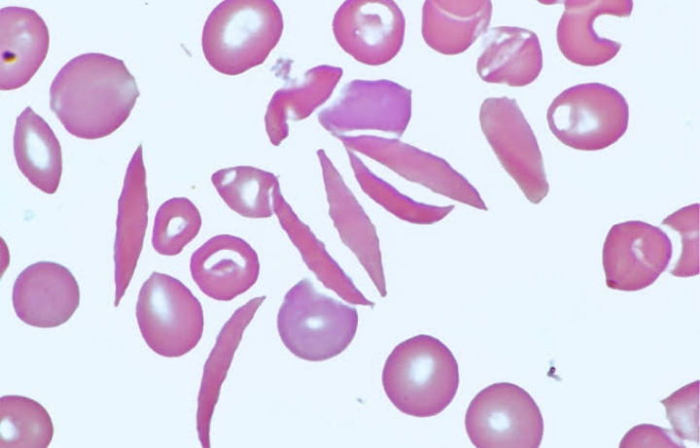

Slide 56
Laboratory findings –
Moderate to severe anaemia
Blood smear show sickle cells and target cells and features of splenic atrophy such as presence of Howell – Jolly bodies.
A positive suckling test with a reducing substance such as sodium metabisulphite.
Haemoglobin electrophoresis shows no normal HbA but shows predominance of HbS and 20% HbF.

Slide 57
3. Double heterozygous state –
involving combinations of HbS with other haemoglobinopathies may occur .
Most common in beta thalassaemia ,sickle C disease, and sickle D disease

Slide 58
Thalassaemias
Are a diverse group of hereditary disorders in which there is reduced synthesis of one or more of the globin polypeptide chains.
These are quantitative abnormalities of polypeptide globin chain synthesis.
These are genetically transmitted disorders .
And there are two main types of thalassaemias .

Slide 59
Alpha thalassaemia – are disorders in which there is defective synthesis of Alpha globin chains resulting in depressed production of haemoglobins that contain alpha chains i.e HbA , HbA ₂ and HbF .
Most commonly due to deletion of one or more of the alpha chains genes located on short arm of chromosomes 16.
Alpha thalassaemias are classified into 4 types –
Four alpha genes- HB Bart ‘s hydops foetalis
Three alpha genes deletion – HbH disease
Two alpha gene deletion – alpha thalassaemia trait
One alpha gene deletion – alpha thalassaemia trait

Slide 60
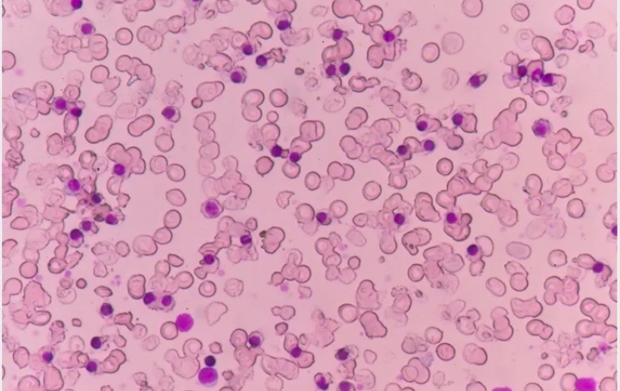

Slide 61
Clinical features –
HB Bart’s hydops foetalis is incompatible with life due to severe tissue hypoxia ,either fatal in utero.
Splenomegaly
Cholelithiasis
Fatigue
Weakness
Pale skin
Slow growth

Slide 62
Laboratory findings –
Blood smear show anisopoikilocytosis ,hypochromia , microcytosis ,polychromasia ,basophilic stippling in Bart’s hydrops foetalis
Svere microcytosis hypochromia basophilic stippling in HbH disease.
Microcyticamd hypochromic red cell morphology but no evidence of haemolysis on anaemia in alpha thalassaemia trait.
Reticulocyte count is high or Mild reticulocytosis.
Serum bilirubin level is elevated.
MCV, MCH ,and MCHC may be slightly reduced.

Slide 63
Beta thalassaemia –
Are caused by decreased rate of beta chain synthesis resulting in reduced formation of HbA in the red cells.
More complex thain alpha thalassaemia.
Most of beta thalassaemias arise from different types of mutations of beta globin gene resulting from single base changes.
There are three types of beta thalassaemias –
Beta thalassaemia major –
Also termed as Mediterranean or cooleys anaemia is the most common form of congenital haemolytic anaemia.
It is a homozygous state with either complete absence of beta chain synthesis or only small amount are formed.

Slide 64
Clinical features –
Anaemia
Marked hepatosplenomegaly
Expansion of bones
Iron overload due to repeated blood transfusion.
Extramedullary haematopoisis.
Slow rate of growth and development
Delayed puberty
Diabetes mellitus
Damage to liver and heart

Slide 65
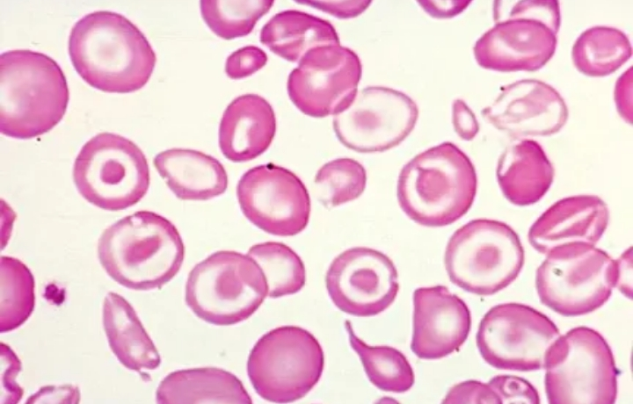

Slide 66
Laboratory finding –
Usually severe anameia
Blood smear shows severe microcytic hypochromic red cell morphology, marked anisopoikilocytosis, basophilic stippling.
Serum bilirubin raised.
Reticulocytes is present
MCV, MCH And MCHC are significantly reduced
WBC count is often raised.

Slide 67
2 .Beta thalassaemia minor – is a heterozygous state is a common entity characterised by moderate reduction in beta chain synthesis.
3 . Beta thalassaemia intermedia- it is iof intermediate degree of severity that does not require regular blood transfusions

Slide 68
Thank you

