Slide 1
SILICEA TERRA
Presented by
Dr. Diksha Goyal
Assistant Professor
Department of Homoeopathic Materia Medica

Slide 2
INTRODUCTION
One of the Schuessler’s twelve tissue remedies.
Common name- pure silica
Proved by Dr. Hahnemann
Long deep acting remedy
In proving it takes a long time to develop the symptoms. So it is suited to complains that develop slowly
Imperfect assimilation of food
Promotes suppuration, hence should not be given
Chronic of pulsatilla

Slide 3
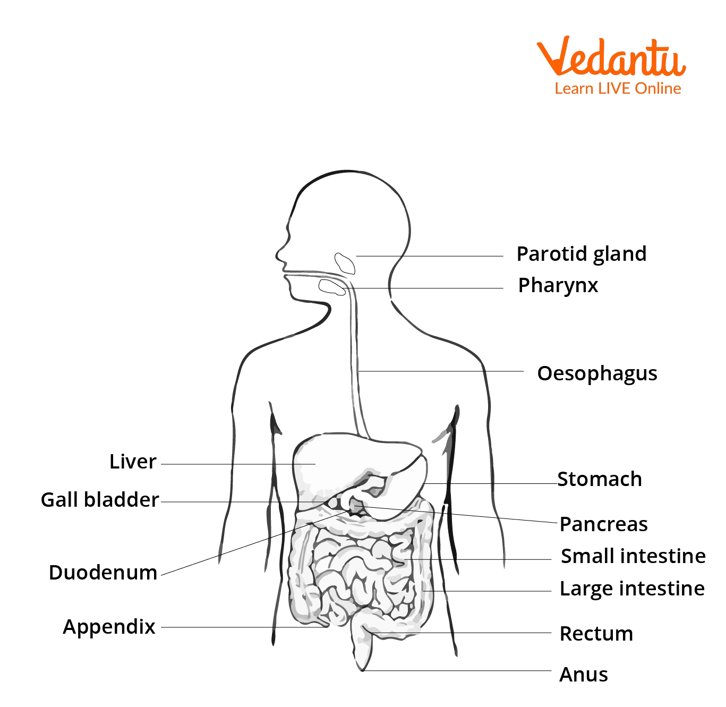
INADEQUATE INTEAKE
QUANTITY/ QUALITY
DEFECTIVE ABSORPTION
INCREASE EXCRETION
IMPERFECT ASSIMILATION

Slide 4
SPHERE OF ACTION
SKIN
MUCUS MEMBRANE
ELASTIC AND CELLULAR TISSUE
BONES, CARTILAGE
NERVES
GLANDS
LACRYMAL DUCT
EUSTACHIAN TISSUE

Slide 5
PATHOGENESIS
It promotes and controls suppuration
Hastens formation of abscess and boils
In tuberculous lungs It tends to re-establish an inflammation and throw it out
TEMPERAMENT – irritable and sanguine
THERMAL REACTION – chilly
MIASM – covers all three miasms, but predominantly antipsoric
DIATHESIS – scrofulous
.

Slide 6
CONSTITUTION
Adapted to the nervous, irritable, sanguine temperament; persons of a psoric diathesis.
Persons of light complexion; find, dry, skin; pale face; weakly, with lax muscles.
Constitutions which suffer from deficient nutrition, not because food is lacking in quality or in quantity, but from imperfect assimilation (Bar. c., Calc.); oversensitive, physically and mentally
Scrofulous, rachitic children with large heads; open fontanelles and sutures; much sweating about the head (lower than Cal.) which must be kept warm by external covering (Sanic.); distended abdomen; weak ankles; slow in learning to walk.

Slide 7
MENTALS
Want of grit
Lack of stamina.
weakness, embarrassment, dread , a state of yielding ( public speaker, lawyer)
Dread of failure – if he has any unusual task to perfom, he fears he will make a failure of it, yet he dose well. This is early state; there comes a time when he cannot perform the work with accuracy and still he may need silicea
Dread of undertaking anything (lyc)
Brain-fag of professional men, students, lawyer, clergymen.
- Silica is not suitable for the irritability and nervous exhaustion coming on from business brain-fag, but more for such brain-fag as belongs to professional men, students, lawyers, clergymen. A lawyer says,
"I have never been myself since that John Doe case"
He went through a prolonged effort and sleepless nights followed. Silica restores the brain.

Slide 8
Cont…
Irritable and irascible when aroused; when let alone he is timid, retiring, wants to shirk everything; mild, gentle tearful women. The Silica child is cross and cries when spoken to. It is the natural complement and chronic of Puls. because of its great similarity.
Pin mania
Headstrong obstinate baby, cry when kindly spoken to
Very sensitive to all impressions
Restless, fidgety, starts at least noise
Mental labor very difficult, reading and writing fatigue, cannot bear to think

Slide 9
PHYSICAL GENERAL
Ailments: caused by suppressed foot-sweat (Cup., Graph., Psor.); exposing the head or back to any slight draught of air; bad effects of vaccination, especially abscesses and convulsions (Thuja); chest complaints of stonecutters with total loss of strength.
Want of vital heat, always chilly, even when taking active exercise (Led., Sep.)
Great weariness and debility; wants to lie down.
Nervous debility; exhaustion with erythism; from hard work and close confinement; may be overcome by force of will.
Has a wonderful control over the suppurative process - soft tissue, periosteum or bone - maturing abscesses when desired or reducing excessive suppuration (affecting chiefly the soft tissues, Calend., Hep.)
Sensation of a hair on tongue.

Slide 10
Night walking; gets up while asleep, walks about and lies down again (Kali br.)
Sweat of hands, toes, feet and axillae; offensive.
Intolerable, sour, carrion-like odor of the feet, without perspiration, every evening.
Promotes expulsion of foreign bodies from the tissues; fish bones, needles, bone splinters.
Inflammation, swelling and suppuration of glands, cervical, axillary, parotid, mammary, inguinal, sebaceous; malignant, gangrenous.

Slide 11
HEAD
Vertigo: spinal, ascending form back of neck to head; as if one would fall forward, from looking up (Puls., - looking down, Kal., Spig.).
Chronic sick headaches, since some severe disease of youth (Psor.); ascending from nape of neck to the vertex, as if coming from the spine and locating in one eye,
especially the right (left, Spig.);
< draught of air or uncovering the head;
> pressure and wrapping up warmly (Mag. m., Stron.);
> profuse urination

Slide 12
GASTRO-INTESTINAL SYSTEM
Constipation: always before and during menses (diarrhoea before and during menses, Am. c., Bov.); difficult, as from inactivity of rectum; with great straining, as if rectum was paralyzed; when partly expelled, recedes again (Thuja).
Fistula in ano alternates with chest symptoms (Berb., Cal. p.)
Feces remain a long time in rectum
Anal fissure great pain after stool
FEMALE REPRODUCTIVE SYSTEM
Discharge of blood from vagina every time the child takes the breast (compare Crot. t.).
Nipple is drawn in like a funnel (Sars.)
A milky (Calc; Puls; Sep), acrid leucorroea

Slide 13
SKIN
Crippled nails on fingers and toes (Ant. c.).
Unhealthy skin; every little injury suppurates (Graph., Hep., Merc., Petr.).
Intolerable, sour, carrion-like odor of the feet, without perspiration, every evening.
ingrowing toe-nails panaritium; blood boils; carbuncles; ulcers of all kinds; fistulae, painful, offensive, high spongy edges, proud flesh in them

Slide 14
MODALITIES
WORSE- new moon, in morning, from washing, during menses, uncovering, lying down, damp, lying on, left side, cold.
BETTER- warmth, wrapping up head, summer; in wet or humid weather.

Slide 15
THANK YOU

