Slide 1

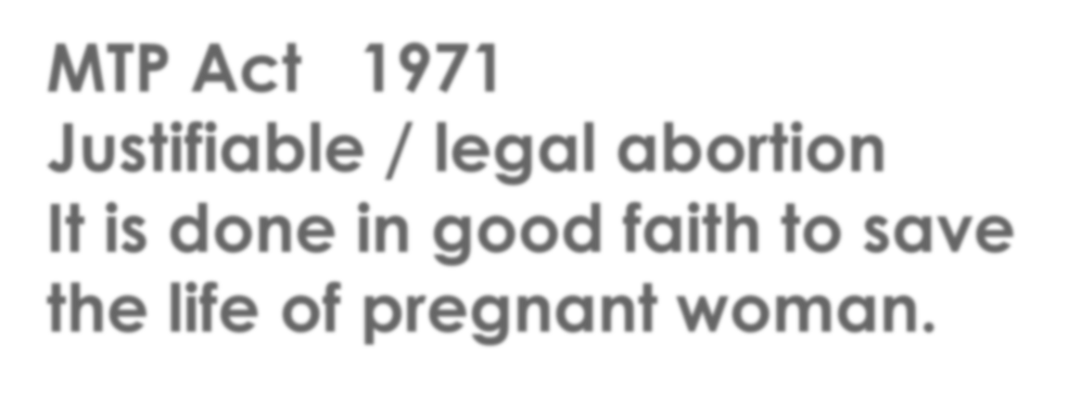
MTP Act 1971
Justifiable / legal abortion
It is done in good faith to save the life of pregnant woman.
.
Dr. Richa Tripathi
Department of Forensic medicine and Toxicology
Madhav homeopathic medical college and hospital .

Slide 2

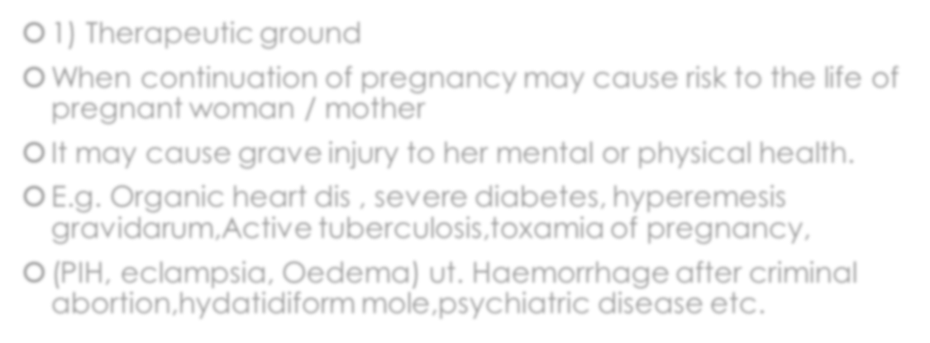
Indications / Grounds for MTP
 1) Therapeutic ground
 When continuation of pregnancy may cause risk to the life of pregnant woman / mother
 It may cause grave injury to her mental or physical health.
 E.g. Organic heart dis , severe diabetes, hyperemesis gravidarum,Active tuberculosis,toxamia of pregnancy,
 (PIH, eclampsia, Oedema) ut. Haemorrhage after criminal abortion,hydatidiform mole,psychiatric disease etc.

Slide 3
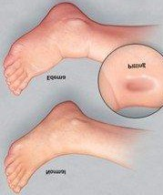


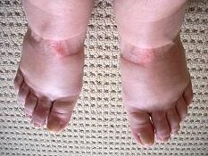
Oedema on feet

Slide 4
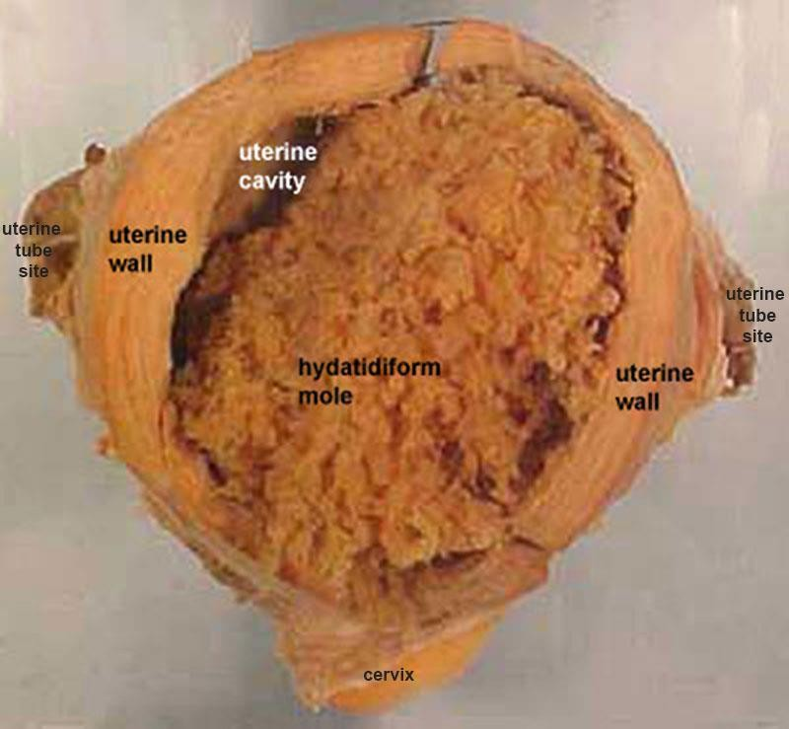


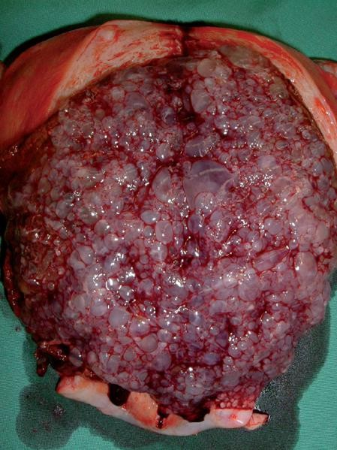
Hydatidiform mole

Slide 5

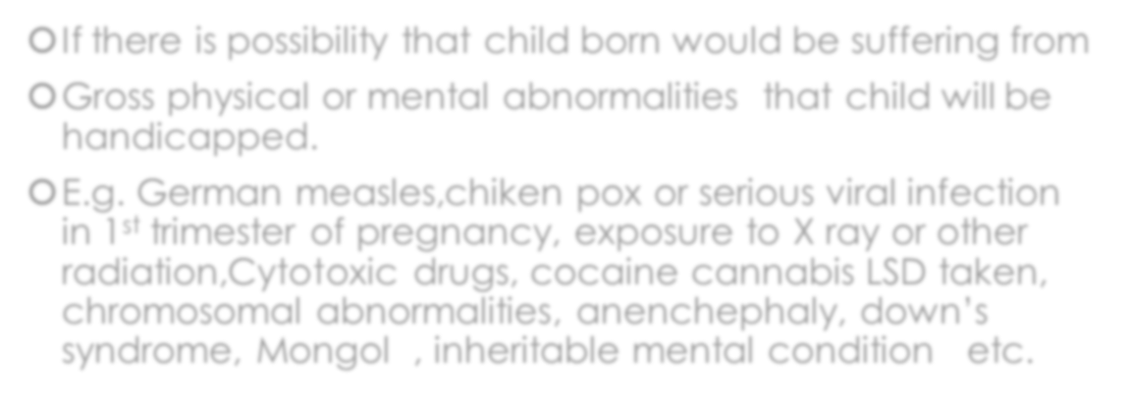
Eugenic ground
( 14 to 20 wks on USG)
If there is possibility that child born would be suffering from
Gross physical or mental abnormalities that child will be handicapped.
E.g. German measles,chiken pox or serious viral infection in 1st trimester of pregnancy, exposure to X ray or other radiation,Cytotoxic drugs, cocaine cannabis LSD taken, chromosomal abnormalities, anenchephaly, down’s syndrome, Mongol , inheritable mental condition etc.

Slide 6


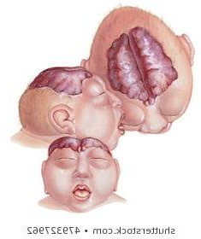
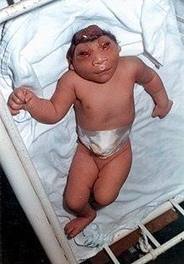
Anenchephaly Absence of skull bone

Slide 7


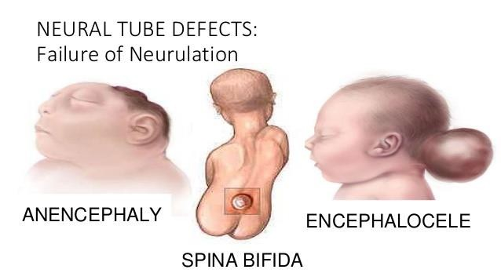
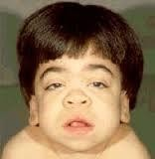
Physical or mentally handicapped baby

Slide 8


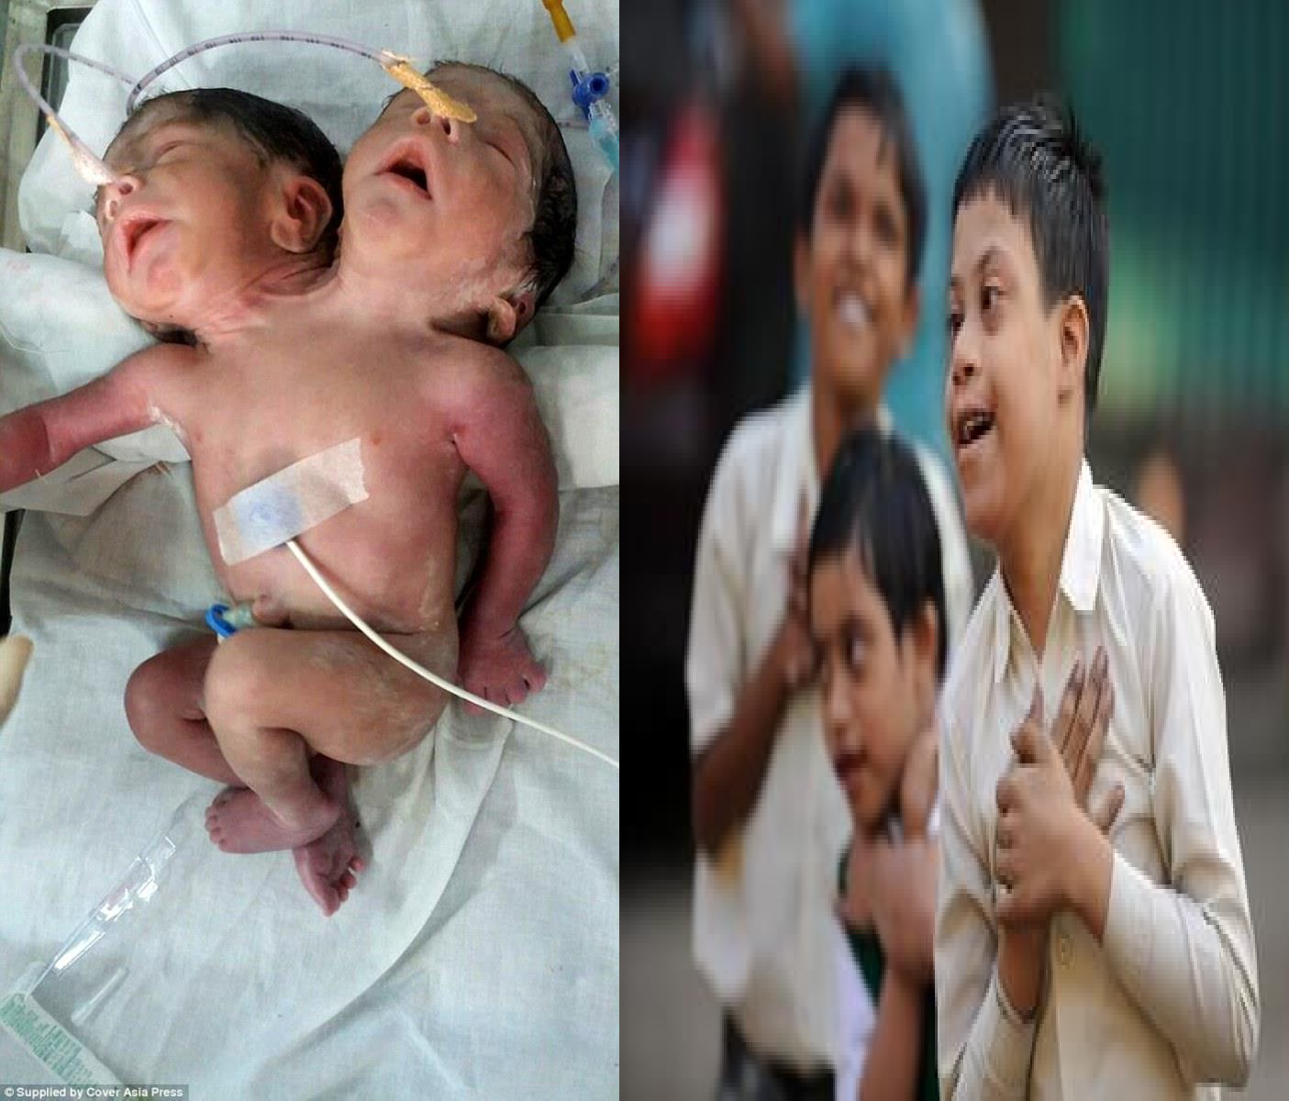
Grossly handicapped Physically & mentally.

Slide 9


Humanitarian ground
When pregnancy is a result of rape.
Rape causes mental& physical Grave injury to the health of a women.

Slide 10




Rape grave physical & & Mental injury

Slide 11

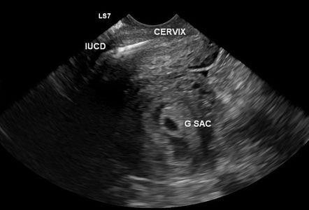
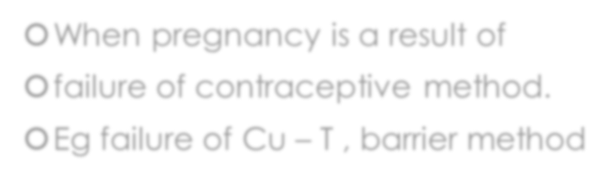
Social & Environmental ground
When pregnancy is a result of
failure of contraceptive method.
Eg failure of Cu – T , barrier method

Slide 12

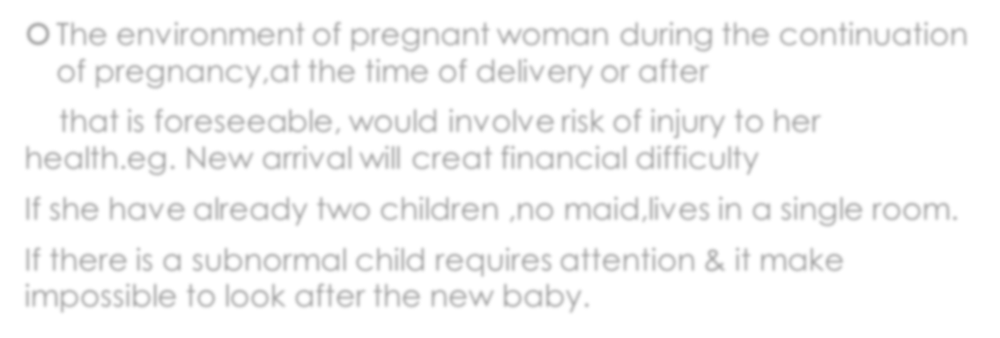
Environmental ground
 The environment of pregnant woman during the continuation of pregnancy,at the time of delivery or after
that is foreseeable, would involve risk of injury to her health.eg. New arrival will creat financial difficulty
If she have already two children ,no maid,lives in a single room.
If there is a subnormal child requires attention & it make impossible to look after the new baby.

Slide 13

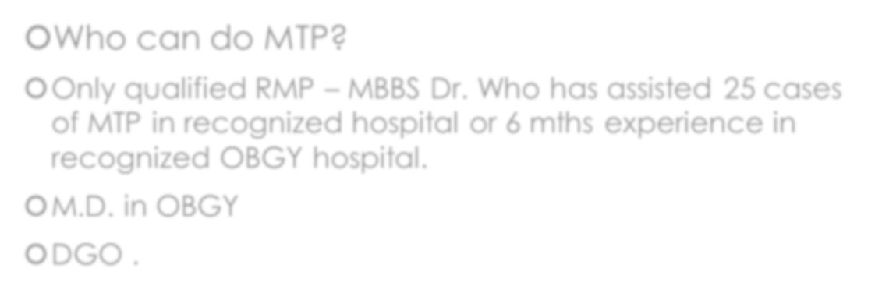
Rules for doing MTP
Who can do MTP?
Only qualified RMP – MBBS Dr. Who has assisted 25 cases of MTP in recognized hospital or 6 mths experience in recognized OBGY hospital.
M.D. in OBGY
DGO .

Slide 14

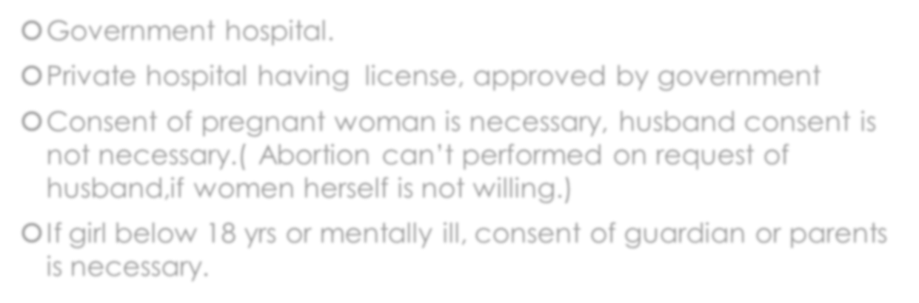
Place & consent
Government hospital.
Private hospital having license, approved by government
Consent of pregnant woman is necessary, husband consent is not necessary.( Abortion can’t performed on request of husband,if women herself is not willing.)
If girl below 18 yrs or mentally ill, consent of guardian or parents is necessary.

Slide 15

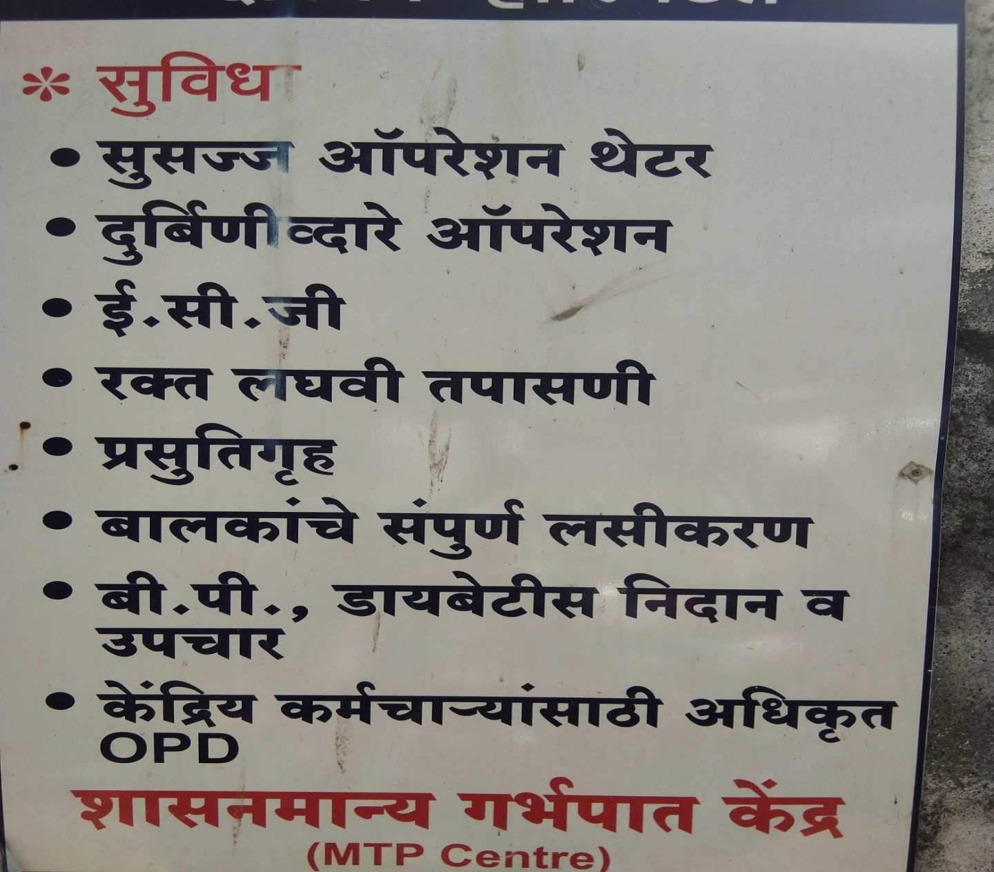

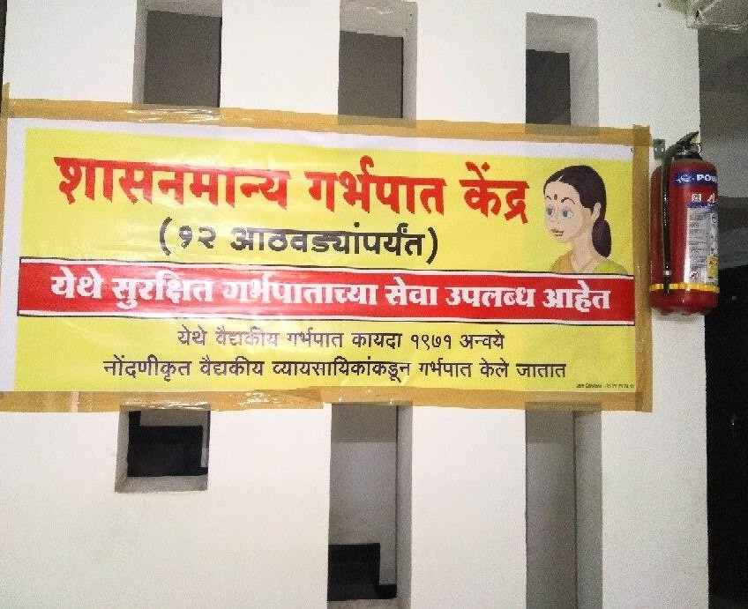
Government hospital /approved private hospital

Slide 16

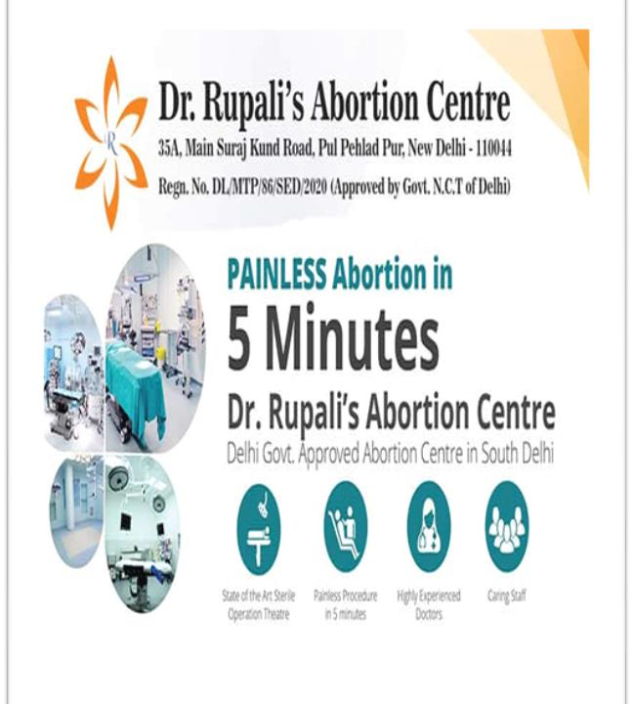
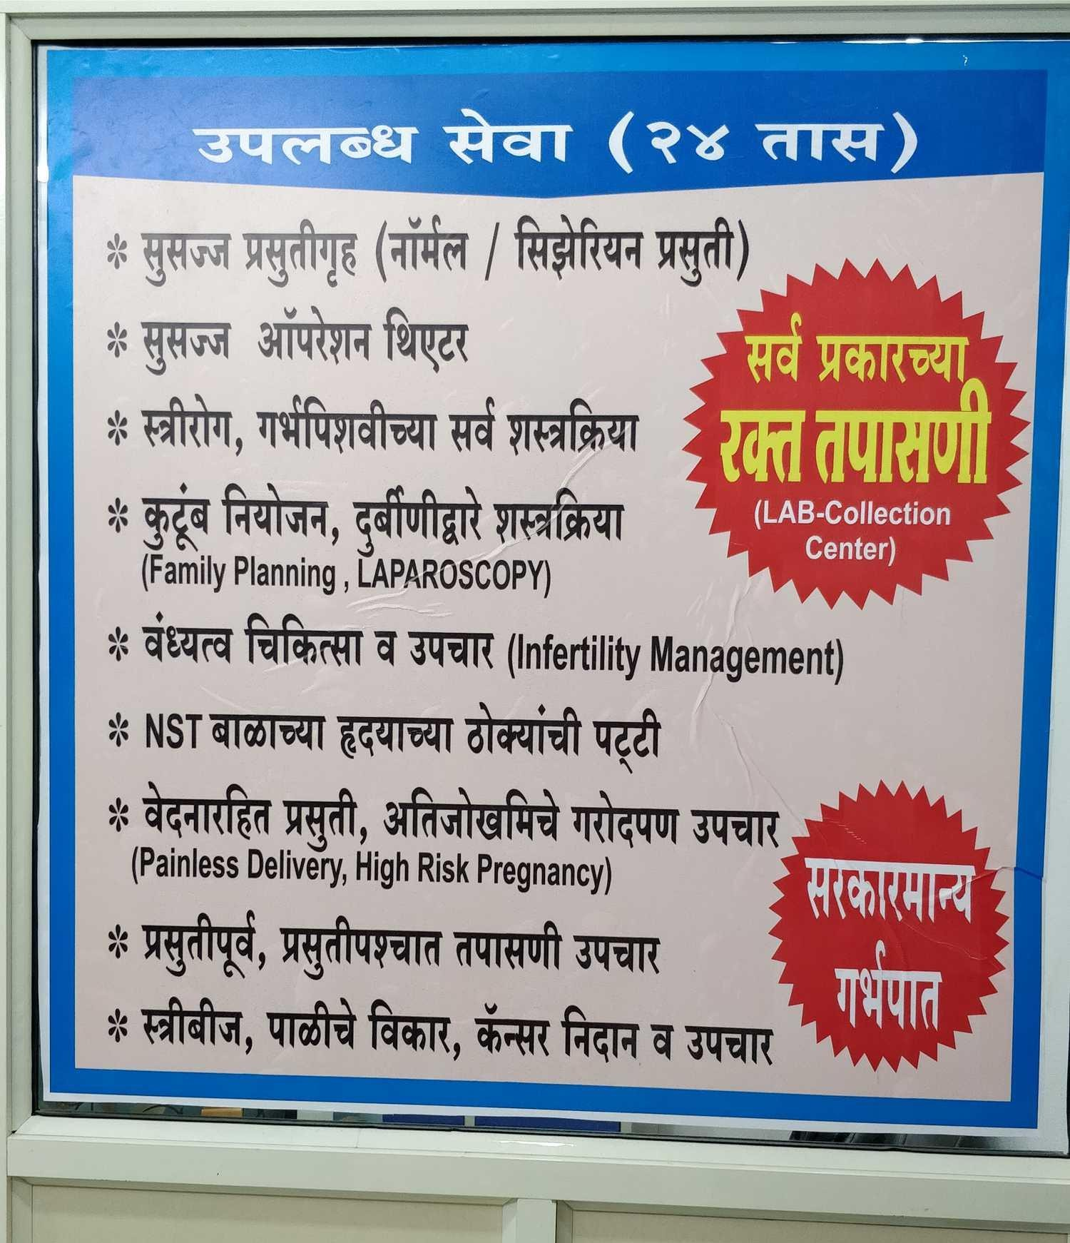

Slide 17

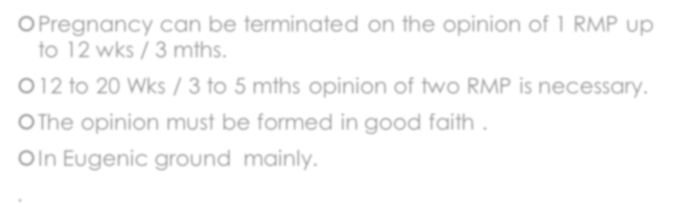
Duration of pregnancy for MTP
Pregnancy can be terminated on the opinion of 1 RMP up to 12 wks / 3 mths.
12 to 20 Wks / 3 to 5 mths opinion of two RMP is necessary.
The opinion must be formed in good faith .
In Eugenic ground mainly.
.

Slide 18

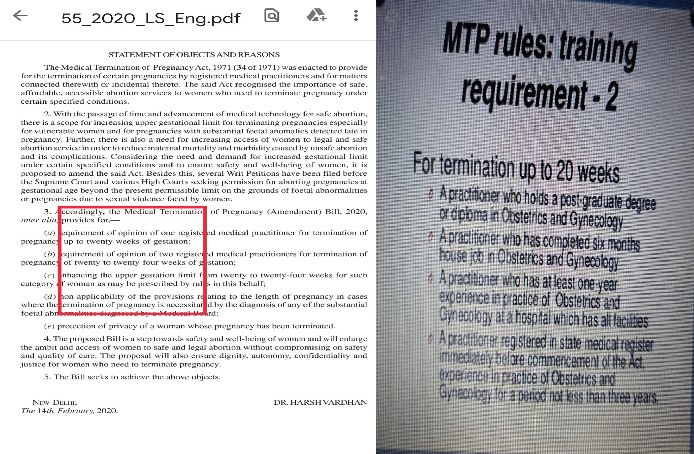

Slide 19

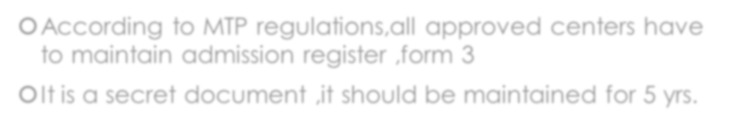
Documentation & record.
According to MTP regulations,all approved centers have to maintain admission register ,form 3
It is a secret document ,it should be maintained for 5 yrs.

Slide 20

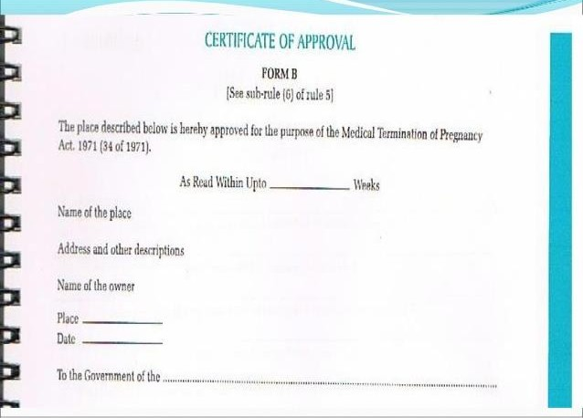

Slide 21

