Slide 1
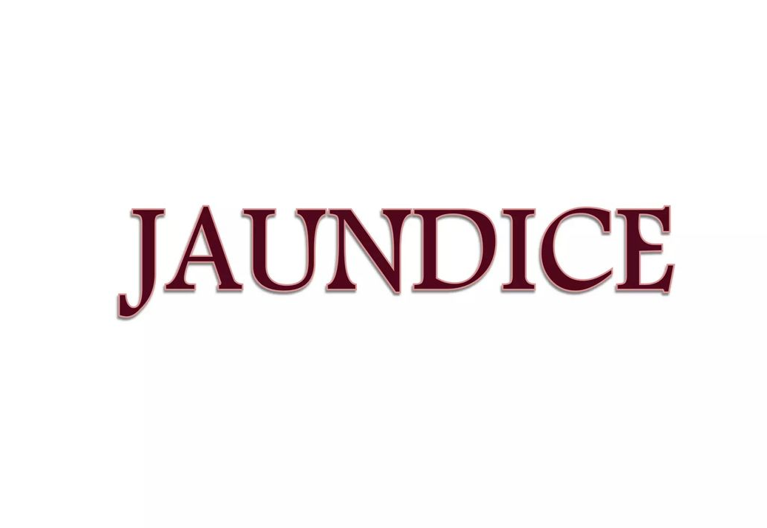
MADHAV HOMOEOPATHIC MEDICAL COLLEGE & HOSPITAL
Dr. Nipun Singh Dabi
Assistant Professor
Department of practice of medicine

Slide 2
DEFINITION
Jaundice is a yellow discoloration of the skin, mucus membrane and whites of eyes [sclera] caused by increase amount of bilirubin in the blood
Bilirubin levels exceeds up to 3 times than normal
The normal value – 0.3 – 1.2 mg/dl

Slide 3
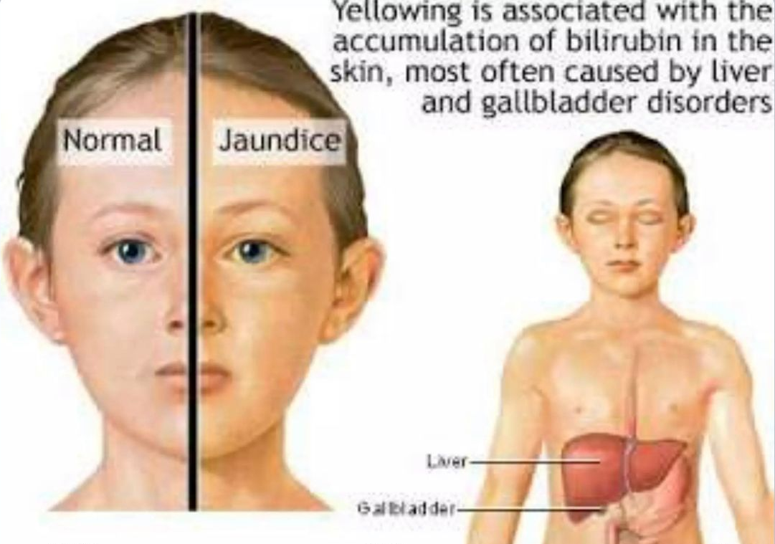

Slide 4
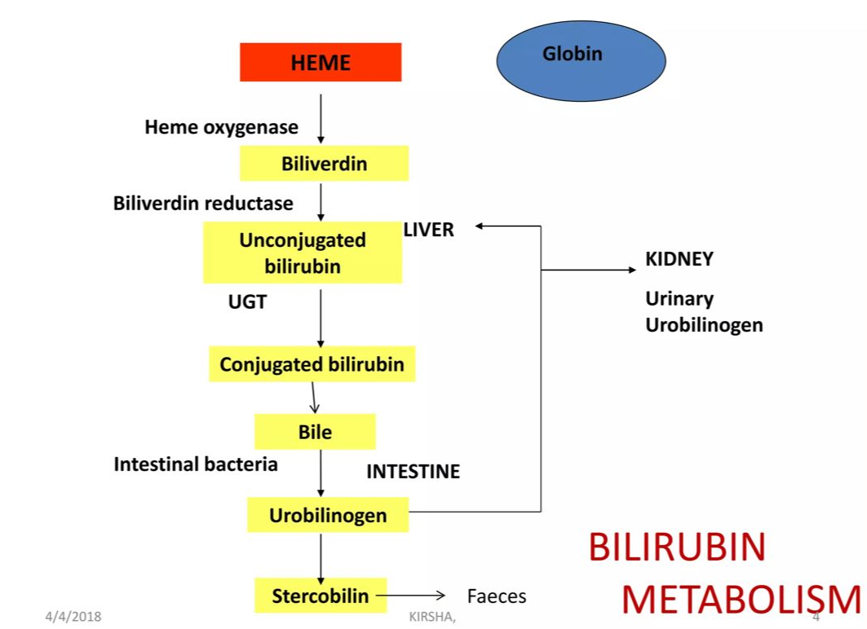

Slide 5
TYPES/CAUSES
There are three types of jaundice
Hemolytic Jaundice (Pre-Hepatic)
It is due to breakdown of RBCs that leads to increase unconjugated bilirubin level in the blood but liver function are normal
causes :-
blood transfusion reaction
haemolytic anaemia
Gall bladder stone

Slide 6
2. Hepatocellular Jaundice (intrahepatic)
It is due to dysfunctioning of the liver cells
causes :-
Infection (hepatitis virus)
Drug or chemical toxicity
Excessive alcohol consumption

Slide 7
3. Obstructive Jaundice (Post Hepatic)
It is due to obstruction of the bile duct that leads to altered secretion of bile.
It is of two types
Extra hepatic obstruction
Due to blockage in the bile duct
E.g. Gall stone, tumour
Intra hepatic Cholestatis
It occur due to blockage or swelling in intra hepatic duct

Slide 8
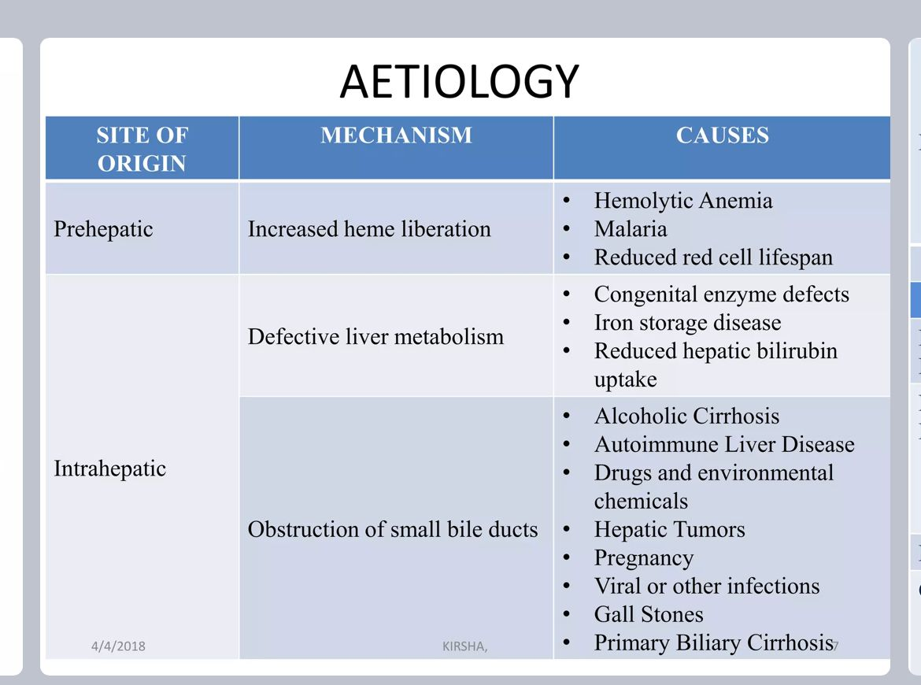

Slide 9
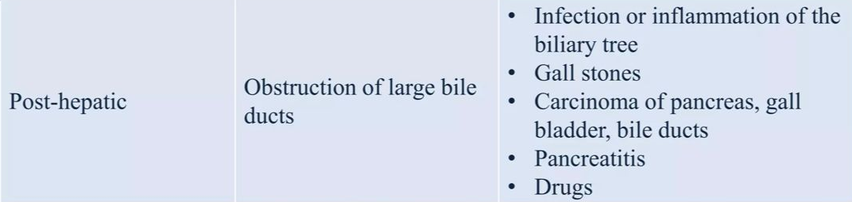

Slide 10
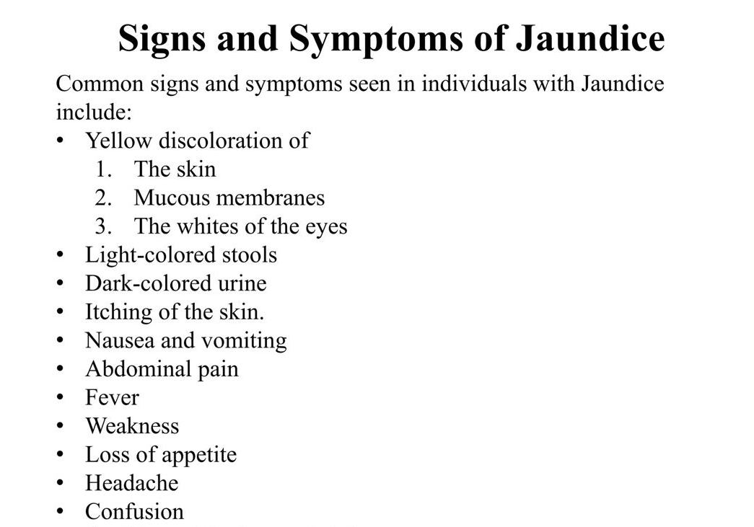

Slide 11
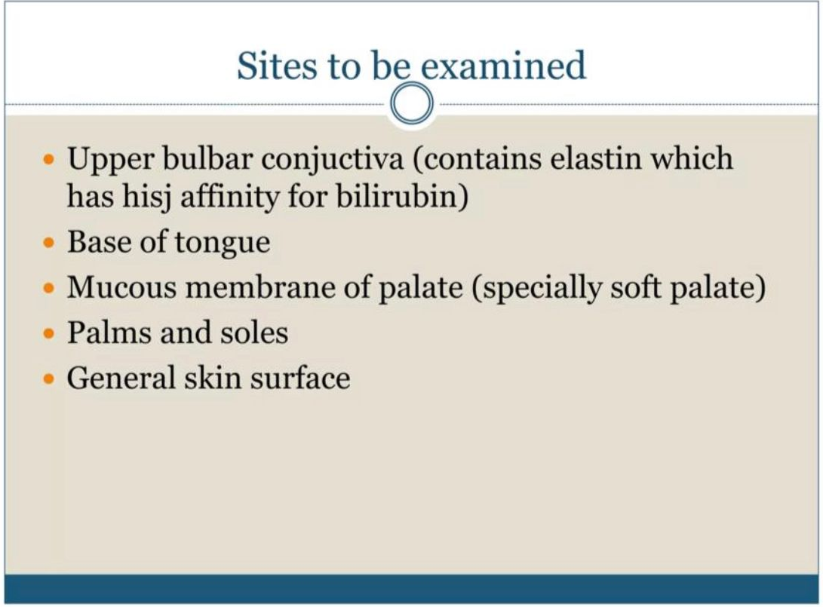

Slide 12
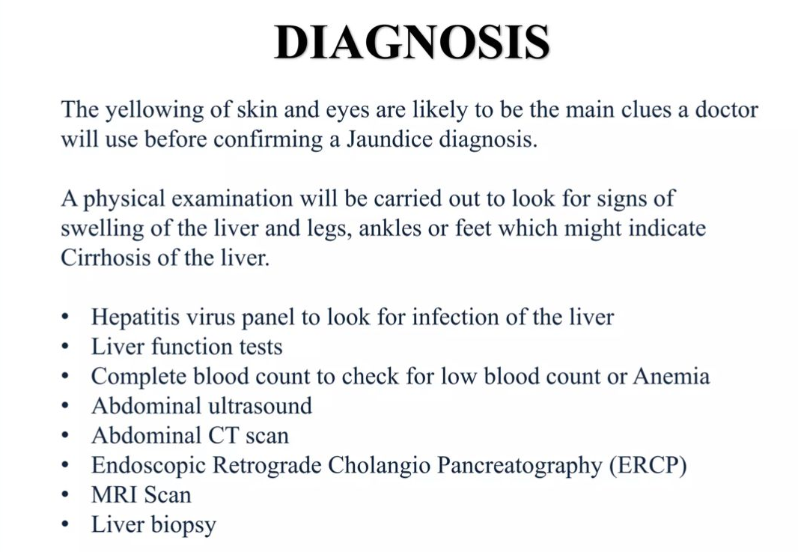

Slide 13
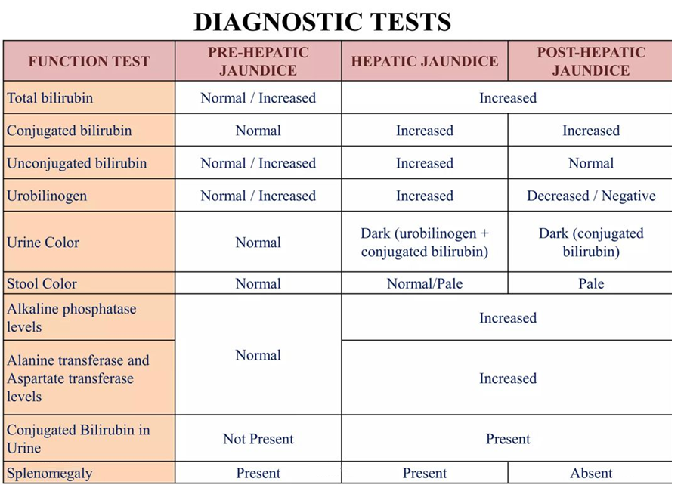

Slide 14
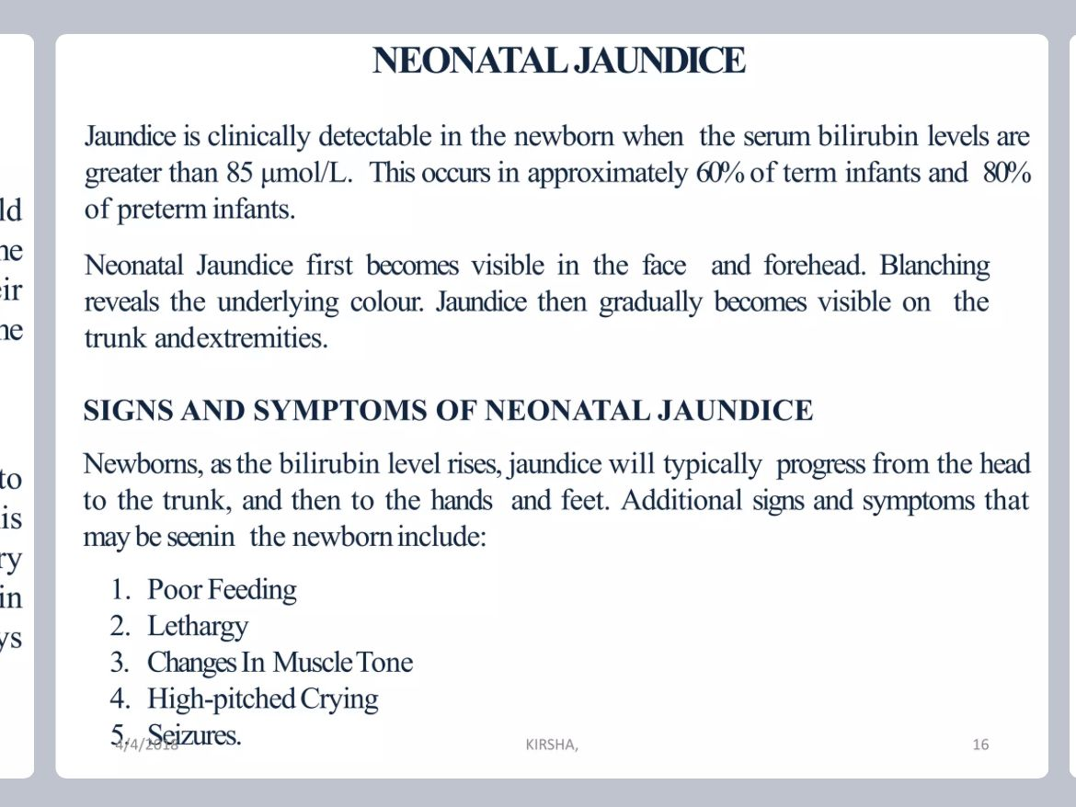
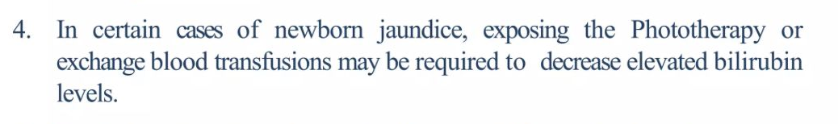

Slide 15
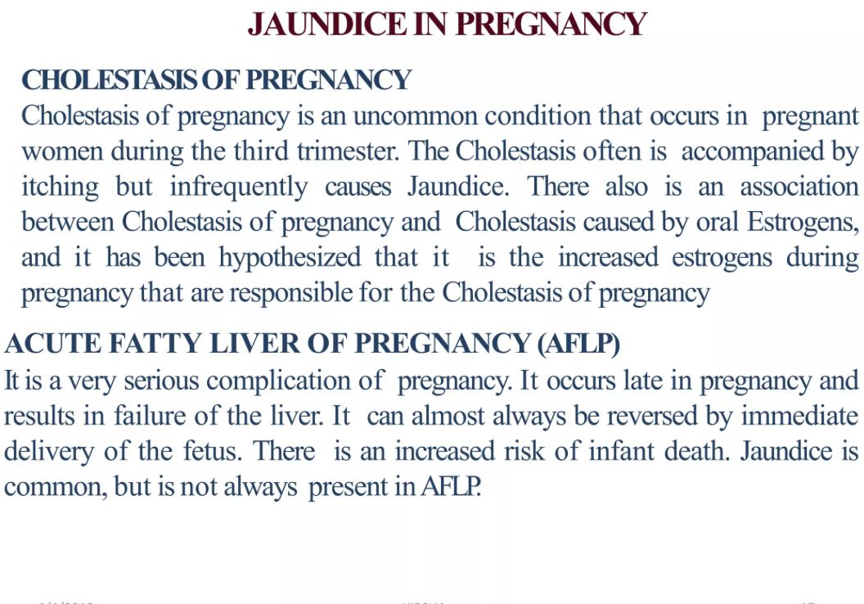

Slide 16
Homoepathic Management
Aconite: Fever with stitches in liver region, scanty dark urine, great fear, anxiety and restlessness. Clay colored stools.
Cardus marianus: Pain in liver region, left lobe enlarged, constipation, hyperema of liver. Gall bladder swollen. Cirrhosis. Nausea and retching; vomiting of green acid fluid. Gall stone diseases with jaundice. Urine golden colored.
Berbeis vul.: Stitches in region of gall bladder; worse pressure extending to stomach, catarrh of gall bladder, constipation and yellow discoloration of skin, gall stones.

Slide 17
Chelidonium : Constant pain under inferior angle of scapula of right side. Face yellow. Tongue yellow with bitter taste. Prefers hot food and drinks. Jaundice due to gall bladder and hepatic diseases. Call stone colic, liver enlarged, profuse foaming yellow urine like beer, constipation - stools hard, round balls or bright yellow pasty, clay coloured, floats on water. Alternate diarrhea and constipation.
Chionanthus: Liver enlarged and sore to touch, clay coloured stools, tongue heavily coated. No appetite. Biliary colic. Urine dark containing bile and sugar. Pruritis. Yellow conjunctiva.
Leptandra: Jaundice, black tarry stools. Malarial effects on liver, Tongue coated yellow, aching in liver region, clay coloured stools. Urine dark brown.

Slide 18
Dietary Management
Advice to pt. for restrict fat intake
Provide high protein diet
High carbohydrate diet
Provide plenty of fluids, juices
Give glucose water

Slide 19
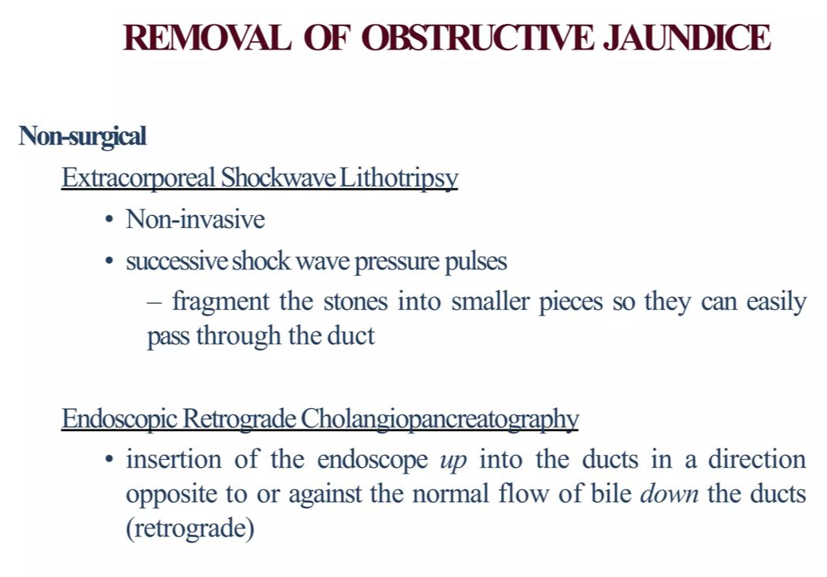

Slide 20
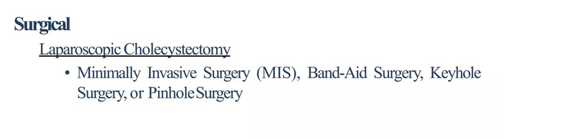

Slide 21


