Slide 1
GESTATIONAL TROPHOBLASTIC DISEASES (GTD)
DR. AMIT KUMAR
Associate Professor
(Department Of OBG)
Madhav Homeopathic Medical College, Abu Road, Sirohi

Slide 2
DEFINITION: Gestational Trophoblastic Disease (GTD) encompasses a spectrum of proliferative abnormalities of trophoblasts associated with pregnancy. Persistent GTD (persistently raised β-hCG) is referred as gestational trophoblastic neoplasia (GTN).

Slide 3
CLASSIFICATION OF GTD
• Hydatidiform mole: – Complete – Partial
• Invasive mole
• Placental site trophoblastic tumor
• Choriocarcinoma

Slide 4
Non metastatic disease (confined to the uterus)
Metastatic disease:
A. Low risk (good prognosis)
– Disease is present < 4 months duration
– Initial serum hCG level < 40,000 mIU/ml
– Metastasis limited to lung and vagina
– No prior chemotherapy
– No preceding term delivery

Slide 5
B. High risk (poor prognosis)
– Long duration of disease (> 4 months)
– Initial serum hCG > 40,000 mIU/ml
– Brain or liver metastasis
– Failure of prior chemotherapy
– Following term pregnancy
– WHO score > 8

Slide 6
HYDATIDIFORM MOLE (Syn: Vesicular mole)
DEFINITION: It is an abnormal condition of the placenta where there are partly degenerative and partly proliferative changes in the young chorionic villi. These result in the formation of clusters of small cysts of varying sizes.
TYPES: • Complete • Incomplete (partial)

Slide 7
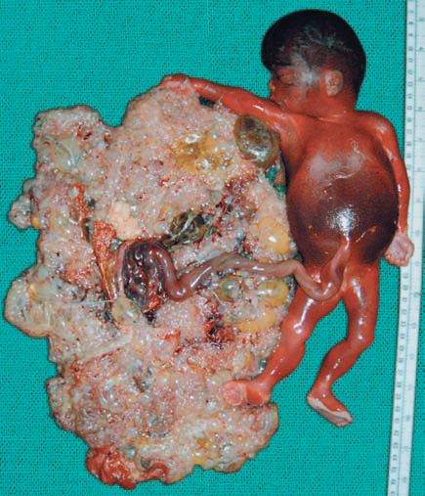
• Complete
• Incomplete (partial)

Slide 8
INCIDENCE -The highest incidence is in Philippines being 1 in 80 pregnancies and lowest in European countries 1 in 752 and USA being about 1 in 2000. The incidence, in India, is about 1 in 400.
ETIOLOGY:
Its prevalence is highest in teenage pregnancies and in those women over 35 years of age.
The prevalence appears to vary with race and ethnic origin.

Slide 9
Faulty nutrition caused by inadequate intake of protein, & Low dietary intake of carotene is associated with increased risk.
Disturbed maternal immune mechanisms suggested by—(a) Rise in gammaglobulin level in absence of hepatic disease (b) Increased association with AB blood group which possesses no ABO antibody.

Slide 10
The higher the ratio of paternal: maternal chromosomes, the greater is the molar change. Complete moles show 2: 0 paternal/maternal ratio whereas partial mole shows 2: 1 ratio.
History of prior hydatidiform mole increases the chance of recurrence (1 to 4%).

Slide 11
SYMPTOMS
Vaginal bleeding
Varying degree of lower abdominal pain may be due to
The patient becomes sick without any apparent reason.
Vomiting of pregnancy becomes excessive
Breathlessness
Expulsion of grape like vesicles per vaginam is diagnostic of vesicular mole.
History of quickening is absent.

Slide 12
INVESTIGATIONS:
Full blood count, ABO and Rh grouping.
Hepatic, renal and thyroid function tests are carried out.
Sonography: Characteristic features of molar pregnancy is ‘snowstorm’ appearance
Definitive diagnosis is made by histological examination of the products of conception

Slide 13
DIFFERENTIAL DIAGNOSIS:
Threatened abortion
Fibroid or ovarian tumor with pregnancy
Multiple pregnancy:

Slide 14
COMPLICATIONS OF MOLAR PREGNANCY
Hemorrhage and shock
Sepsis
Perforation of the uterus
Pre-eclampsia with convulsion on rare occasion
Acute pulmonary insufficiency

Slide 15
MANAGEMENT
The principles in the management are:
Suction evacuation (SE) of the uterus as early as the diagnosis is made.
Supportive therapy: Correction of anemia and infection, if there is any.
Counseling for regular follow-up

Slide 16
PARTIAL OR INCOMPLETE MOLE
In partial hydatidiform mole, the affection of the chorionic villi is focal. There is a fetus or at least an amniotic sac.
Microscopic examination of the dilated chorionic villi shows predominant hyperplasia of the syncytiotro-phoblast and presence of fetal blood vessels with fetal red blood cells.

Slide 17
Once the diagnosis is made and the fetus is not alive,termination of pregnancy is to be done.
Even if the fetus is alive, the patient should be warned about the risks involved to the fetus if pregnancy is continued.

Slide 18
PLACENTAL SITE TROPHOBLASTIC TUMOR (PSTT)
It is a rare histological diagnosis. Syncytotrophoblastic cells are generally absent. So there is persistent low level of serum or urinary hCG.
The tumor arises from the intermediate trophoblasts of the placental bed and is composed mainly of cytotrophoblastic cells.
Patient presents with vaginal bleeding. Local invasion into the myometrium and lymphatics occurs. PSTT is not responsive to chemotherapy.
Hysterectomy is the preferred treatment.

