Slide 1
NUX VOMICA POISONING
Dr. Abhijit Giri
Associate Professor
Department of Forensic Medicine and Toxicology
Madhav homeopathic medical college and hospital

Slide 2
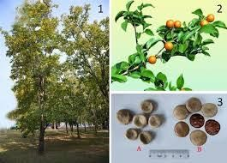

Slide 3
OBJECTIVES
At the end of this session you will be able to
Understand the Action of Nux vomica
Know the Signs and symptoms of this particular poisoning
State the FD & FP of Nux vom poisoning
Explain the circumstances and treatment of poisoning
Differentiate this poisoning from tetanus

Slide 4
STRYCHNOS NUX VOMICA
Spinal poison
Medium sized tree
Family-- Loganiaceae
Synonyms
Poison nut
Kuchla
Quaker buttons
Vomit nut
Dog buttons

Slide 5
USES
Strychnine is extremely toxic
Used in veterinary medicine as CNS stimulant and tonic
Used as antidote to barbiturate poisoning
Used as rodenticide

Slide 6
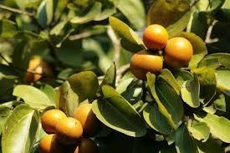

Slide 7
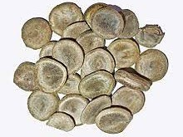

Slide 8
CHEMICAL CONSTITUENTS
mainly alkaloids
Strychnine
Iso strychnine
protostrychnine
Brucine
Vomicine
Novacine

Slide 9
The seeds contain
Strychnine and brucine as active principle

Slide 10
MECHANISM OF ACTION
An antagonist of glycine (inhibitory neurotransmitter)
Inhibitory glycine receptors are more in spinal cord &brain stem where they are mainly involved in regulating motor functions

Slide 11
Alkaloid of NV is a potent convulsant poison
It lowers the threshold for stimulation of spinal reflexes by blocking inhibitory pathways exerted by motor cells in spinal cord
As a result,any stimulus like noise,light even breeze causes a violent reflex action producing general contraction

Slide 12
EFFECTS
Increased reflex action
Increased rate of respiration
Increased force,rate,and volume of the pulse
Raised arterial pressure
Increased sharpness to sight,hearing,and smell
General irritation

Slide 13
FD
One crushed seed OR
1-2mg/kg
FP
1-2 hrs

Slide 14
ABSORPTION AND EXCRETION
Rapidly absorbed from GIT,nasal mucosa and all parenteral sites
Rapidly metabolised in liver
Its highest concentrations are seen in the liver,kidneys,and blood

Slide 15
SIGNS AND SYMPTOMS
If the seed are taken as a whole– non poisonous(the thick pericarp is not digested by gastric juice)
Only the broken or chewed seeds cause poisoning
s/s appear after 15-30 mts of the ingestion

Slide 16
SIGNS AND SYMPTOMS
Bitter taste
Anxious &restless
Clonic ,tonic seizures
Affects flexor and extensor muscles simultaneously

Slide 17
Clonic spasms refer to alternating involuntary muscular contraction and relaxation in quick succession.
Tonic spasms are rigid muscle contractions that last a period of time.

Slide 18
Convulsions with consciousness
Convulsions are repeated in every 3-4 minutes in between convulsions are decreased
Convulsions are very painful &unfortunately person remains conscious during

Slide 19
Risus sardonicus and lock jaw(trismus)
due to muscle spasm
Opisthotonus
spasm of the muscles causing backward arching of the head, neck, and spine, ( in severe tetanus, some kinds of meningitis, and strychnine poisoning.)
Respiratory distress and death

Slide 20
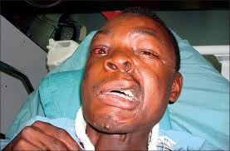
Trismus

Slide 21
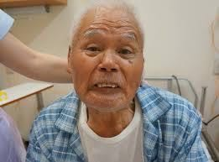
Risus sardonicus

Slide 22
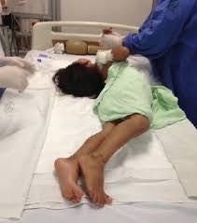
Opisthotonus

Slide 23
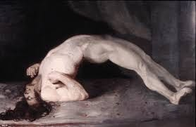

Slide 24
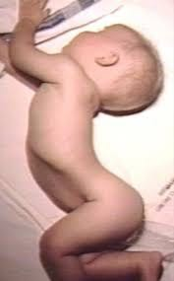

Slide 25
TREATMENT
No specific antidote
Maintain clear airway and adequate ventilation
Control of convulsions– diazepam,general anaesthetics,muscle relaxants
Barbiturates are antidote
Gastric lavage with potassium permanganate,if there is no convulsions
Symptomatic treatment

Slide 26
P/M FINDINGS
Not characteristic
Signs of asphyxia
Rigor mortis appears and disappears early
Extravasated blood may be seen the muscles

Slide 27
Congestion of viscera
Postmortem caloricity
Spinal cord congested ,shows haemorrhage in anterior &posterior horns

Slide 28
M/L IMPORTANCES
Deadly poisonous
Mostly accidental
Due to overdose,quack remedies,in case of children eating seeds
Homicide is rare due to its bitter taste

Slide 29
Aphrodisiac
Cattle poison
Arrow poison to kill dogs and rats
Tolerance develops on repeated consumptions
Can be easily detected even in decomposed body

Slide 30
HOW TO DIFFERENTIATE NUX VOM POISONING FROM TETANUS
INFECTION?

Slide 31
SL NO | FEATURES | STRYCHNINE POISONING | TETANUS
1 | History of injury | None | Present
2 | Onset | Sudden | Gradual
3 | Site of action | Post synaptic membrane | Presynaptic membrane
4 | Muscles affected | All muscles are affected at the same time | Not affected at the same time
5 | Lower jaw | Does not start in, nor esply affect | Starts in and affect jaw(lock jaw)
6 | Muscle condition | Relaxed in between convulsions | Rigid
7 | FP | 1-2 hrs | >24 hrs
8 | Chemical analysis | Strychnine found | No poison
9 | Culture | No growth | Clostridium tetani present
10 | Progression | Steadily worse/better | Rarely steady.variations seen

Slide 32
Thank you

