Slide 1
HUMAN PHYSIOLOGY & BIOCHEMISRY
TOPIC – ERYTHROPOIESIS
BY Dr.Deepak Bhataniya
Asssistant professor
Department of Physiology

Slide 2
The process of formation of RBCs is called Erythropoiesis

Slide 3
Learning Objectives of Today’s Lecture
At the end of this lecture student should be able to recognize:
Sites of Erythropoiesis
Main features of different stages of Erythropoiesis
Features of mature RBCs
The regulation of RBC production and erythropoietin hormone secretion in response to hypoxia

Slide 4
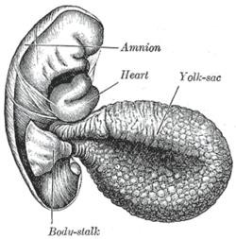
Site of RBC Production
Early weeks of embryonic life:
– Nucleated RBCs - Yolk sac

Slide 5
Site of RBC Production, Cont.
Middle trimester of gestation:
  Liver form blood cells (mainly)
Spleen + lymph nodes form blood cells
Last month of gestation and after birth:
- Red bone marrow (exclusively)

Slide 6
RBC Production after birth
The bone marrow of all bones - 5 years
Marrow of the long bones (except for the proximal humerus and tibia)
  No more red blood cells are produced after the age of 20 years.
Most RBCs continue to be produced in the marrow of the membranous bones, such as
  Vertebrae, Sternum, Ribs, and Ilia

Slide 7
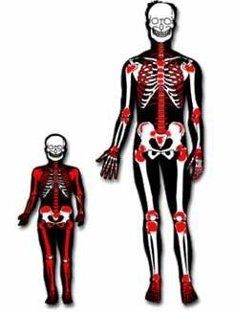

Slide 8
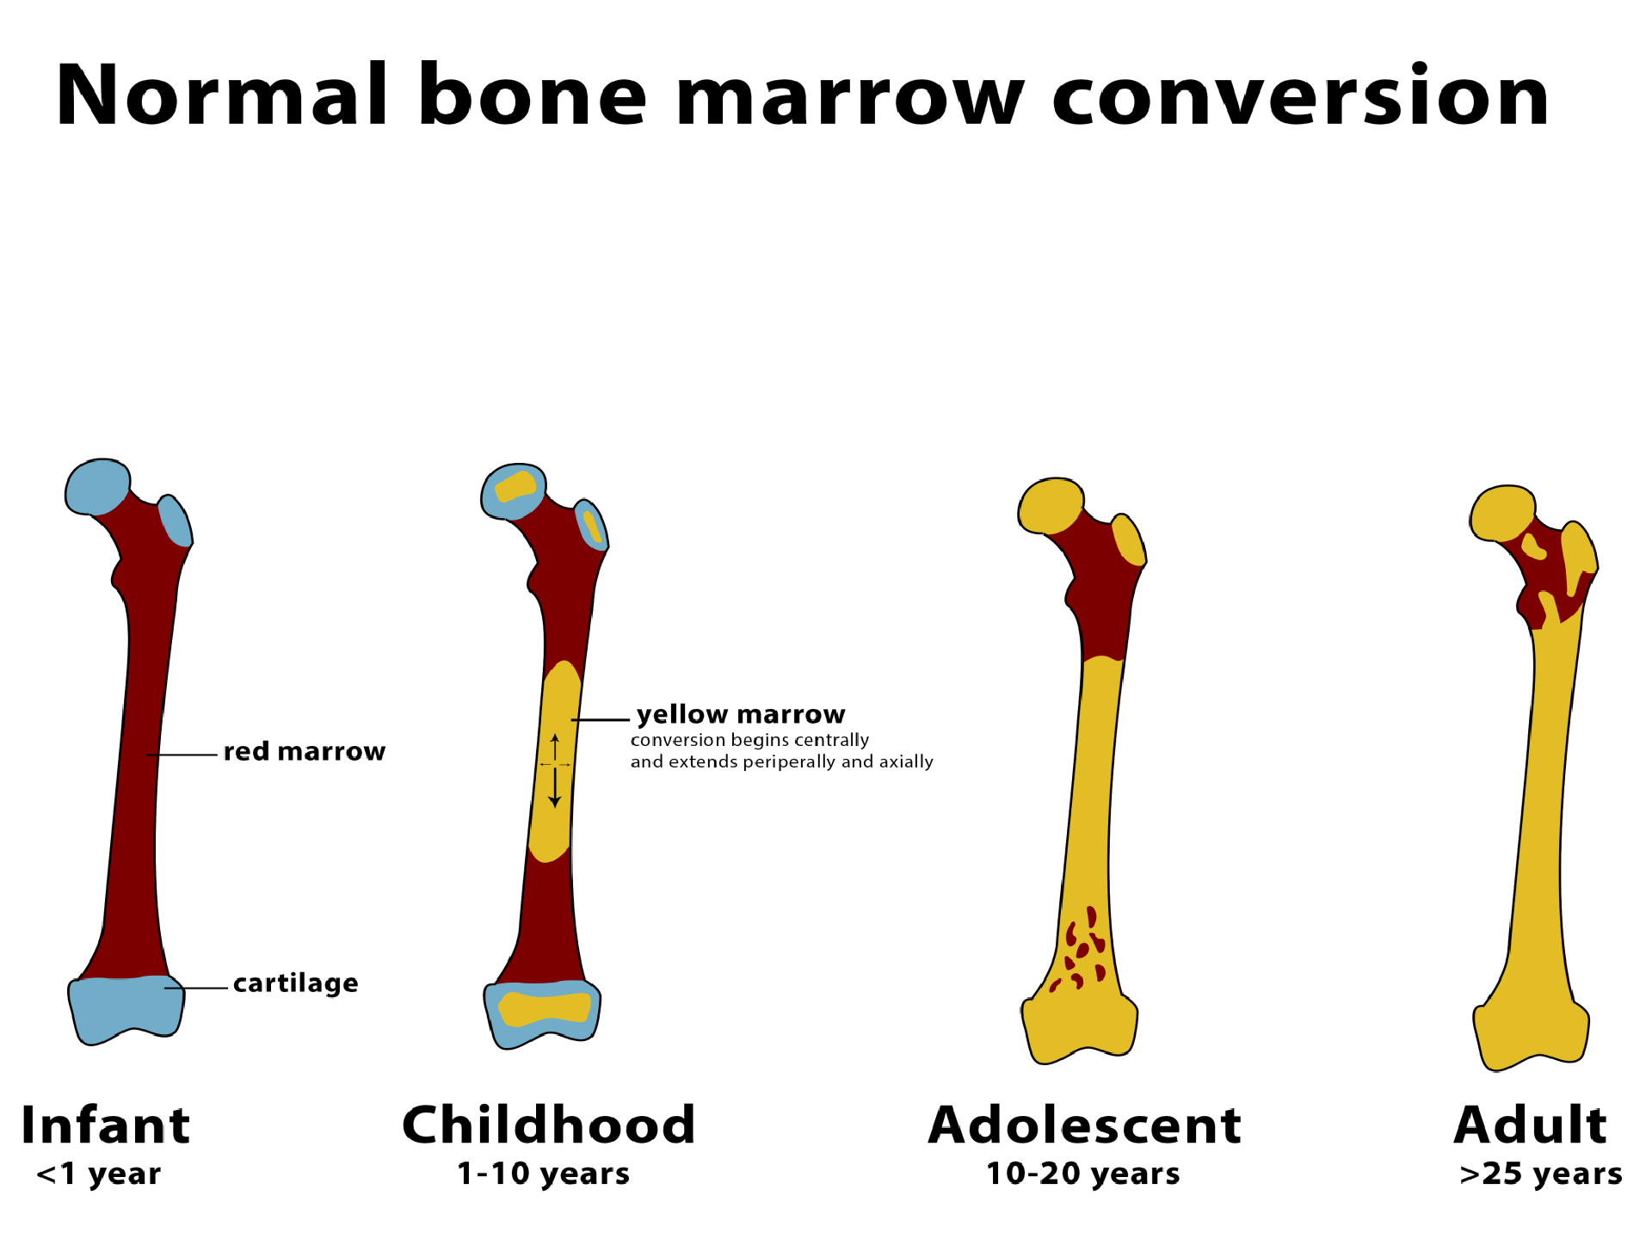

Slide 9
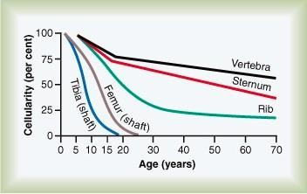
Relative rates of red blood cell production in the bone marrow of different bones at different ages.

Slide 10
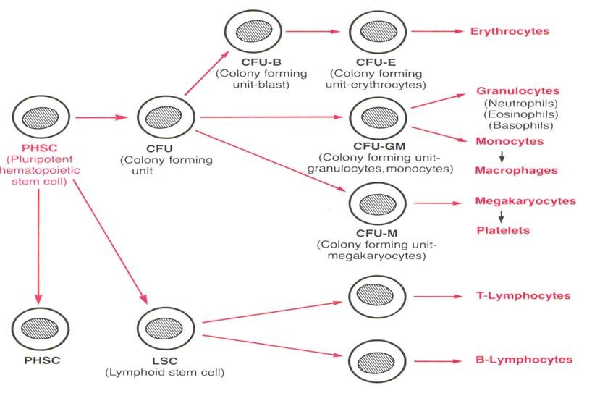
Genesis of RBC
(Hemocytoblast)
(1) Myeloid stem cell
(2) Lymphoid stem cell
10

Slide 11
Genesis (Production) of RBC
Pluripotential hematopoietic stem cell (PHSC).
Committed stem cell that produces erythrocytes is called Colony-forming unit–erythrocyte, CFU-E
Factors:
  Growth inducers, such as interleukin-3
  Differentiation inducers.

Slide 12
Stages of Erythropoiesis
PHSC
Comittes stem cell, CFU-E Proerythroblast
Basophil erythroblast Polychromatophil erythroblast Orthochromatophil erythroblast
Reticulocyte Erythrocyte

Slide 13
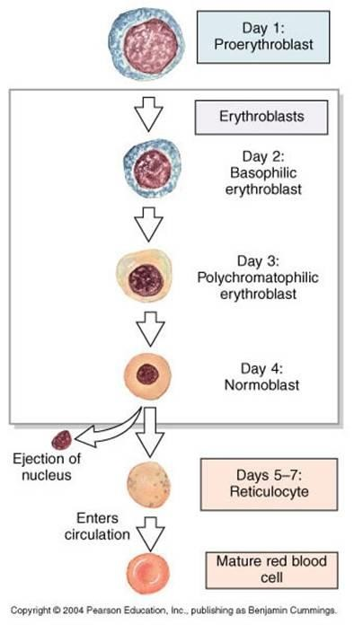


Maturation Times
Erythroblasts actively synthesize Hb. They are categorized on the basis of total size, the amount of Hb present, and the size of nucleus.

Slide 14
Erythropoiesis
RBC development is characterized by:
  A decrease in cell size
  A disappearance of nucleus
  An appearance of hemoglobin
14

Slide 15

Proerythroblast
No hemoglobin
Nucleus 12 um
Contain nucleoli

Slide 16

Basophil erythroblast
Early Normoblast
Nucleoli disappear
Show mitosis
Cytoplasm deep blue
– Increase in RNA
Hemoglobin starts appearing – Little Hb

Slide 17

Polychromatophil erythroblast
Late Normoblast
Nucleus smaller
Coarse Chromatin
Hemoglobin increases

Slide 18

Orthochromatic Erythroblast
Normoblast
Contains a small dense nucleus
Nuclear lysis and
Nuclear extrusion

Slide 19

Reticulocyte
Reticulum
Remnant of ER & GA
Contains RNA in the cytoplasm to:
  Synthesize Hb
  synthesize other proteins
Few Mitochondria
Young RBCs (80% Hb)
< 1 % of RBCs

Slide 20
Transfer of RBC to Circulation
RBC pass from the bone marrow into the blood
capillaries
By
Diapedesis
(squeezing through the pores of the capillary membrane).

Slide 21
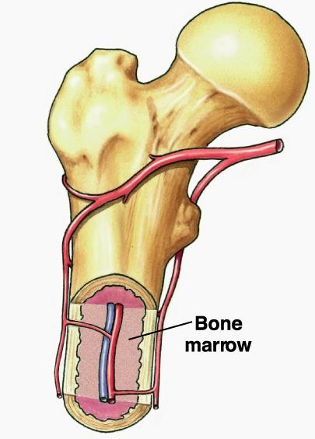
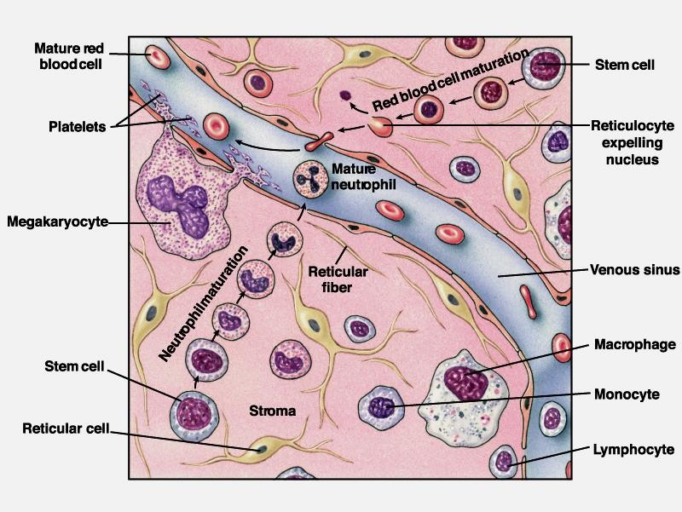

Slide 22
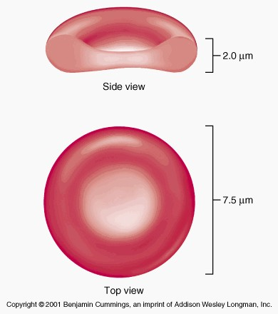
Erythrocytes
Round, biconcave, disc shaped.
Smooth contours
Diameter 7- 8 um.
Normally no variation in size and shape.
Can deform easily
Hb =34g/dl of cells
Hb= 14-16 g/dl in the blood

Slide 23
STRUCTURE OF RBC
Negative surface charge
Bag of fluid with dissolved substances and hemoglobin
Membrane –
  Outer glycoprotein coat
  Lipid bilayer (PL 55%,Cholesterol 45%)
  Inner protein molecules cytoskeleton
  Spectrin, Actin, Ankyrin etc.

Slide 24
ENERGY METABOLISM
Less energy required
Utilize Glucose for energy by:
  Anaerobic glycolysis
  Pentose phosphate pathway

Slide 25
RBC Count
MALE :
– 5,200,000
FEMALE :
– 4,700,000
± 300000 per mm³ (uL).
± 300000 per mm³ (uL).
LIFE SPAN: 120 Days.

Slide 26
Regulation of RBC production
Erythropoiesis is stimulated by erythropoietin (EPO) hormone produced by the kidney in response to hypoxia (low oxygen in the blood)
Hypoxia caused by:
  Low RBC count (Anaemia)
  Hemorrhage
  High altitude
  Prolong heart failure
  Lung disease
26

Slide 27
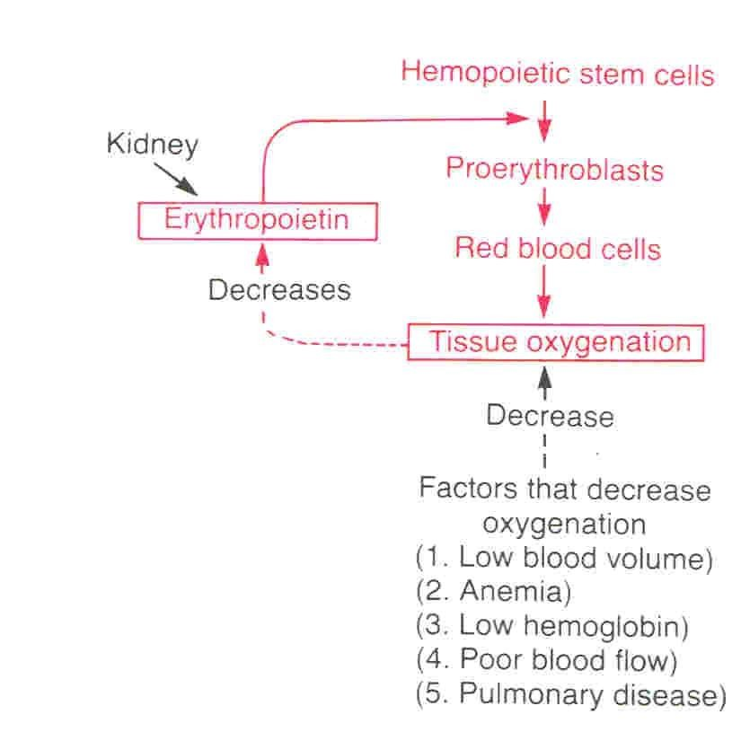
Tissue oxygenation and RBC formation
CFU-E
27

Slide 28
Erythropoietin (EPO)
Glycoprotein
90% of EPO is produced from peritubular fibroblasts
in the renal cortex and 10% from the liver
Renal failure?
Stimulate the growth of early stem cells
Can be measured in plasma & urine
High levels of erythropoietin
  Anemia, hemorrhage
  High altitude
  Heart failure
  Lung Disease
(Result in polycythemia)

Slide 29
Role of EPO
EPO stimulates increased cell division rates in erythroblasts and stem cells that produce erythroblasts.
EPO speeds up the maturation of RBCs by accelerating the rate of Hb synthesis.
Under maximum EPO stimulation, bone marrow can increase the rate of RBC production tenfold.
Blood doping?
30

Slide 30
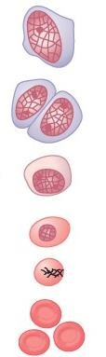
Main Features - Stages of Erythropoiesis
Proerythroblast
Basophilic Erythroblast
Polychromatophil Erythroblast
Orthochromatic erythroblast
Reticulocyte
Erythrocyte

Slide 31
Erythropoiesis
TEXTBOOK OF MEDICAL PHYSIOLOGY
GUYTON & HALL 11TH EDITION
1

