Slide 1
Dr.Sajjan Singh Rathore
(Assistant Professor)
Department - Social Science & Humanities
Madhav University Pindwara Sirohi
Rajasthan

Slide 2
INTRODUCTION
The Harappan Civilization was a Bronze Age society in the Indus Valley, with advanced urban planning and drainage systems. It ﬂourished from 3300 to 1300 BCE, but its decline remains a mystery. The legacy of the Harappan Civilization continues to intrigue archaeologists and historians worldwide.

Slide 3
URBAN PLANNING
The Harappan cities, such as Mohenjo-daro and Harappa, displayed remarkable urban planning with grid-like streets, advanced drainage, and well-organized residential and commercial areas. This level of sophistication was unparalleled in contemporary civilizations.

Slide 4
TRADE AND COMMERCE
The Harappans engaged in extensive trade, evidenced by the discovery of seals and artifacts in Mesopotamia. Their trade networks extended to Afghanistan, Central Asia, and the Persian Gulf, indicating a thriving commercial economy.

Slide 5
WRITING SYSTEM
The Harappans developed a unique script that remains undeciphered, posing a linguistic challenge to scholars. The script appears on seals, pottery, and other artifacts, suggesting a sophisticated system of communication.

Slide 6
RELIGIOUS PRACTICES
The Harappans had a rich religious life, as evidenced by the discovery of ritual objects and ﬁgurines. Their religious beliefs and practices remain enigmatic, providing insights into their spiritual worldview.

Slide 7
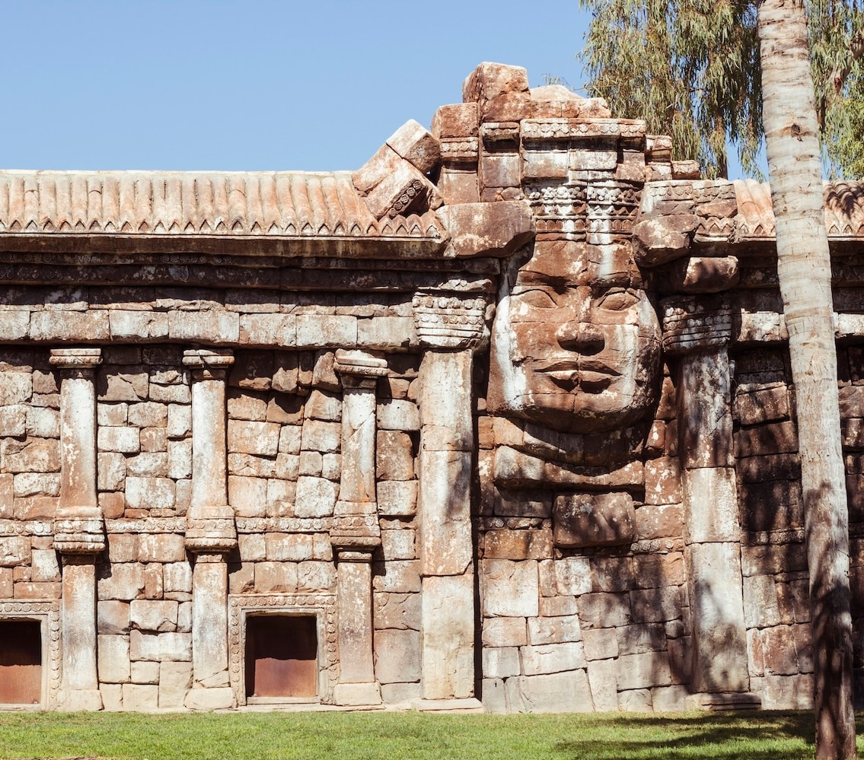
DECLINE AND DISAPPEARANCE
The reasons for the decline of the Harappan Civilization are debated among scholars.
Theories include environmental changes,
invasion, or internal social and political upheaval. The civilization gradually disappeared, leaving behind a mysterious legacy.

Slide 8
LEGACY IN ART AND ARCHITECTURE
The Harappans left a lasting legacy in art and architecture, as seen in their intricate pottery, jewelry, and structures. Their artistic motifs and architectural styles continue to inspire contemporary design and creativity.

Slide 9
ARCHAEOLOGICAL DISCOVERIES
Archaeological excavations at Harappan sites have revealed insights into their daily life, technology, and cultural practices. These discoveries have expanded our understanding of the sophistication of the ancient civilization.

Slide 10
HARAPPAN CIVILIZATION TODAY
The legacy of the Harappan Civilization continues to fascinate researchers and the public alike. Ongoing archaeological studies and research aim to unravel the enigmatic aspects of this ancient society, shedding light on its enduring impact.

Slide 11
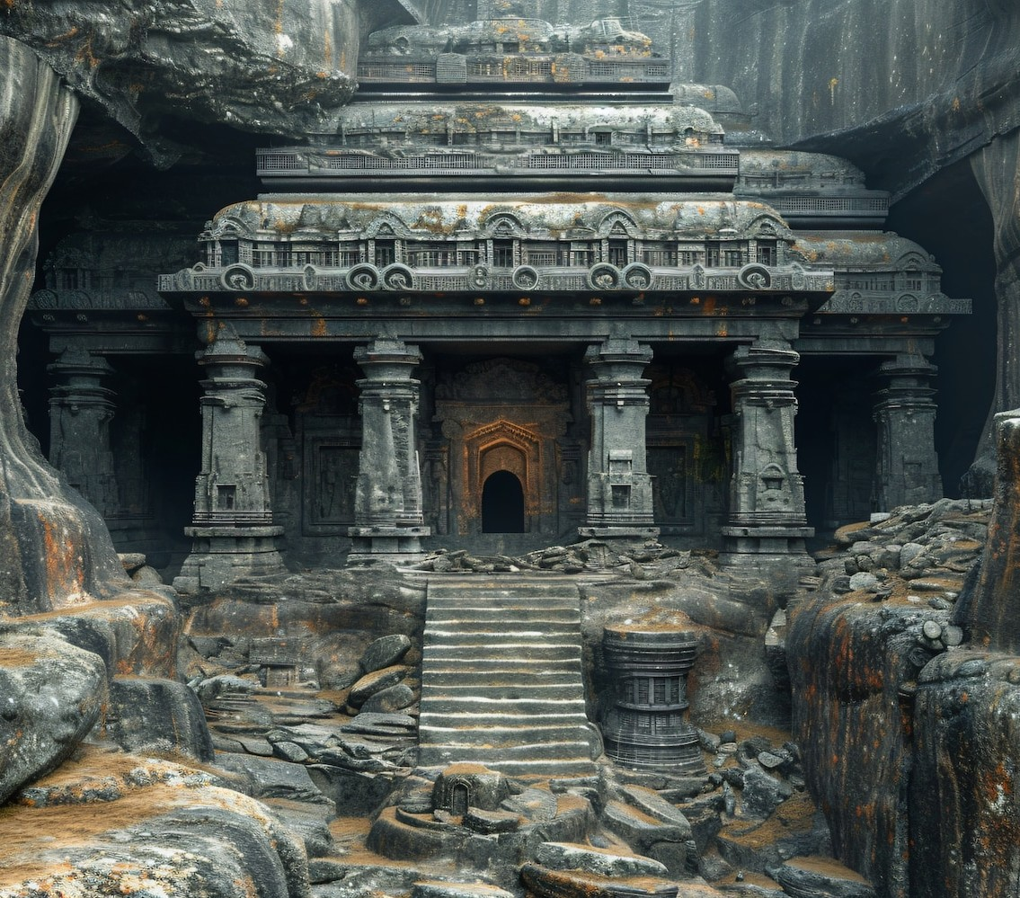
UNSOLVED MYSTERIES
The Harappan Civilization's undeciphered script, enigmatic decline, and mysterious religious practices present enduring challenges to researchers. These mysteries fuel ongoing scholarly pursuits to unlock the secrets of this ancient civilization.

Slide 12
SIGNIFICANCE IN HISTORY
The Harappan Civilization's sophistication and legacy hold signiﬁcant importance in understanding the development of early urban societies. Its impact on subsequent civilizations and its enduring mystery make it a compelling area of historical study.

Slide 13
CONCLUSION
The enigmatic legacy of the Harappan Civilization continues to captivate scholars, oﬀering a fascinating glimpse into an ancient society that thrived over 4,000 years ago. Its enduring mysteries and cultural contributions remain a testament to the civilization's lasting impact.

Slide 14
Thank You

