Slide 1
MADHAV HOMOEOPATHIC MEDICAL
COLLEGE AND HOSPITAL
BY: Dr. Asmita Verma

Slide 2
Fractures and dislocations

Slide 3
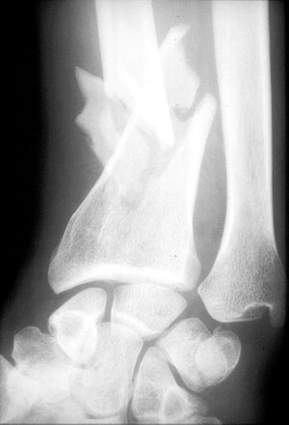
What is fracture(#)?
a break in the continuity of a bone or cartilage.
common causes of fractures:
Fall from a height
car accidents
Direct blow
Repetitive forces
Pathology
Signs and Symptoms
Swelling or tenderness
pain
Numbness
Bleeding
Broken skin with bone protruding
Limitation or unwillingness to move a limb

Slide 4
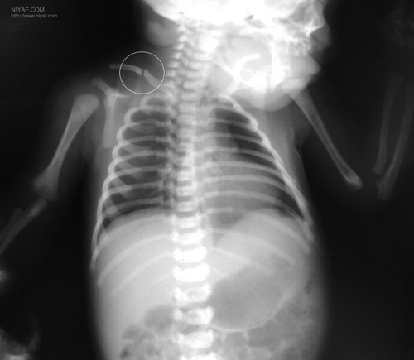
Fracture Types
1/ Traumatic
Closed fracture: A closed fracture is one where the fracture hematoma does not communicate with the outside
Open fracture: This is one where the fracture hematoma communicates with the outside through an open wound.
Stress fracture :
It is a fracture occurring at a site in the bone subject to
repeated minor stresses over a period of time.
Birth fracture:
It is a fracture in the new born children
due to injury during delivery.

Slide 5
Fracture Types
2/ Pathological
It is a fracture occurring after a trivial violence in a bone weakened by some pathological lesion. This lesion may be :
- Localized disorder
(e.g. secondary malignant deposit)
- Generalized disorder
(e.g. osteoporosis).

Slide 6
Fracture Types
According to the Path of the # Line
Transverse Fracture
A fracture in which the # line is perpendicular to the long axis of the bone .
Oblique Fracture
A fracture in which the # line is at oblique angle to the long axis of the bone.

Slide 7
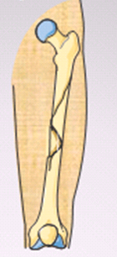
Fracture Types
According to the Path of the # Line
Spiral Fracture
A severe form of oblique fracture in which the # plane rotates along the long axis of the bone. These #s occur secondary to rotational force.
Longitudinal Fracture
A fracture in which the # line runs nearly parallel to the long axis of the bone. A longitudinal fracture can be considered a long oblique fracture.

Slide 8
Fractures
Anatomical classification of fractures
Comminuted # :
The bone is broken into than two fragments.
Stellate fracture:
This # occurs in the flat bones of the skull and in the patella, where the fracture lines run in various directions from one point.

Slide 9
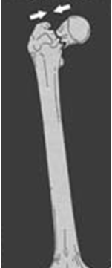
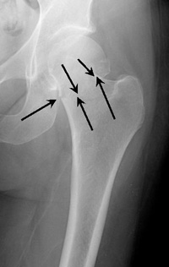
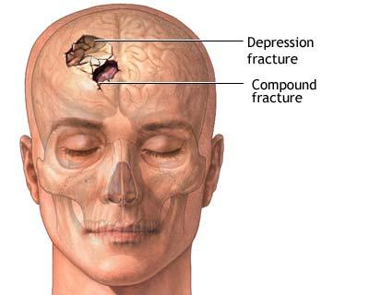
Fracture Types
Anatomical classification of fractures
Impacted fracture:
This # where a vertical force drives the distal fragment of the fracture into the proximal fragment.
Depressed fracture:
This # occurs in the skull where a segment of bone gets depressed into the cranium.

Slide 10
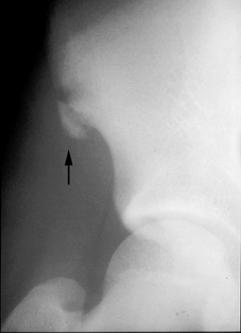
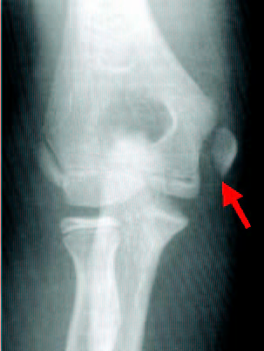
Fracture Types
Anatomical classification of fractures
Avulsion fracture:
This is one, where a chip of bone is avulsed by the sudden and unexpected contraction of a powerful muscle from its point of insertion,
Examples
1. The supra spinatus muscle avulsing the
greater tuberosity of the humerus.
2. Avulsion fracture of the tibial tuberosity

Slide 11
Fracture Types
Summary
Simple little or no bone displacement
Compound fracture ruptures the skin & bone protrudes
Green stick occurs mostly in children whose bones have not calcified or hardened
Transverse crack perpendicular to long axis of the bone - displacement may occur
Oblique diagonal crack across the long axis of the bone
Spiral diagonal crack involving a "twisting" of the bone about the longitudinal axis
Comminuted "crushing" fracture - more common in elderly
Impacted one end of bone is driven up into the other
Depressed broken bone is pressed inward (skull fracture)
Avulsion fragment of bone is pulled away by tendon

Slide 12
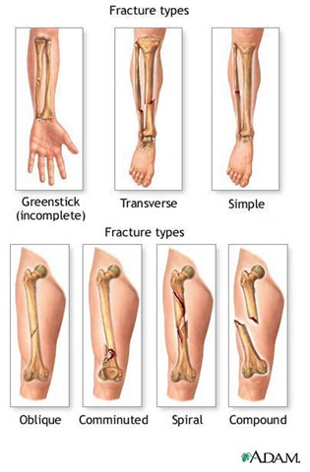
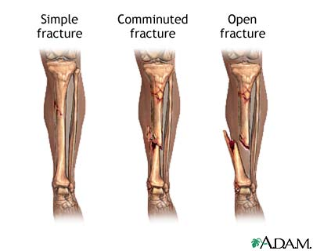
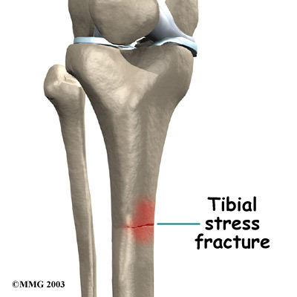

Slide 13
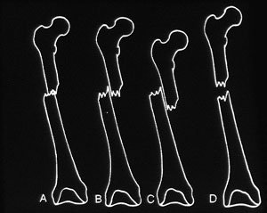
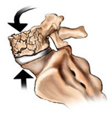
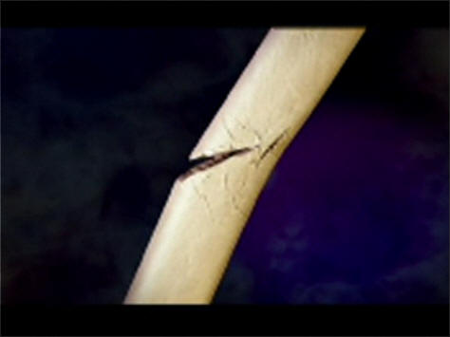
Other Terms used in describing fracture
Greenstick
is the fracture in the young bone of children where the break is incomplete, leaving one cortex intact .
Plastic - Bowing fracture in children without disruption of cortex.
Distraction Is a separation of fragments that have been pulled apart.
Distraction #
Greenstick #

Slide 14
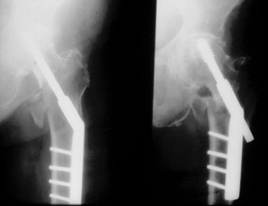
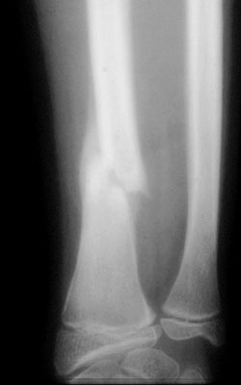
Terms used in fracture follow-up
1.Position - changed or unchanged
.2. Healing -central or peripheral bony bridging

Slide 15
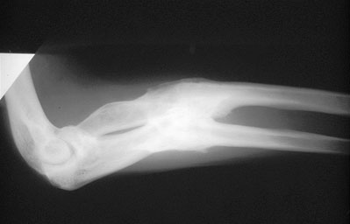
Terms used in fracture follow-up
Delayed union - the healing process is slower than normal.
Non-union - the healing stopped before union occurred.
Malunion - the fracture healed in unacceptable position.

Slide 16
Fractures management and healing

Slide 17
Principles of Management:
Aims : (A)- safe life (B)-save the limb (C)-save the function
Efficient First Aid: This relieves the pain and prevents complications.
Safe transport: This help to minimize complications in injures to the spine, fracture of the lower limbs, ribs etc (all fractures should be immobilized immediately ) .
Assessment of condition of the patients for shock & other injuries.
Assessment of local condition of the injured limb regarding complications like vascular injury, nerve involvement and injury to neighboring joints .
Resuscitation. If needed
Radiography of the part
X-ray before plaster AP & LAT( to determine site and degree of displacement)
Post Reduction films ( wet plaster) for insurance of good alignment
Follow up films to assess healing
Films Before removal of plaster to confirm complete healing
7. Reduction of the fracture(correction of displacement of fragments and done by :
closed Manipulation
open reduction

Slide 18
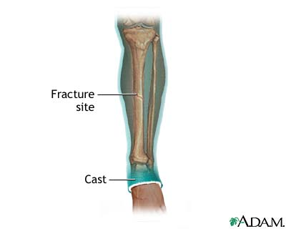
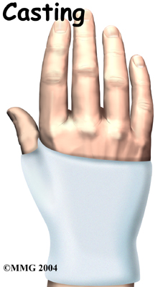
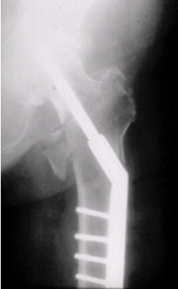
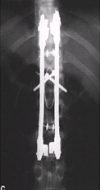
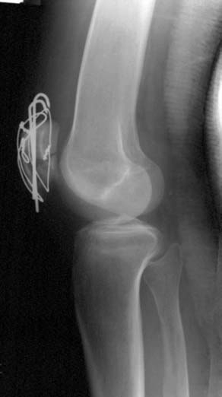
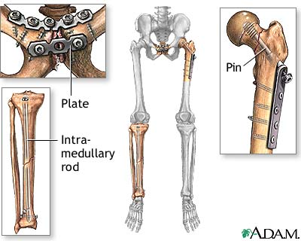
Principles of Management:
8. Immobilization of the fragments.
External fixation
Cast (plaster)
Internal fixation
Screws
Plates
intramedullary nails and rod
wires & pins

Slide 19
9. Early physiotherapy : for the preservation of function of the limb (local complication such as ischemia ,nerve damage ,joint stiffness ,infection ..etc may endanger the function of the limb. 10. Rehabilitation : After union of the fracture to restore full muscle power and joint movements and to make the patient fit for his original job. NOTE:
Fractures are treated by reduction (realignment) &immediate immobilization
In most cases, simple fractures heal completely in approximately 6 - 8 weeks
Compound # better to deal with it within6hrs of injury to avoid infection
The accurate diagnosis of the fracture (site ,lines and displacement ) is made from X- ray examination.
Tow projections is required AP or PA +lateral or oblique
Tow joints above and below the site of the # should be included in the radiographs
Tow limbs radiographs for comparison of value in children.

Slide 20
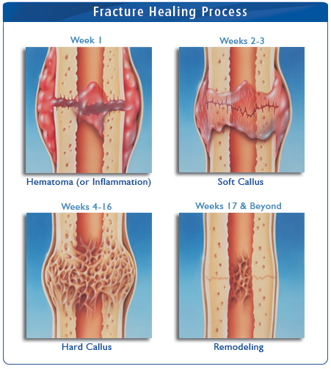
FRACTURE HEALING
Fracture healing is considered as a series of phases which occur in sequence as follows:
(I) Inflammatory Phase.
Stage or hematoma formation.
Stage of granulation tissue. (more fibrin to the hematoma and increase blood flow
(II) Reparative Phase.
(A) Stage of fibro cartilaginous callus.
(B) Stage of bony callus (woven bone become calcified)).
(III) Remodeling Phase.
Excess material inside bone shaft is
replaced by more compact bone

Slide 21
Factors Affecting Bone Healing
Enhancing
Youth Early Immobilization of fracture fragments Bone fragments contact Adequate blood supply Proper Nutrition Adequate hormones Growth hormone Thyroxin Calcitonin
Inhibiting
Age (e.g. Average # Femur Healing Time) Infant: 4 weeks Teenager: 12 to 16 weeks Extensive local soft tissue trauma Bone loss due to the severity of the fracture Inadequate immobilization (motion at the fracture site) Infection Avascular Necrosis

Slide 22
Fracture - Complications
At time of injury (Immediate)
Haemorrhage
Damage to important internal structures (brain ,heart..)
Skin loss ,Shock ,Nerve damage
Later Complications
Local | General
Tissue necrosis | Deep Vein Thrombosis,
Local wound Infection | Pulmonary embolism
Loss of alignment | Osteoarthritis
Delayed and malunion
Joint stiffness

Slide 23
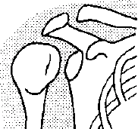
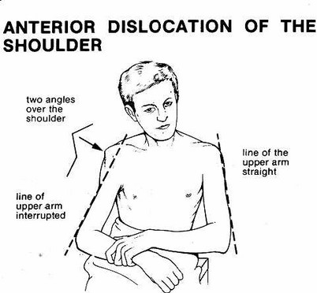
Joints Dislocation
What is Dislocation?
Is the total displacement of the articular end of a bone from the joint cavity.
Subluxation : Is an incomplete displacement.
Reduction : Is the restoration of the normal alignment of the bones.
Classification:
Dislocations are classified
as follows:
Congenital
Traumatic
Pathological
Paralytic

Slide 24
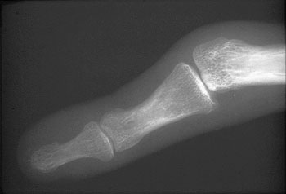
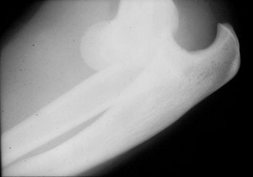
Dislocation & Subluxation
(Sample Radiographs)
PIPJ Subluxation
Elbow joint Dislocation.

Slide 25
?
Q
U
E
S
T
I
O
N
S
Thank you

