Slide 1
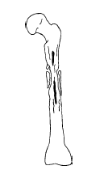
Osteomyelitis
Prof.(Dr.) Manoj Kumar Behera
BHMS,MD(HOM.)PGDHA(APOLLO)
DEAN-PRINCIPAL

Slide 2
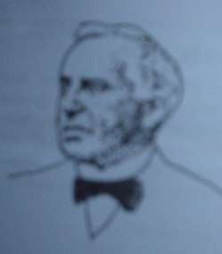
Osteomyelitis
Nelaton (1834) : coined osteomyelitis
The root words osteon (bone) and myelo (marrow) are combined with itis (inflammation) to define the clinical state in which bone is infected with microorganisms.

Slide 3
Introduction
Osteomyelitis is an inflammation of bone caused by an infecting organism.
It may remain localized, or it may spread through the bone to involve the marrow, cortex, periosteum, and soft tissue surrounding the bone.

Slide 4
Classification
Attempts to classify are based on
the duration and type of symptoms (2)the mechanism of infection
(3)the type of host response

Slide 5
Osteomyelitis
Based on the duration and type of symptoms
Acute: | <2weeks | Early acute Late acute(4- 5days)
Subacute: | 2weeks— 6weeks | Less virulent – more immune
Chronic: | >6 weeks

Slide 6
Classified according to mechanism
Osteomyelitis may be
Exogenous(trauma, surgery (iatrogenic), or a contiguous infection)
2. Hematogenous (bacteremia)

Slide 7
Etiology
In infants:
Staphylococcus aureus Streptococcus agalactiae Escherichia coli
In children over one year of age:
Staphylococcus aureus, Streptococcus pyogenes Haemophilus influenzae¹
Staphylococcus aureus
common organism isolated.²
Single pathogenic organism hematogenous osteomyelitis,
Multiple organisms direct inoculation or contiguous focus infection.
Staphylococcus aureus ---most commonly isolated pathogen.
gram-negative bacilli and anaerobic organisms are also frequently isolated
Song KM, Sloboda JF. Acute hematogenous osteomyelitis in children. J Am Acad Orthop Surg. 2001;9:166-75 2.Lew DP, Waldvogel FA. Osteomyelitis. N Engl J Med. 1997;336:999-1007

Slide 8
Organisms Isolated in Bacterial Osteomyelitis
Organism
Comments
Staphylococcus aureus
Organism most often isolated in all types of osteomyelitis
Foreign-body–associated infection
Coagulase-negative staphylococci or
Propionibacterium species
Enterobacteriaceae species orPseudomonas aeruginosa
Common in nosocomial infections and punchured wounds
Streptococci or anaerobic bacteria
Associated with bites, fist injuries caused by contact with another person’s mouth, diabetic foot lesions, decubitus ulcers
Salmonella species orStreptococcus pneumoniae
Sickle cell disease
Lew DP, Waldvogel FA. Osteomyelitis. N Engl J Med 1997;336:999-1007.

Slide 9
Rare organisms Isolated in Bacterial Osteomyelitis
Bartonella henselae
Pasteurella multocida or Eikenella corrodens
Aspergillus species, Mycobacterium avium- intracellulare or Candida
albicans
Mycobacterium tuberculosis
Human immunodeficiency virus infection
Human or animal bites
Immunocompromised patients
Populations in which tuberculosis is prevalent.
Population in which these pathogens are endemic
Brucella species, Coxiella burnetii (cause of chronic Q fever) or other fungi found in specific
geographic areas

Slide 10
Why staphylococcus most
common?
S.aureus and S.epidermis ----- elements of normal skin flora
S.aureus -----increased affinity for host proteins (traumatised bone)
Enzymes (coagulase, surface factor A) ----- hosts immune response .
Inactive “L” forms ------dormant for years
“Biofilm” (polysaccharide “slime” layer) adherence to any substrate .
----
increases
bacterial
Large variety of adhesive proteins and glycoproteins ----- mediate binding with bone components.

Slide 11
Epidemiology
The number of cases of osteomyelitis involving long bones is decreasing while the rate of osteomyelitis at all other sites remained the same⁴.
The prevalence of Staphylococcus aureus infections is also decreasing, from 55% to 31%, over the twenty-year time period⁴.
The incidence of osteomyelitis due to direct inoculation or contiguous
focus infection is increasing due to⁵:
motor-vehicle accidents
the increasing use of orthopaedic fixation devices
total joint implants.
Males have a higher rate of contiguous focus osteomyelitis than do females⁵.
Blyth MJ, Kincaid R, Craigen MA, Bennet GC. The changing epidemiology of acute and subacute haematogenous osteomyelitis in children. J Bone Joint Surg Br. 2001;83:99-102.
Gillespie WJ. Epidemiology in bone and joint infection. Infect Dis Clin North Am. 1990;4:361-76.

Slide 12
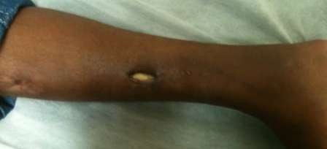
Epidemiology
Incidence of infection increases with increase in grade of compounding (Guistilo, Anderson) :
Approx. 2% for type I and type II
Approx. 10% to 50% for type III
The tibia most common site for infection.

Slide 13
:
Hematogenous
spread
the
usually involves metaphysis of long bones in children or the vertebral bodies in adults
Direct inoculation of microorganisms into bone penetrating injuries and surgical contamination are most common causes
Microorganisms in bone
Osteomyelitis
Contiguous focus of infection seen in patients with severe vascular disease.

Slide 14
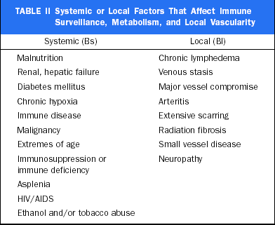
Pathogenesis:
Host Factors

Slide 15
Bacterial factors:
Formation of a glycocalyx surrounding the infecting organisms.
protects the organisms from the action of phagocytes and prevents access by most antimicrobials.
A surface negative charge of devitalized bone or a metal implant promotes organism adherence and subsequent glycocalyx formation.

Slide 16
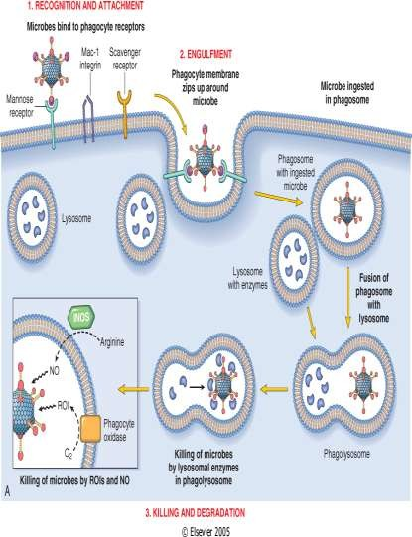
osteomyelitis:
Prostaglandin-E production has been shown to be five to thirty fold higher in infected bone than in normal bone
postulated to be responsible for bone resorption and sequestrum formation^{6,7}.
Effective phagocytosis is defense in patients with osteomyelitis⁸.
Intramedullary oxygen tensions important
for phagocytic function
oxygen tensions of <30 mm Hg impair normal phagocytic function⁹.
6.Plotquin D, Dekel S, Katz S, Danon A. Prostaglandin release by normal and osteomyelitic human bones. Prostaglandins Leukot Essent Fatty Acids.1991;43:13-5. 7.Ralston SH. Role of cytokines in clinical disorders of bone metabolism. In:Gowen M, editor. Cytokines and bone metabolism. Boca Raton, FL: CRCPress; 1992.p 370-1. 8.Subasi M, Kapukaya A, Kesemenli C, Kaya H, Sari I. Effect of granulocytemacrophage colony-stimulating factor on treatment of acute osteomyelitis.
An experimental investigation in rats. Arch Orthop Trauma Surg. 2001;121: 170-3.
9. Mader JT, Brown GL, Guckian JC, Wells CH, Reinarz JA. A mechanism forthe amelioration by hyperbaric oxygen of experimental staphylococcal osteomyelitis in rabbits. J Infect Dis. 1980;142:915-22.

Slide 17
Pathology:
Hematogenous osteomyelitis:
occurs in children < 15 years of age although adults can have this disease
occurs in the metaphysis of the long bones.
In metaphysis decreased activity of macrophages
Frequent trauma
Precarious blood supply
Diaphysial osteomyelitis :
Earlier metaphysis but due to growth becomes diaphyseal mostly in children.
Direct trauma to diaphysis
Tubercular

Slide 18
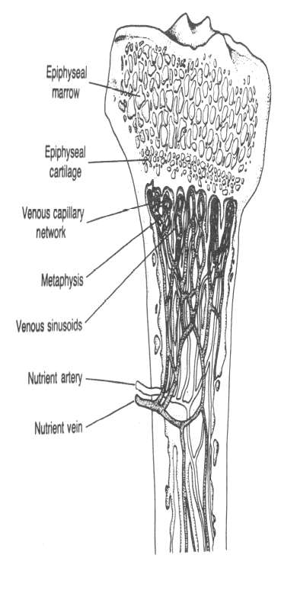
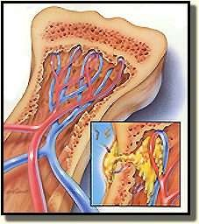
Pathology:
sharp hairpin turns
flow becomes considerably slower and
more turbulent

Slide 19
Pathogenesis
Whatever may be the inciting cause the bacteria reaches the metaphysis of rapidly growing bone & provokes an inflammatory response.
why metaphysis is involved
Infected embolus is trapped in U-shaped small end arteries located predominantly in metaphyseal region
Relative lack of phagocytosis activity in metaphyseal region
Highly vascularised region ---minor trauma—hemorrhage ----locus
minoris resistantae---excellent culture medium
1.

Slide 20
Pathology
These are end-artery branches of the nutrient artery
acute inflammatory response due to infection
tissue necrosis, breakdown of bone
Obstruction
Avascular necrosis of bone
Squestra formation
Chronic osteomyelitis

Slide 21
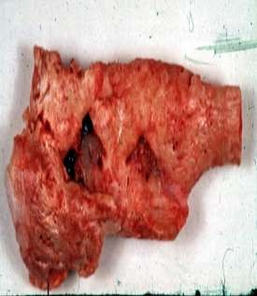
Pathology:
Pathologic features of chronic osteomyelitis are :
The presence of sclerotic, necrotic piece of bone usually cortical surrounded by radiolucent inflammatory exudate and granulation tissue known as sequestrum.
Features:
Dead piece of bone
Pale
Inner smooth ,outer rough
Surrounded by infected granulation tissue trying to eat it
Types-
ring(external fixator)
tubular/match-stick(sickle)
coke and rice grain(TB)
Feathery(syphilis)
Colored(fungal)
Annular(amputation stumps)

Slide 22
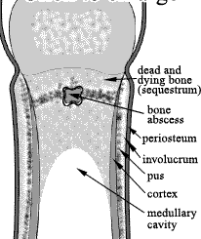
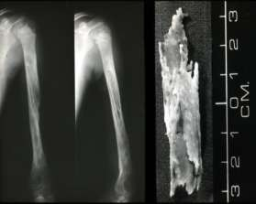
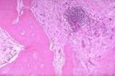
Pathology:
The involucrum is the sheath of reactive, new, immature, subperiosteal bone that forms around the sequestrum, effectively sealing it off the blood stream just like a wall of abscess.
The involucrum is irregular and is often perforated by openings.
The involucrum may gradually increase in density and thickness to form part or all of a new diaphysis.
New bone formation
There is exudation of polymorphonuclear leukocytes joined by large numbers of lymphocytes, histiocytes, and occasionally plasma cells.

Slide 23
local signs
calor, rubor, dolor, tumor
Heat, red, pain or tenderness, swelling
Initially, the lesion is within the medually cavity, there is no swelling, soft tissue is also normal.
The merely sign is deep tenderness.
Localized finger-tip tenderness is felt over or around the metaphysis.
it is necessary to palpate carefully all metaphysic areas to determine local
tenderness, pseudoparalysis

Slide 24
Clinic picture
An increase effusion in the adjacent joint proves in most cases to be a sympathetic synovitis with sterile clear fluid..
It is important to remember that the metaphysis lies within the joint capsule of the hip, shoulder, ankle. Therefore these joints can develop septic arthritis by extension of osteomyelitis.
If the infection and septicemia proceeded unabated, the patient
may have toxic shock syndrome.

Slide 25
Clinical features
During the period of inactivity, no symptoms are present.
Only Skin-thin, dark, scarred, poor nourished, past sinus, an ulceration that is not easily heal
Muscles-wasting contracture, atrophy
Joint-stiffness
Bone-thick, sclerotic,
often contains abscess cavity

Slide 26
Clinical features
At intervals, a flare-up occurs,
The relapse is often the result of poor body condition and lower
resistance.
A lighting up of infection is manifested by aching pain that is worse at
night.
Locally there will be some heat, swelling, redness, tenderness, edema, because pus may build up in cavity, then a sinus may open and starts to exudate purulent material and small sequestra.
The sinus closes and the infection subsides.

Slide 27
Laboratory findings
The white blood cell count will show a marked leucocytosis as high as 20,000 or more
The blood culture demonstrates the presence of bacteremia, the blood must be taken when the patient has a chill, especially when there is a spiking temperature.
Aspiration. The point of maximal tenderness should be aspirated with a large-bore needle.
The thick pus may not pass through the needle.
Any material aspirated should be gram stained and cultured to determine the sensitivity to antibiotics.

Slide 28
Microbiology :
In patients with Cierny-Mader Stage-1, or hematogenous,
osteomyelitis, positive cultures of blood or joint fluid diagnostic.
Definitive diagnosis obtained from intraop biopsy samples.
Best samples are tissue fragments directly from center of infection.
If possible, culture specimens should be obtained before antibiotics are
initiated.
The empiric regimen should be discontinued for three days before the collection of samples for cultures.ª
Cultures of specimens from the sinus tract are not reliable for
predicting which organisms will be isolated from infected bone.
a.Ericsson HM, Sherris JC. Antibiotic sensitivity testing. Report of an international collaborative study. Acta Pathol Microbiol Scand [B] Microbiol Immunol. 1971;217(Suppl 217):1-90.

Slide 29
Microbiology :
Improved techniques for processing purulent materials:
A lysis-centrifugation technique
Mild ultrasonication removes hardware to provide optimal bacterial removal.
Polymerase chain reaction
Used in the diagnosis of bone infection due to unusual or difficult pathogens, such as
Mycoplasma pneumoniae
Brucella species
Bartonella henselae,
Both tuberculous and nontuberculous mycobacterium species.

Slide 30
X-ray findings
X-ray films are negative within 1-2 weeks
Careful comparison with the opposite side may show abnormal soft tissue
shadows.
It must be stressed that x-ray appearances are normal in the acute phase. There are little value in making the early diagnosis.
By the time there is x-ray evidence of bone destruction, the patient has entered the chronic phase of the disease.

Slide 31
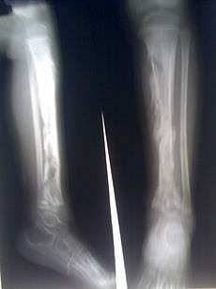
X-ray findings
It takes from 10 to 21 days for an osseous lesion to become visible on conventional radiography, because a 30–50% reduction of bone density must occur before radiographic change is apparent
Bonakdarpour A, Gaines VD (1983) The radiology of osteomyelitis. Orthop Clin North Am 14:21–33

Slide 32
X-ray findings
Localized osteopaenia and trabecular destruction are early signs of a suppurative acute process in the bone.
The type and extent of cortical destruction is variable . A wide spectrum is encountered, ranging from a solitary radiolucency to irregular, multiple radiolucencies (mottling) to a permeative pattern. The individual lesions are generally indistinct and irregular in outline.

Slide 33
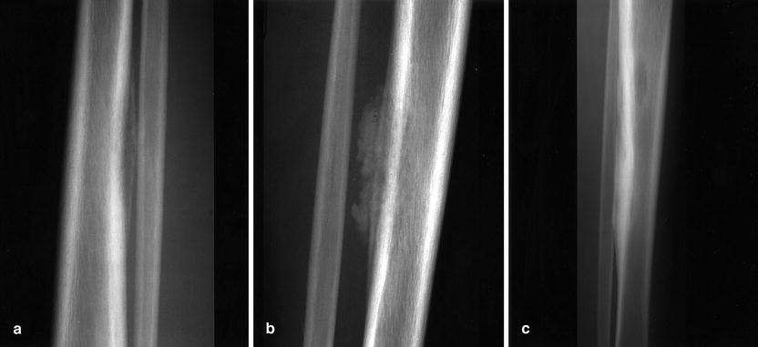

Slide 34
X-ray findings
Lamellated periosteal reactions are invariably present .
The reparative phase during therapy is characterized by endosteal and periosteal new bone formation, development of surrounding sclerosis and sometimes large osteosclerotic areas.
Soft tissue changes, such as swelling and obliteration of tissue planes, are rarely of diagnostic value in adults.
In newborns and infants, however, loss of normal fat planes within days of the onset of symptoms may be an early sign of soft tissue swelling. In this age group lamellated periosteal changes are generally discernible before any bone destruction. A late manifestation is the ballooned metaphysis, sometimes with involvement of the epiphysis.

Slide 35
Sonography
Ultrasound cannot directly access bone marrow abnormalities present in osteomyelitis but can document osteomyelitis indirectly by identifying periosseous soft tissue abnormalities
The very first sonographic sign, seen even before any periosteal reaction, is edematous swelling of the deep soft tissues
osteomyelitis affecting distal tibial metaphysis seen on ultrasound
Cardinal E, Bureau NJ, Aubin B, Chhem RK (2001) Role of ultrasound in muskuloskeletal infections. Radiol Clin North Am 39:191–201

Slide 36
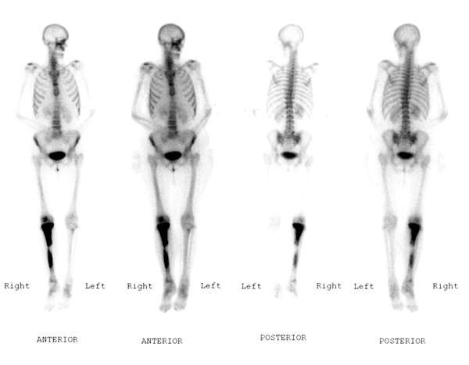
Bone scan
Radioisotopic bone scanning is valuable in early localization (within 48 hrs) of bone infection.
The specificity of radioactive isotopic imaging techniques have
improved in the evaluation of musculoskeletal infection.
Technitium-99m imaging is very sensitive , it is the choice for acute hematogenous osteomyelitis, the overall accuracy being 92%.
Bone scan revealing hot spot in right tibia

Slide 37
Ga⁶⁷ scintigraphy provides the best way to detect vertebral osteomyelitis radiologically.
In¹¹¹ labeled leucocyte imaging is the test of choice for osteomyelitis elsewhere in body.

Slide 38
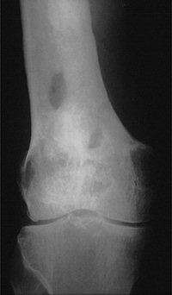
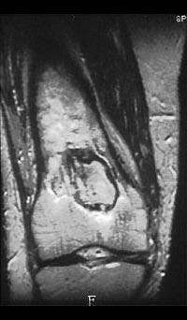
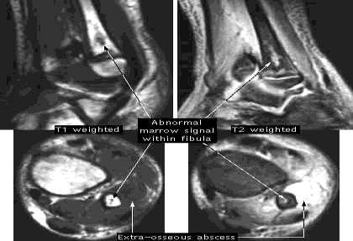
Magnetic Resonance Imaging:
Magnetic resonance imaging has very high sensitivity and specificity.
Advantage:
Useful for differentiating between bone and soft-tissue infection.
Plain film and MR images chronic osteomyelitis of right
Helpful in surgical planning.
Disadvantage:
A metallic implant in the region of interest may produce focal artifacts.
False positives in tumors and
healing fractures.
distal femur.
A case of chronic osteomylitis of fibula

Slide 39
Early diagnosis depends on following:
severe acute illness, rapid onset and toxemia
local severe pain and unwillingness to move limbs
deep tenderness
WBC count is as high as 20,000 or more
Every effort must be made to obtain a bacterial culture and determinate the sensitivity to antibiotics
Tc99m scaning
CT or MRI: MRI rather than planar bone scintigraphy should be considered for the detection of chronic non bacterial osteomyelitis lesions at diagnosis¹
1. Comparison of magnetic resonance imaging and 99mTechnetium-labelled methylene diphosphonate bone scintigraphy in the initial assessment of chronic non-bacterial osteomyelitis of childhood and adolescents. Morbach H, Schneider P Clin Exp Rheumatol. 2012 Jul 5

Slide 40
MORREY AND PETERSON’S
CRITERIA
Definition- the pathogen is isolated from bone or adjacent soft tissue as
there is histologic evidence of osteomyelitis
Probable- a blood culture is positive in setting of clinical and radiological features of osteomyelitis
Likely- typical clinical finding and definite radiographic evidence of osteomyelitis are present and response to antibiotic therapy
Morrey, B.- F. & Peterson, H. A. (1975) Hematogenous pyogenic osteomyelitis in children. Orthop. Clin. N. Amer. 6, 935-951.

Slide 41
criteria
-Pus on aspiration
-Positive bacterial culture from bone or blood
-Presence of classic signs and symptoms of acute osteomyelitis
-Radiographic changes typical of osteomyelitis
*--Two of the listed findings must be present for establishment of the diagnosis.
Peltola H, Vahvanen V (1984) A comparative study of osteomyelitis and purulent arthritis with special reference
to aetiology and recovery. Infection 12:75–79

Slide 42
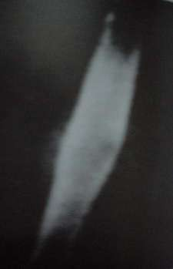
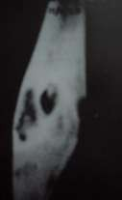
Differential diagnosi
s:
Tuberculosis –
Thin watery d/s
Undermining ,bluish discoloration
Diaphyseal involv. More common
H/o pulm. T.B.
Often multifocal
Soft tissue infection
absence of bony changes
Ewing sarcoma
radiological d/d
acute presentation
Bx is diagnostic.
Foreign body
Osteoid osteoma
Histiocytic eosinophilic granuloma
Garre’s osteomyelitis

Slide 43
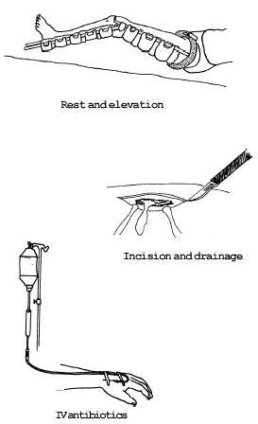
Treatment
General treatment: nutritional therapy or general supportive treatment by intaking enough caloric, protein, vitamin etc.
Antibiotic therapy
Surgical treatment
Immobilization

Slide 44
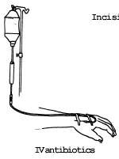
Nade’s principles
Antibiotic is effective before pus forms
Antibiotic cannot sterilise avacular tissue
Antibiotic prevents reformation of pus once removed
Pus removal restores periosteum---- restores blood flow
Antibiotic should be continued after surgery
Nade S. Antibiotics in the management of acute haematogenous osteomyelitis and acute septic arthritis in infancy and childhood. Aust New Zealand J Surg. 1978;48:78– 80

Slide 45
Prospective Evaluation of a Shortened Regimen of Treatment for Acute Osteomyelitis and Septic Arthritis in Children
Included 70 consecutive, eligible children aged 2 weeks to 14 years.
Staphylococci were the only organisms isolated in cases of osteomyelitis
Found that 59% of children could be converted to oral therapy after
3 days of intravenous therapy and 86% after 5 days.
Established that 3 weeks of oral therapy was appropriate for those patients who received 5 days or less intravenous treatment.
Journal of Pediatric Orthopaedics Issue: Volume 29(5), July/August 2009, pp 518-525

Slide 46
Nade’s indications for surgery
Abscess formation
Severely ill & moribund child with features of acute osteomyelitis
Failure to respond to IV antibiotics for >48 hrs

Slide 47
Complications
Chronic osteomyelitis- 2% in >3wks, 19% in < 3wks
Septic arthritis
Growth disturbance
Septicemia
DVT
Pulmonary embolism
Ramos OM: Chronic osteomylitis in children. Paedi Infe Dis J 2002; 21:431

Slide 48
SUBACUTE HEMATOGENOUS OSTEOMYELITIS
More insidious onset and lacks the severity of symptoms
Diagnosis typically is delayed for more than 2 weeks.
a pathogen is identified only 60% of the time
S. aureus and Staphylococcus epidermidis
The diagnosis often must be established by an open biopsy and
culture

Slide 49
classification
Type | Gledhill Classification | Robert et al. Classification
I | Solitary localized zone of radiolucency surrounded by reactive new bone formation | Ia—Punched-out radiolucency
 |  | Ib—Punched-out radiolucent lesion with sclerotic margin
II | Metaphyseal radiolucencies with cortical erosion | —
III | Cortical hyperostosis in diaphysis; no onion skinning | Localized cortical and periosteal reaction
IV | Subperiosteal new bone and onion skin layering | Onion skin periosteal reaction
V | — | Central radiolucency in epiphysis
VI | — | Destructive process involving vertebral body

Slide 50
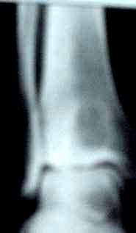
Brodie’s abcess
Bone abscess containing pus or jelly like granulation tissue surrounded by a zone of sclerosis
Age 11-20 yrs, metaphyseal area, usually upper
tibia or lower femur
Deep boring pain, worse at night, relieved by rest
Circular or oval luscency surrounded by zone of
sclerosis
Treatment:
Conservative if no doubt - rest + antibiotic for 6 wks.
if no response – surgical evacuation & curettage, if large cavity - packed with cancellous bone graft

Slide 51
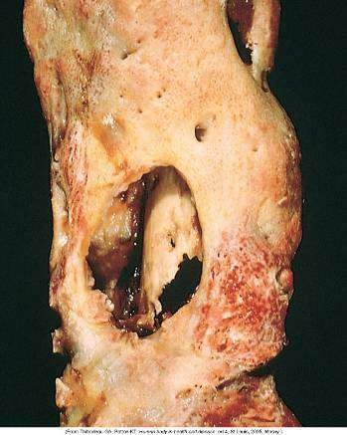
Chronic Osteomyelitis of the Femur

Slide 52
Chronic osteomyelitis
If any of sequestrum, abscess cavity, sinus tract or cloaca is present.
Hematogenous infection with an organism of low virulence may be present by chronic onset.
Infection introduced through an external wound usually causing a chronic osteomyelitis.
It is due to the fact that the causative organism can lie dormant in avascular necrotic areas occasionally becoming reactive from a flare up.

Slide 53
Classification
The two most widely used in the medical literature and in clinical practice are those presented by :
Waldvogel et al-
Osteomyelitis is described as either acute or chronic, depending on the absence or presence of dead bone.
Osteomyelitis is also classified according to the source of the infection:
hematogenous when it originates from a bacteremia
contiguous focus when it originates from an infection in nearby tissue
A third category in this classification is osteomyelitis in the

Slide 54
Classification
Cierny et al -
Includes four anatomic stages
Stage-1, or medullary, osteomyelitis is confined to the medullary cavity of the bone.
Stage-2, or superficial, osteomyelitis involves only the cortical
bone.
Stage-3, or localized, osteomyelitis usually involves both cortical and medullary bone but does not involve the entire diameter of the bone.
Stage-4, or diffuse, osteomyelitis involves the entire thickness of the bone, with loss of stability.

Slide 55
Classification
With this system, a patient with osteomyelitis is classified as an A, B, or C host.
An “A” host has no systemic or local compromising factors.
A “B” host is affected by one or more compromising factors.
Bs-systemic compromise
Bl-local compromise
Bls-both sys and local compromise
A “C” host is so severely compromised that the radical treatment
necessary would have an unacceptable risk-benefit ratio (Table I).

Slide 56
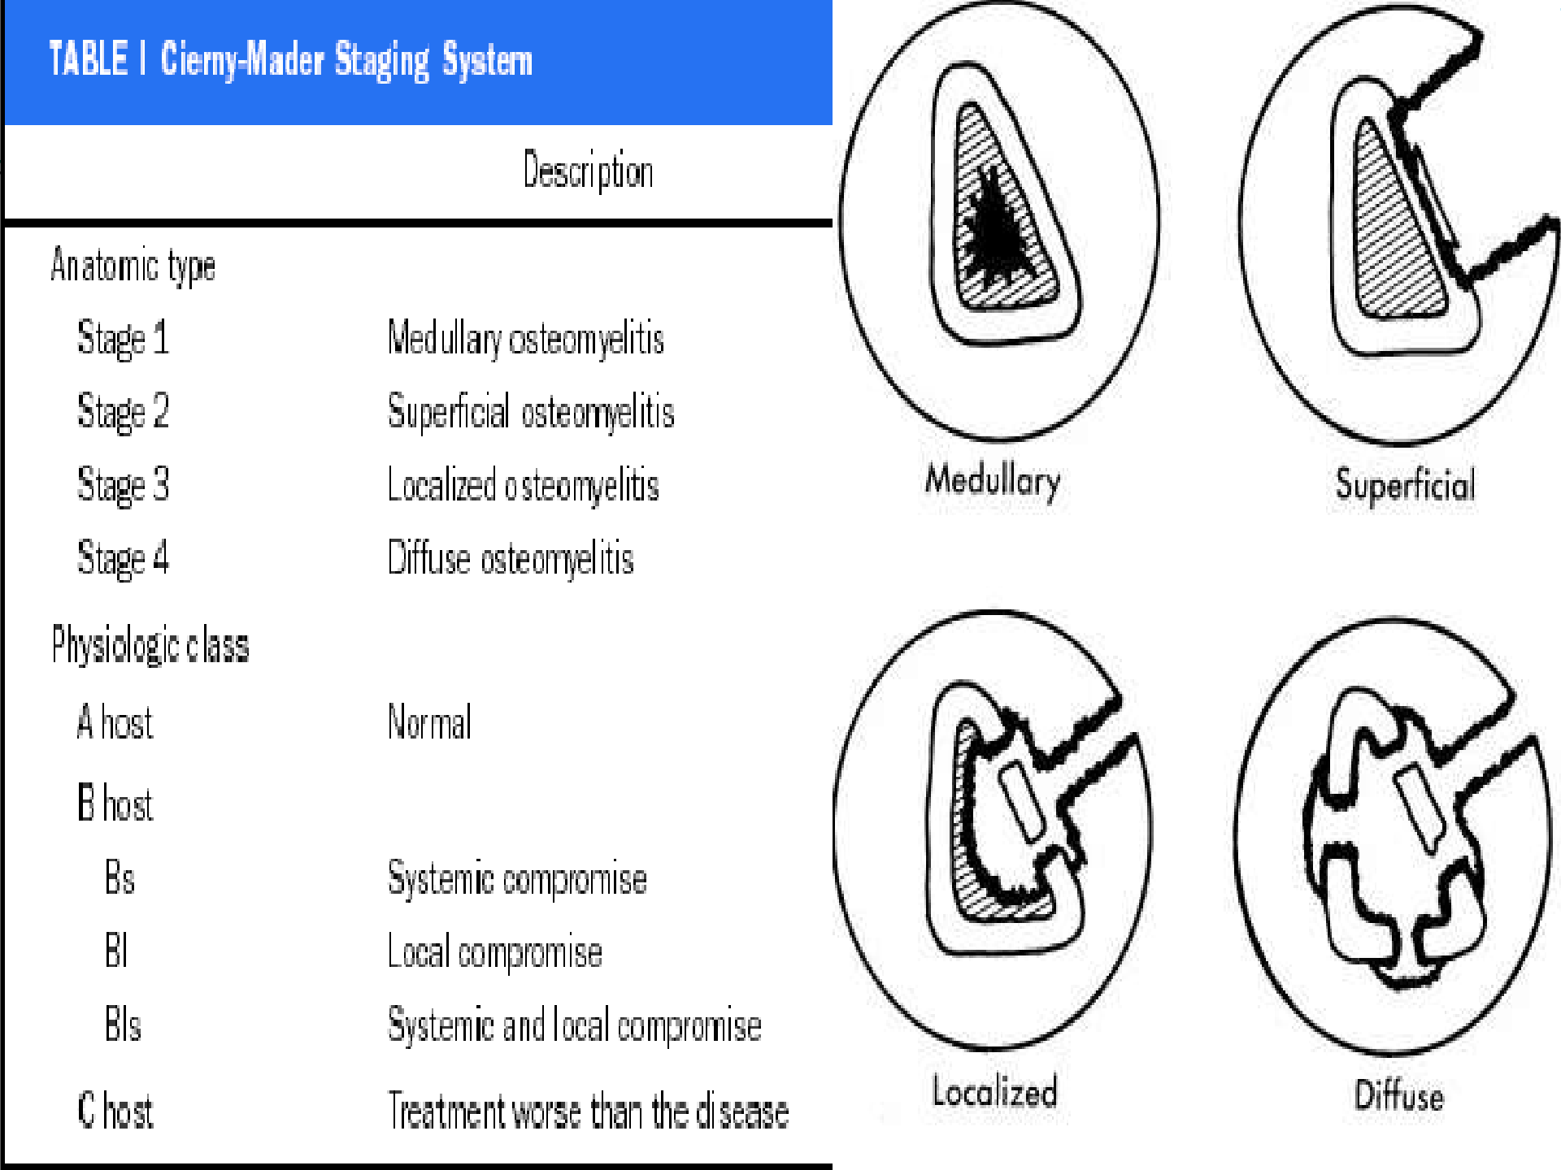

Slide 57
Clinical features
During the period of inactivity, no symptoms are present.
Only Skin-thin, dark, scarred, poor nourished, past sinus, an ulceration
that is not easily to heal
Muscles-wasting contracture, atrophy
Joint-stiffness
Bone-thick, sclerotic,
often contain abscess cavity

Slide 58
Clinical features
At intervals, a flare-up occurs,
The relapse is often the result of poor body condition and lower
resistance.
A lighting up of infection is manifested by aching pain that is worse at
night.
Locally there will be some heat, swelling, redness, tenderness, edema, because pus may build up in cavity, then a sinus may open and start to exudates purulent materials and small sequestra.
The sinus closed and the infection subsided.

Slide 59
PERIOSTEAL NEW BONE FORMATION INVOLUCRUM
SEQUESTRUM

Slide 60
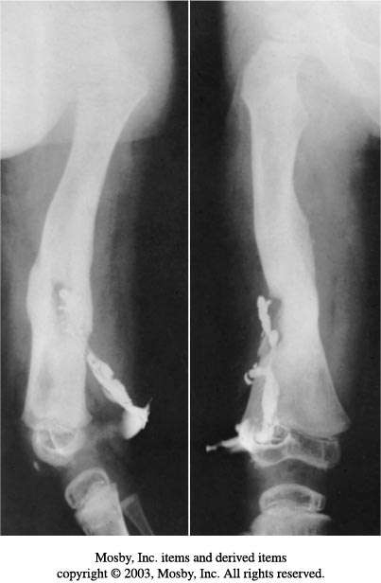
Sinography:
Sinography can be performed if a sinus track is present
Roentgenograms made in two planes after injection of radiopaque liquid into sinus.
Helpful in locating focus of infection in chronic osteomyelitis.
A valuable adjunct to surgical planning

Slide 61
¹⁸FDG PET Scan
Meta-analysis showed –Fluorodeoxyglucose positron emission tomography has the highest accuracy for confirming or excluding the diagnosis of Chronic Osteomyelitis.¹
PET/CT images allowing correct differentiation between osteomyelitis and soft-tissue infection in patients of Diabetes Mellitis when MRI picture is not clear. ²
“The Accuracy of Diagnostic Imaging for the Assessment of ChronicOsteomyelitis: A Systematic Review
and Meta-Analysis” The Journal of Bone and Joint Surgery (American). 2005;87:2464- 2471.
“FDG PET/CT imaging in the diagnosis of osteomyelitis in the diabetic foot” Kagna O, Srour S Eur J
Nucl Med Mol Imaging. 2012 Jul 17

Slide 62
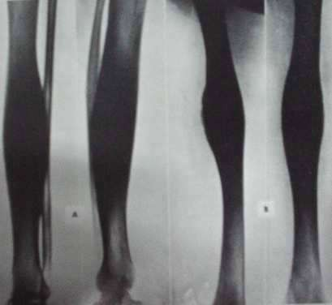
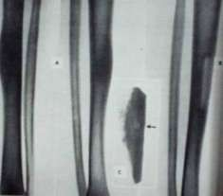
Garre’ s osteomyelitis
Sclerosing, nonsuppurative
Jaw (mandible)
No abcess, cortical thickening
Acute local pain, pyrexia subside- fusiform swelling
Acute stage-rest, antibiotics
Sx: Gutter
excision+curettage
holing,

Slide 63
Culture Blood ± bone
Treatment algorithm of
Cierny-Mader Stage-1, or
hematogenous, bone osteomyelitis.
long-
Initial antibiotic selection
Change or confirm d/o culture results
Poor response
Good response
Operative treatment unroofing ,abscess drainage, IM reaming
Continue 2 wks parenteral & 4 wks Oral antibiotics
4 wks antibiotics
Failure
Arrest
Retreat as above

Slide 64
Treatment algorithm of Cierny-Mader Stage-1 long-bone osteomyelitis associated with infection at the site of hardware
Hardware removal
Bone unstable
Bone stable
Hardware removal IM reaming
Suppressive antibiotic treatment until stabilisation
Antibiotics Continue 2 wks
parenteral & 4 wks Oral
Failure
Arrest
Retreat as above

Slide 65
Treatment algorithm Cierny-Mader
Superficial
debridement
of
Stage-2 long-bone
osteomyelitis
Biopsy & culture
Initial antibiotic selection
Change or confirm based on culture
results
± Local or microvascular coverage
Continue antibiotics for 2
wks

Slide 66
Biopsy & Culture
Treatment algorithm of Cierny-Mader Stages-3 and 4 long-bone osteomyelitis.
Debridement
Initial antibiotic selection
Hardware
removal
Change or confirm d/o
culture results
Dead space management, beads, bone grafts, & muscle flaps
6wks antibiotics
after major operative debridement
Stabilisation external fixation
Ilizarov technique
Arrest
Failure
Retreat
as above
Soft tissue coverage
Osteomyelitis in long bones, L . Lazzarini,J.T.Mader,JBJS.Am.2004;86:2305-2318

Slide 67
ANTIBIOTICS
IV antibiotics
Nafcillin/oxacillin/nafcillin with rifampcin
Vancomycin/ampicillin/cefazolin/ceftriaxone
Clindamycin/sulbactum/piperacillin/tazobactam ORAL antibiotics
Clindamycin/rifampcin/cotrimoxazole
Fluoroquinolones in gram –ve organisms
Linezolid-oral & IV antibiotics—MRSA

Slide 68
Rifampicin - 1st line anti staph antibiotic in chronic infection
It achieves intraleukocytic bactericidal action.
Ramos OM: Chronic osteomylitis in children. Paedi Infe Dis J 2002; 21:431

Slide 69
To wait is to invite disaster.
Surgical treatment

Slide 70
Bone Debridement:
The goal of debridement is to leave healthy, viable tissue.
Débridement of bone is done until punctate bleeding is noted, giving rise to the term the paprika sign.
Copious irrigation with 10 to 14 L of normal saline.
Pulsatile lavage using fluid pressures 50-70 pounds per square inch and 800 pulses per min.
The extent of resection is important in B hosts as B hosts treated with marginal resection (i.e., with a clearance margin of <5 mm) found to have a higher rate of recurrence than normal hosts.^{A}
Repeated debridements may be required.
A.Simpson AH, Deakin M, Latham JM. Chronic osteomyelitis. The effect of the extent of surgical resection on infection-free survival. J Bone Joint Surg Br. 2001;83:403-7.

Slide 71
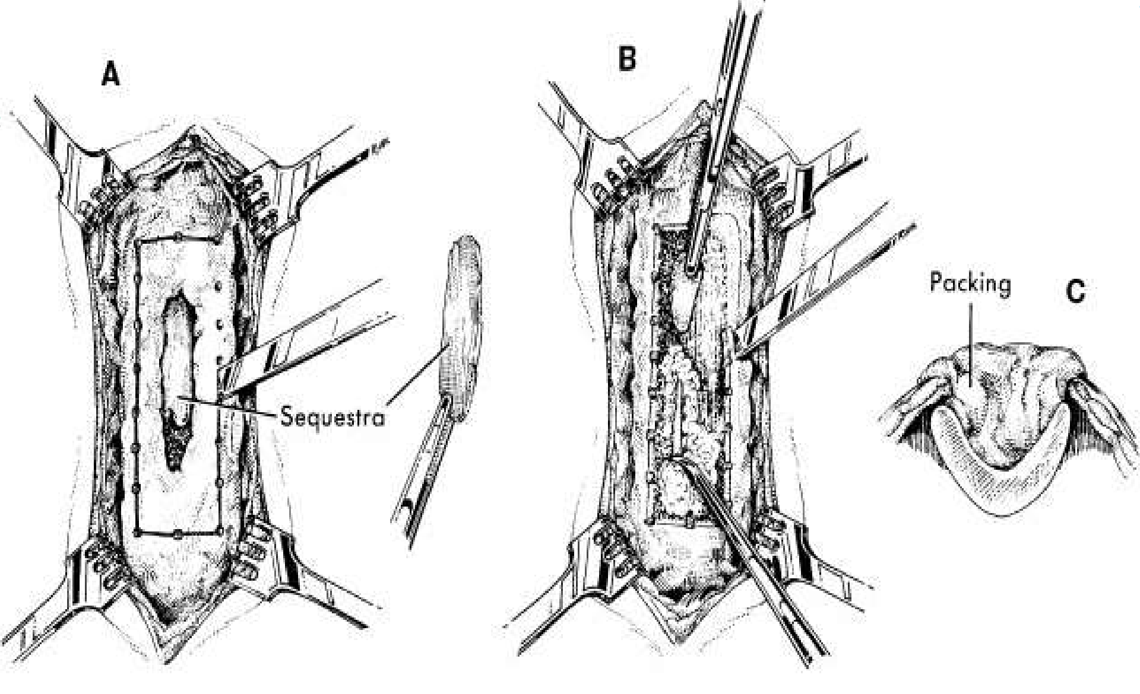
Sequestrectomy and curettage. A, Affected bone is exposed, and sequestrum is removed. B, All infected matter is removed. C, Wound is either packed open or closed loosely over drains.

Slide 72
When to do sequestrectomy?
Early sequestrectomy
- Eradicate infection
-Better environment for periosteum to respond
Delayed sequestrectomy
Wait till sufficient involucrum has
formed before doing a sequestrectomy
to mimimize the risk of fracture,
deformity & segmental loss
In either case
preferable to wait
it is critical to preserve the involucrum
at least 3-6 months before
performing a sequestrectomy

Slide 73
Prerequisites for Sequestrectomy
Radiological
Well formed involucrum surrounding the discretely visible sequestrum adequately at least 2/3rd diameter of bone (3 intact walls on two views ensure 3/4th intact walls)
Clinical
Symptomatic patient with pus discharge or chronic unreleaved disabling pain due to osteomyelitis per se and type A/B host.

Slide 74
Post sequestrectomy
NO STABLISATION IS NECESSARY WHEN 70% OF THE ORIGINAL CORTEX REMAINS INTACT
If >70% cortical volume has been retained—protect by cast
Greater bone loss-Ext fix
Focal bone loss-open cancellous BG/conventional BG
Seg. bone loss—BG/Bone
transport/other devices
Radiologically if cortical continuity of the involucrum is 50% of the over all cortical diameter on 2 orthogonal views then the involucrum is structurally adequate

Slide 75
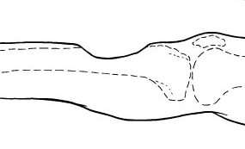
Saucerization
Extension of surgical debridement
Debrided wounds left open widely through excision of overhanging soft tissue and bone
Wounds drain freely
Abscesses do not form
Limited to areas where it causes acceptable loss of function e.g. Tibia and femur
May require stabilization

Slide 76
Management of Dead Space:
Adequate debridement may leave a large bone defect, termed a dead
space.
It is a predisposing condition for the persistence of infection because it is poorly vascularized.
Appropriate management of any dead space created by debridement is mandatory
to arrest the disease
to maintain the integrity of the skeletal part.
Help improve the local biological environment by bringing in a blood
supply important for
host defense mechanisms
antibiotic delivery
osseous and soft-tissue healing.
The goal of dead space management is to replace dead bone and scar tissue with durable vascularized tissue.

Slide 77
Management of Dead Space:
A free vascularized bone graft has been used successfully to fill dead space. e.g.the fibula or ilium.
Local tissue flaps or free flaps can also be used to fill dead space.
Cancellous bone grafts beneath local or transferred tissues can also be used where structural augmentation is necessary.
Open cancellous grafts without soft-tissue coverage are useful when a free tissue transfer is not an option and local tissue flaps are inadequate.
Careful preoperative planning is critical to the conservation of the
patient’s limited cancellous bone reserves.

Slide 78
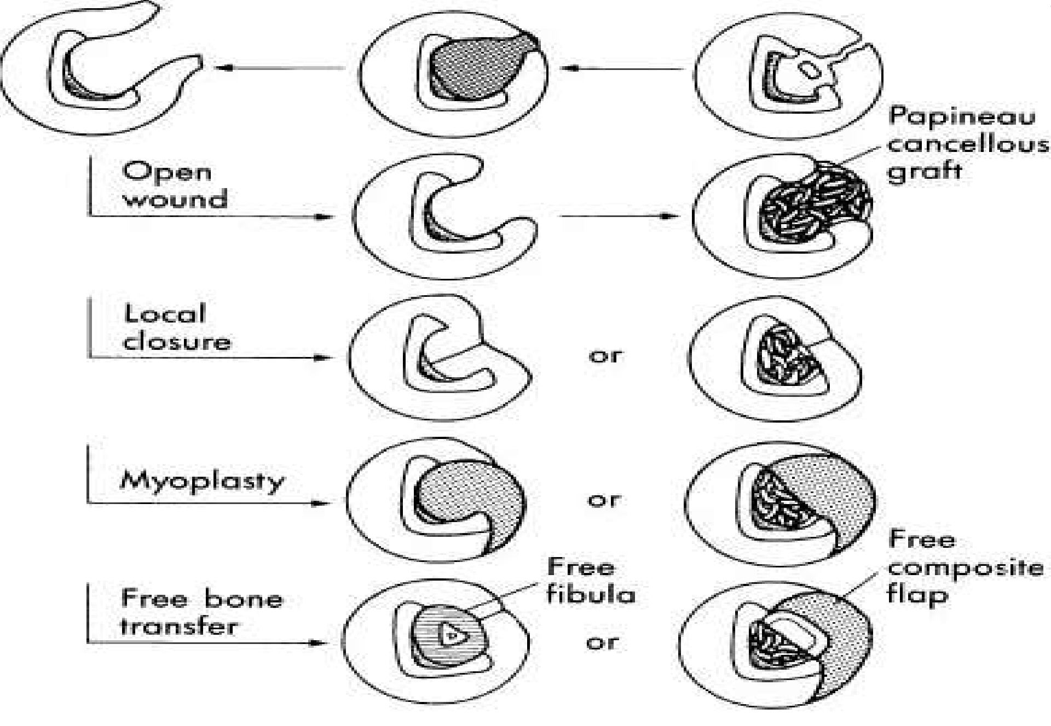
Four basic methods of immediate, biological management of dead space using living tissue or cancellous bone grafts.

Slide 79
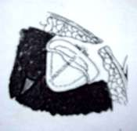
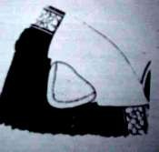
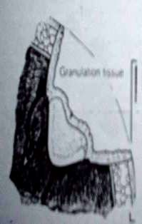
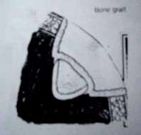
Dead space management
RHINELANDER –PAPINEAU TECHNIQUE
3 STAGES
Debridement
stabilization if necessary
ext. fixator preferable.
Rhinelander used cast.
Papineau-IM nails.
Cancellous bone grafting-after entire cavity is covered with granulation tissue
Best donor site- post. Ilium
others-gt. Trochanter,distal femur, proximal tibia.disadv. include pathological #
Cut into small pieces-3-4mm thick and 4-6cm long
all cortical pieces discarded
chips packed fingertight .
No dead space allowed
over period of several weeks
,slowly invaded by granulation tissue &become vascularized

Slide 80
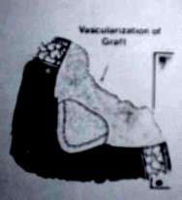
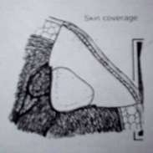
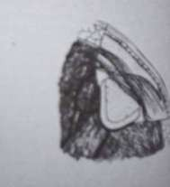
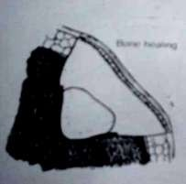
3.wound coverage
Small wounds –spontaneous epithelization
Large wound-SSG or other soft tissue procedure, usually after 8-16 wks.
Ext. fixator removal
Protected wt. Bearing
Failure of granulation tissue to invade the graft with loss of surface chips-repetition of tech.( mini –papineau )
LIMITATIONS-cannot be used when:
Segmental defect >4 cm.
Poor quality soft tissue
Poor vascular supply

Slide 81
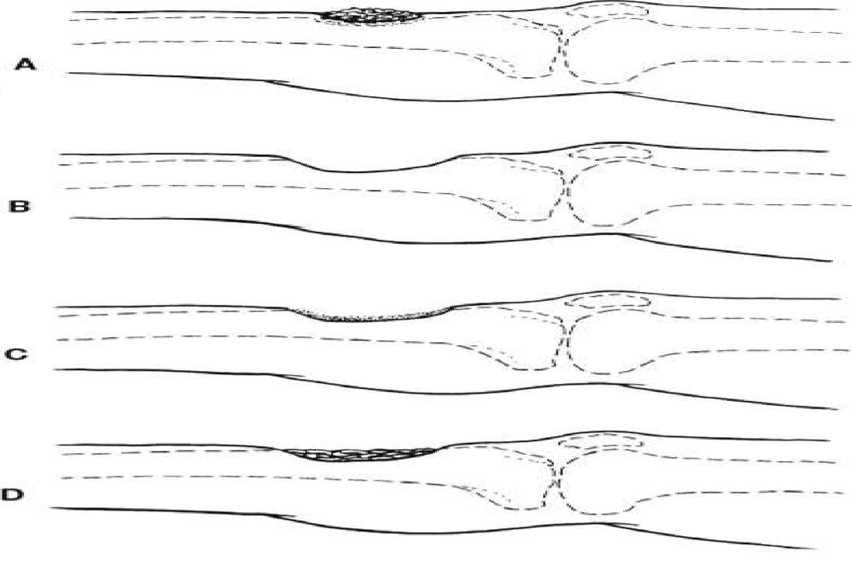
Papineau technique:

Slide 82
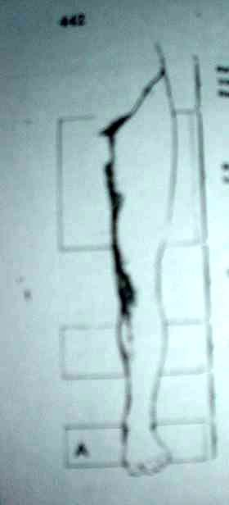
Muscle flaps
Increases the blood supply to that area.
Superior to skin flaps .
Obliterates dead space in irregularly contoured
osseous cavity.
Resistance to recurrent sepsis.
Gastocnemius most common -covers proximal 1/3 of
tibia , knee, distal 1/5 of femur.
Not used in –distal 1/3 tibia, midfoot, forefoot.
Cross leg flaps-prolonged immobilization, exposes
normal extremity to infection.

Slide 83
Indications :
Adjacent soft tissue cannot cover the area.
Area should anatomically permit transportation of a local muscle flap without compromising its neurovascular bundle.
Debridement procedure hasn’t compromised the mechanical integrity of osseous structures.
Gross purulence has been eliminated.

Slide 84
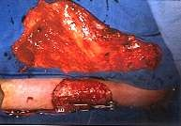
Vascularized muscular & musculocutaneous flaps
Pedicle flap, free flap
Assessment:
size of wound & muscle
size & length of pedicle
nearest good recipient vessels
recipient vessels- palpation, doppler-arteriogram
position of pt. On table.
L. dorsi (most common ), gracilis, TFL, omentum
Omentum- flexible, covers large irregular defects, long pedicle.
Disadv: complications of laprotomy.

Slide 85
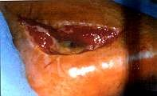
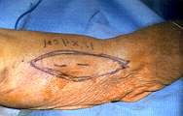
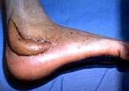

Slide 86
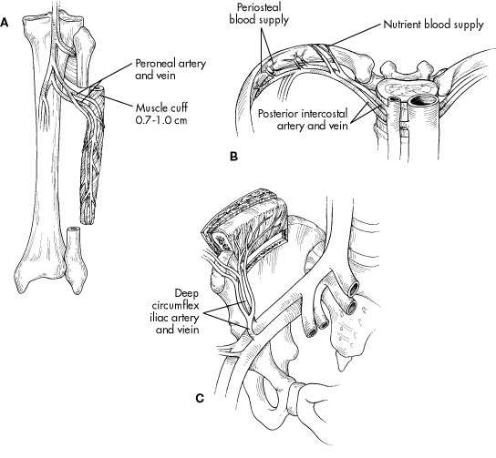
transfer
Indications :
restoration of bone mass with soft
tissue coverage
>6 cm. in length
Fibula, iliac crest, ribs, lat. Scapula, metatarsal,lat. portion of radius.
Fibula:
based on 1 or more nutrient vascular perforators
include a flap of muscle [PB,PL,FHL]
most useful for defects >10 cm.
length-6-35 cm.
Iliac crest:
based on multiple nutrient perforators from deep circumflex iliac vessels
useful for shorter defects<8cm.

Slide 87
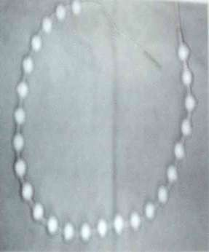
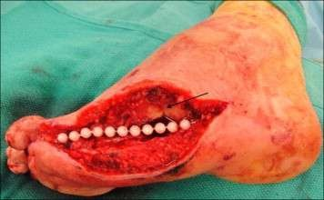
Management of Dead Space:
Antibiotic Beads
May be used to sterilize and temporarily maintain a dead space.
Beads are made with PMMA+ab
Cement -40 gm.
Genta- 1-2 gm. or vanco 1-2 gm.
Other antibiotics that can be used are Tobramycin, Penicillin, cephalosporins, amikacin, vancomycin.
The gentamycin concentration remain for 30 days
after implantation.
The shape and type of methylmethacrylate has a significant effect on the amount of antibiotic delivery, as well as duration.
The best delivery profile was with PMMA beads
impregnated with gentamicin.ª
Usually removed within two to four weeks and are replaced with a cancellous bone graft.
a. Patzakis MJ, Mazur K, Wilkins J, et al. Septopal beads and autogenous bone grafting for bone defects in patients with chronic osteomyelitis. Clinical Orthopaedics and Related Research 1993, 295: 112–8.

Slide 88
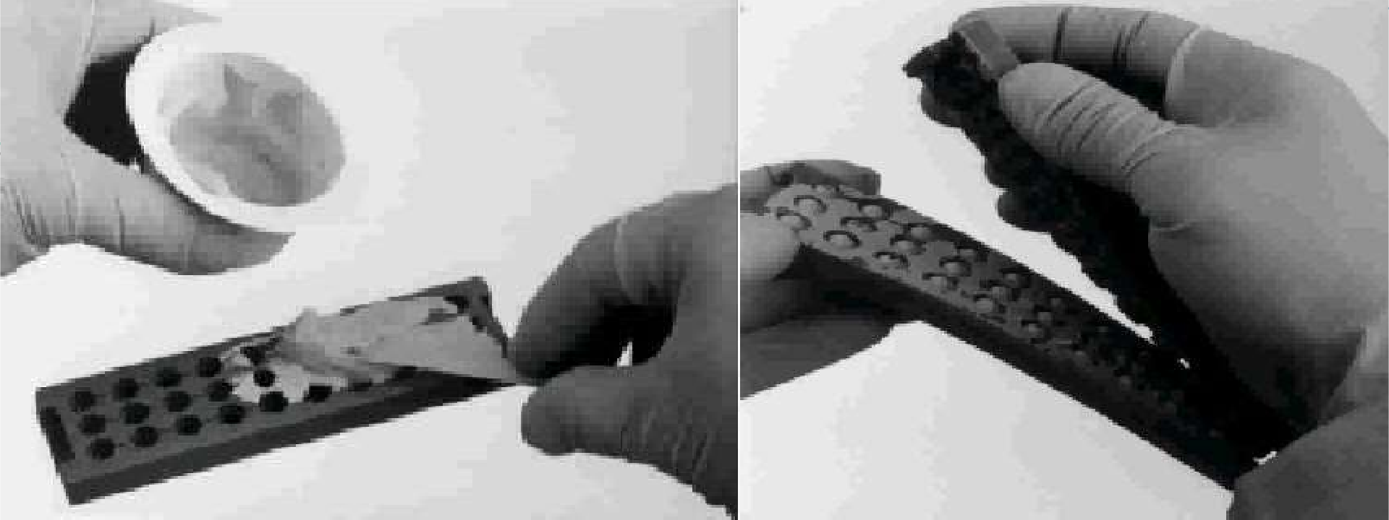
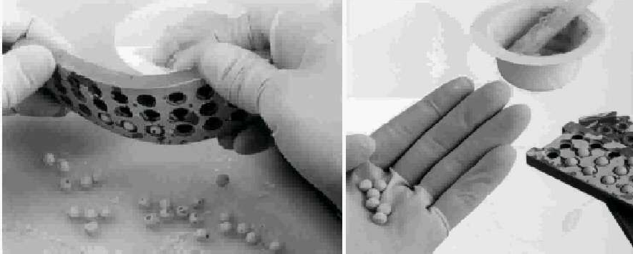
Preparation of antibiotic beads

Slide 89
Antibiotic beads:
Nelson et al found the delivery of both gentamicin and tobramycin at day one ranged from 88 to 807 µg/ml respectively.
There was a significant dropoff in the amounts at day two, and a much more gradual decrease out to 30 days.
By day 30, between 1 and 28 µg/ml of antibiotic was delivered respectively.
The rate of arrest of osteomyelitis has ranged from 55% in a study of fifty-four patientsª to 96% in a study of forty-six patients^{b}.
Cho SH, Song HR, Koo KH, Jeong ST, Park YJ. Antibiotic-impregnated cement beads in the treatment of chronic osteomyelitis.
Bull Hosp Jt Dis. 1997;56:140-4.
Modi SP, Eppes SC, Klein JD. Cat-scratch disease presenting as multifocal osteomyelitis with thoracic abscess. Pediatr Infect Dis J.
2001;20:1006-7.

Slide 90
Antibiotic beads:
Can act as a biomaterial surface to which bacteria preferentially adhere.
To avoid such a problem, biodegradable antibiotic-impregnated (calcium sulfate) beads have been employed recently and have shown favorable antibiotic release kinetics^{c}.
Elution testing of 4% by weight loaded calcium sulfate pellets revealed a maximum concentration of 828 µg/ml and undetectable levels by day 15.
Antibiotic-impregnated cancellous bone grafts were recently used in a clinical trial of forty-six patients, and the osteomyelitis was arrested in 95% of them^{d}.
c. Steven Gitelis and Gregory T. Brebach: The treatment of chronic osteomyelitis with a biodegradable antibiotic-impregnated implant Journal of Orthopaedic Surgery 2002, 10(1): 53–60
d. Chan YS, Ueng SW, Wang CJ, Lee SS, Chen CY, Shin CH. Antibioticimpregnated autogenic cancellous bone grafting is an effective and safe method for the management of small infected tibial defects: a comparison study. J Trauma. 2000;48:246-55.

Slide 91
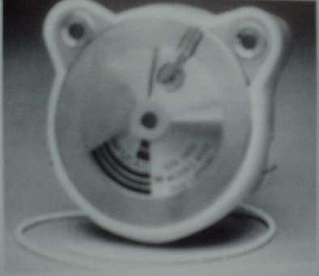
Management of Dead Space:
Antibiotics (clindamycin and amikacin) have also been delivered directly into dead spaces with an implantable pump.
Very high local and low systemic levels of antibiotics have been achieved.

Slide 92
Management of Dead Space:
Use of vacuum-assisted closure system, a device that applies localized negative pressure over the surface of wounds and aids in the removal of fluids.
useful as an adjunct therapy for high-energy soft-tissue injuries.^{a,b}
o Tigecycline-impregnated hydroxyapatite can have a potential in the treatment of chronic osteomyelitis of methicillin-resistant S. aureus origin, which may be considered as a therapeutic alternative by surgeons dealing with osteomyelitis.^{c}
Mooney JF, Argenta LC, Marks MW, Morykwas MJ, DeFranzo AJ. Treatment of soft tissue defects in pediatric patients using the V.A.C. system. Clin Orthop. 2000;376:26-31.
Herscovici D Jr, Sanders RW, Scaduto JM, Infante A, DiPasquale T. Vacuum-assisted wound closure (VAC therapy) for the management of patients with high-energy soft tissue injuries. J Orthop Trauma. 2003;17: 683-8.
Kaya M, Simşek-Kaya G Local treatment of chronic osteomyelitis with surgical debridement and tigecycline-
impregnated calcium hydroxyapatite: an experimental study. Oral Surg Oral Med Oral Pathol Oral Radiol. 2012 Mar;113(3):340-7.

Slide 93
Vacuum-assisted closure
system:

Slide 94
Vacuum-assisted closure
system:

Slide 95
Closed suction drains
DRAIN
Suction double lumen catheter
Tubes with separate stab wound
4 hrly antibiotics
cleaned shortly before next instillation
More tidy than continuous suction irrigation which normally fails due to leakage.
Continued till effluent is sterile
tubes are gradually withdrawn
as cavity
diminishes.
meticulous care & supervision.
Wound
closed/open
close if no significant cellulitis,
abcess,
adequately debrided wound
if any doubt – leave open
Abandoned by many contamination and infection.
due to secondary

Slide 96
Soft-Tissue Coverage:
Three methods commonly used:
Primary closure- if no infection
Let tissue heal by secondary intention
Small soft-tissue defects may be covered with a split-thickness
skin graft.
Local muscle flaps and free vascularized muscle flaps in the presence of a large soft-tissue defect or an inadequate soft-tissue envelope.
Healing by so-called secondary intention should be discouraged, since the scar tissue that fills the defect may later become avascular.

Slide 97
Bone Stabilization:
If skeletal instability is present at the site of an infection, measures must be taken to achieve stability with
Plates
Screws
Rods
An external fixator
External fixation is preferred over internal fixation because
of the tendency of the sites of medullary rods to become secondarily infected and to spread the extent of the infection.
Rigid fixation helpful in union of fracture sites.

Slide 98
Limb reconstruction:
Ilizarov external fixation
Is used for reconstruction of segmental defects and difficult infected nonunions.
Based on the technique of distraction osteogenesis whereby an osteotomy created in the metaphyseal region of the bone is gradually distracted to fill in the defect.
Used for difficult cases of osteomyelitis when stabilization and bone-lengthening are necessary.
May also be used to compress nonunions and to correct malunions.

Slide 99
Limb reconstruction:
Disadvantages:
The technique is laborintensive and requires an extended period of treatment with the device, averaging 8.5 months.
In addition, the sites of the wires or pins usually become infected
and the device is painful.
In studies in which this technique was used, osteomyelitis arrest rates have ranged between 75% in a series of twenty-eight patientsª and 100% in a series of thirteen patients^{b}.
Cattaneo R, Catagni M, Johnson EE. The treatment of infected nonunions and segmental defects of the tibia by the methods of lizarov. Clin Orthop. 1992;280:143-52.
Morandi M, Zembo MM, Ciotti M. Infected tibial pseudarthrosis. A 2-year follow up on patients treated by the Ilizarov technique.
Orthopedics. 1989;12:497-508.

Slide 100
AMPUTATION:
Infrequently performed
INDICATIONS
Malignancy
Arterial insufficiency
Nerve paralysis
Jt. Contracture & stiffness making limb nonfunctional

Slide 101
Complementary therapies:
Hyperbaric oxygen:
Augment host immune system
Allow formation of peroxides
Promote wound healing
Electrical stimulation :For non unions with acceptable alignment
Types:
direct current
Inductive coupling
Capacitive coupling
Ultrasound: low intensity

Slide 102
Complications :
Acute exacerbations- most common
Growth abnormalities
Deformities
Pathological #
Jt. Stiffness
Amylodosis
Malignancy(0.25%) –sq. cell carcinoma most common, reticulam cell carcinoma,fibrosarcoma
Septic arthritis- hip, ankle, shoulder
,elbow

Slide 103
CASE REPORT
Histoplasma Osteomyelitis
Simulating Giant-Cell Tumor of the Distal Part of the Radius
The Journal of Bone and Joint Surgery (American). 2010;92:708-714.

Slide 104
its role for distal humerus
Barnea Y etal -the free fibula flap and reconstruction .¹
Koort JK etal²
based on controlled ciprofloxacin release from poly (D/L-lactide).
therapeutic level of ciprofloxacin (>2microg/mL) between 60 and 300 days.
a promising option as resorbable carriers.
was maintained
Ross JJ³
described role of angiogenic gene and agents in treatment of osteomyelitis.
Recommended studies of various agents like vascular endothelial growth factor (VEGF) , placental growth factor , sonic hedgehog, bone morphogenetic proteins, matrixmetalloproteinase-9, secretoneurin, and pluripotent stem cells
1.
Barnea Y, Amir A, Shlomo D, Cohen N, Zaretski A, Leshem D, Miller E, Meilik B, Kollender Y, Meller I, Bickels J, Gur E. Free fibula flap elbow-joint hemiarthroplasty reconstruction for chronic osteomyelitis of the distal humerus. J Reconstr Microsurg. 2006 Apr;22(3):167-71.
Koort JK, Suokas E, Veiranto M, Makinen TJ, Jalava J, Tormala P, Aro HT.In vitro and in vivo testing of bioabsorbable antibiotic containing bone filler for osteomyelitis treatment.J Biomed Mater Res A. 2006 Sep 1;78(3):532-40.
Ross JJ. Angiogenic gene therapy as a potential therapeutic agent in chronic osteomyelitis. Med Hypotheses. 2006;67(1):161-3. Epub 2006 Mar 7.
2.
3.

Slide 105
Archdeacon MT etal described Modern papineau technique with
vacuum-assisted closure.⁴
Results encouraging.
Vestn Khir Im I I Grek – use of laser osteoperforation.⁵
Hong JP etal- use of anterolateral thigh perforator flaps in chronic osteomyelitis of thelower extremity.⁶
Di Silvio L etal⁷
biodegradable drug delivery system
the use of a degradable gelatin DDS, for the combined release of therapeutic levels of both gentamicinand growth hormone (GH)
a promising DDS for the management of acute and chronic bone and tissue infection
4.
5.
6.
7.
Archdeacon MT, Messerschmitt P. Modern papineau technique with vacuum-assisted closure.J Orthop Trauma. 2006
Feb;20(2):134-7.
Krochek IV, Privalov VA, Lappa AV, Nikitin SV.[The clinical-morphological estimation of the results of laser osteoperforation in treatment of chronic osteomyelitis] Vestn Khir Im I I Grek. 2004;163(6):68-72. Russian
Hong JP, Shin HW, Kim JJ, Wei FC, Chung YK. The use of anterolateral thigh perforator flaps in chronic osteomyelitis of the lower extremity.Plast Reconstr Surg. 2005 Jan;115(1):142-7.
Di Silvio L, Bonfield W. Biodegradable drug delivery system for the treatment of bone infection and repair. J Mater Sci Mater Med. 1999 Oct-Nov;10(10/11):653-8.

Slide 106
Hashmi MA etal⁸
The management of chronic osteomyelitis using the Lautenbach
method
Involves:
debridement.
intramedullary reaming.
the insertion of double-lumen tubes to establish both a local antibiotic delivery system and cavity analysis for volume and culture .
The end-point of treatment is
the irrigate produces three consecutive clear cultures
improvement in the blood indices
obliteration of the cavity volume.
Recommended for long-standing complex cases.
8.
Hashmi MA, Norman P, Saleh M. The management of chronic osteomyelitis using the Lautenbach method. J Bone Joint Surg Br. 2004 Mar;86(2):269-75.

Slide 107
THANK YOU

