Slide 1
CARBON MONOXIDE POISONING
Dr.Richa Tripathi
ASSISTANT PROFESSOR
DEPT.OF FORENSICS MEDICINE AND TOXICOLOGY

Slide 2
At the end of this session you will be able to
Know the sources of carbon monoxide
Understand the action of carbon monoxide
Explain the signs and symptoms of carbon monoxide poisoning
Understand the postmortem appearance and medicolegal importance of CO poisoning
Know the treatment of CO poisoning
OBJECTIVES

Slide 3
Asphyxiants deprive the body of oxygen.
Simple asphyxiants displace oxygen from the lungs
systemic asphyxiants interfere with transport of oxygen by hemoglobin or with mitochondrial oxidative phosphorylation.
Asphyxiants may be gases, liquids, or solids, or their metabolites.
ASPHYXIANT S

Slide 4
The typical clinical picture
progressive mental status changes
Alteration of breathing
Progressively abnormal vital signs
Coma
Seizures
Eventually cardiovascular collapse and death

Slide 5
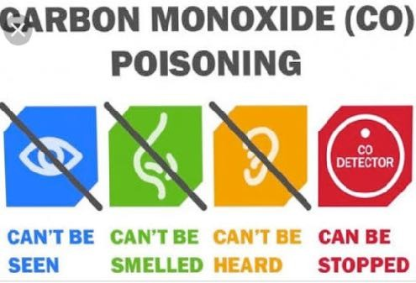
CO POISONING

Slide 6
Example for chemical asphyxiant which Prevents oxygen utilisation by combining with Hb or Acting on tissues
Other examples –hydrogen sulphide,cynide
CARBON MONOXIDE

Slide 7
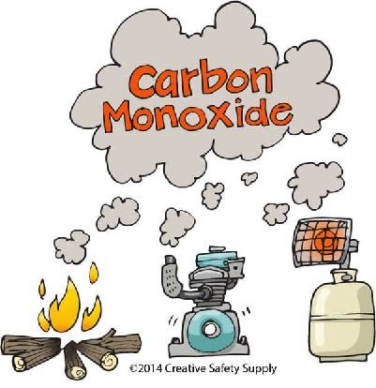

Slide 8
Colourless
Tasteless
Odorless
Non irritating gas
Produced due to incomplete combustion of Carbon
Lighter than air
Burns with blue flame
PROPERTIES

Slide 9
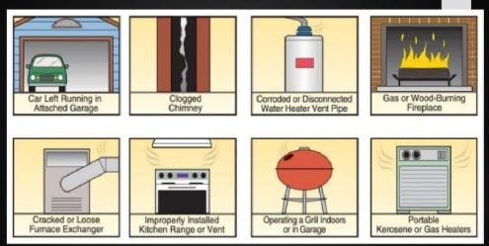
SOURCES

Slide 10
Gas space heaters
Furnaces and chimneys
Back drafting/vent pipes
Gas stove
Generators&other gasoline powered equipments
Automobile exhaust
SOURCES

Slide 11
Reducing oxygen transportation (binding with Hb)
Decreasing oxygen storage capacity (binding with myoglobin)
Inhibiting cellular respiration (On mitochondrial cytochrome oxidase)
ACTION

Slide 12
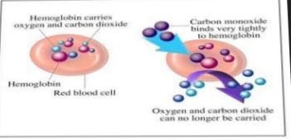
TOXICOKINETICS

Slide 13
Multiple toxic properties
Major one is the displacement of oxygen from Hb,forming COHb(imparts cherry red colour)
Hb has stronger affinity( 200 times more) for CO
CO binds with myoglobin,(affinity is 40times more than oxygen)→myocardial inhibition→hypotension→ventricular arrhythmias →cardiacc arrest
TOXICOKINETI CS

Slide 14
ACUTE POISONING
Early– non specific
classical
2classical features (rare)
Cherry red colour of tissues and blood
Cutaneous blisters
SIGNS & SYMPTOMS

Slide 15
Based on severity
Mild(<30% of COHb)
Moderate (30-40%)
Severe(>40%)

Slide 16
Acute poisoning
Mild
Headache
Nausea
Vimiting
Dizziness
Exertional dyspnoea
SIGNS & SYMPTOMS

Slide 17
Moderate
Chest pain
blurred vision
confusion
Weakness
Tachycardia
Ataxia
Increasing dyspnoea
tachypnoea

Slide 18
Severe
Trismus
Muscle spasms
Convulsions
Palpitations
Disorientation
Ventricular arrhythmia
MI
Hypotension
Respiratory failure
Coma

Slide 19
Headache, dizziness, Weakness
Nausea,Vomiting, abdominal pain
Paraesthesia
Palpitation
Hyperthermia
Hypertension
Cherry red Skin
Visual disturbance
Aggravation of angina
CHRONIC POISONING

Slide 20
Mild
Headache
Nausea and vomiting
Blurred vision
Dizziness
Shortness of breath
Carboxy haemoglobin
<15-20%

Slide 21
Moderate
Worsening headache
Confusion
Syncope
Chest pain
Dyspnoea
Tachycardia
Tachypnea
Weakness
Carboxy Hb 21-40%

Slide 22
Severe
Dysrhythmia
Palpitationn
Cardiac ischaemia
Hypotension
Confusion
Respiratory arrest
Coma
Pulmonary oedema
seizures
Cardiac arrest
Carboxy Hb 41-59%

Slide 23
Carboxy Hb
>60%
Fatal(anaemic hypoxia)

Slide 24
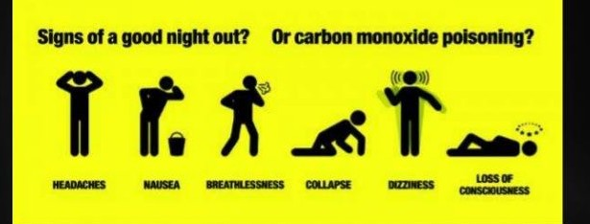

Slide 25
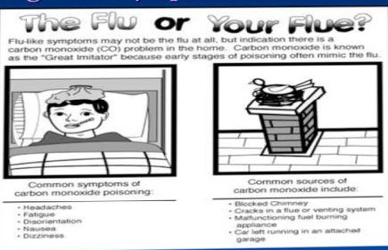

Slide 26
Uncommon as it’s not accumulated
However repeated exposure may lead to this especially in heavy smokers, pregnancy, Higher altitude
The foetus is vulnerable—causes malformations,LBW,and death
CHRONIC TOXICITY

Slide 27
LATE COMPLICATION S
Personality disorders
Parkinsonism
Depression
Short term memory loss

Slide 28
External
Cherry red colour –skin,MM,PM staining, tissues and internal organs
Usually it is associated with COHb level,>30%CO
In dark skinned individuals,fingernail beds can be examined
Fine froth at nostrils/mouth
Blisters of skin over dependent areas or bony pressure points like buttocks,calves,wrists and knees due to cutaneous edema
POSTMORTE M APPEARANCE

Slide 29
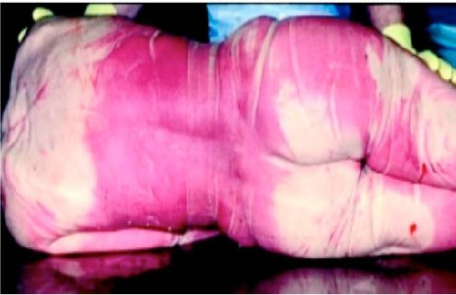
Cherry red PM staining

Slide 30
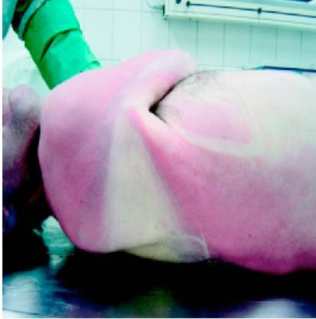

Slide 31
Internal
Cherry red colour of blood and tissues
Pulmonary oedema And congestion
Heart– lesions vary from petechiae haemorrhage to myocardial necrosis
Cerebral oedema
Punctiform haemorrhage and softening of cerebral cortex &corpus striatum (esply in globus pallidus)
Necrosis & cavitation of basal ganglia&globus pallidus

Slide 32
First aid is to remove the victim from source of exposure
Begin CPR if needed
100%oxygen By a tight fitting oxygen mask
Hyperbaric oxygen
Electrolyte balance
TREATMENT

Slide 33
Hyperbaric oxygen is a treatment in which a patient breathes 100% oxygen intermittently while inside a treatment chamber at a pressure higher than at sea level pressure (ie, >1 atm).

Slide 34
Common mode of suicidal poisoning
Accidental is also common from the sources
Unintentional fatalities occur in stationary vehicles from malfunctioning exhaust system
Homicide– uncommon( Exhaust fumes used to poison an immobilised person)
MEDICOLEG AL IMPORTANCE

Slide 35
A victim of CO poisoning can be placed in bed to simulate natural death
Masochistic sexual asphyxia may be due to CO
Heavy smokers have COHb upto 10%
COHb can be detected even in putrefied/ embalmed body,and it’s not a product of putrefaction

Slide 36
Simple asphyxiant which displaces oxygen
CARBON DIOXIDE POISONING

Slide 38
Heavy
Colourless
Odourless
Slightly irritating gas
Constituent of atmospheric air(0.04%)
Slightly acidic in taste
PROPERTIES

Slide 39
Formed during
Respiration
Combustion
Fermentation & putrefaction of organic matter
Mine explosion
Refrigerating plants
Solid form is known as dry ice
Formed in old wells,mine shafts,and damp cellars
SOURCES

Slide 40
Pure Carbon dioxide →vagal inhibition along with glottis spasm→instant death
All symptoms are due to lack of oxygen
ACTION

Slide 41
Fatal concentration
Minimum– 25-30%
Maximum– 60-80%
FP
Instant collapse &death
FATAL CONCENTRATI ON &FATAL PERIOD

Slide 42
Blood Carbon dioxide level(%) | Signs & symptoms
0-2 | No symptoms
2-5 | Increased respiration throbbing headache
5-10 | Hyperpnoea Tinnitus Mental confusion Muscular tremor
10-20 | Slow respiration Fall in BP
20-40 | Dyspnoea Muscular weakness Fall in BP Loss of reflexes
SIGNS & SYMPTOMS

Slide 43
Blood Carbon dioxide level(%) | Signs & symptoms
40-60 | Dyspnoea Feeling of tightness in chest Tinnitus Muscular weakness Drowsiness Unconsciousness Coma Death
60-80 | Immediate unconsciousness Convulsions Death due to asphyxia(cerebral hypoxia)
SIGNS & SYMPTOMS

Slide 44
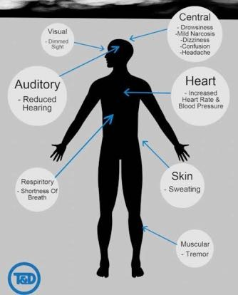

Slide 45
Shift to fresh atmosphere
Maintain body warmth
Artificial respiration with oxygen therapy
IV
Cardiac stimulants can be used
TREATMENT

Slide 46
Features of asphyxia
Cyanosis
Dilated pupils
Marked capillary and venous congestion
Petechiae haemorrhage
Froth at nostrils&mouth
Blood– dark and fluid
Deep congestion of viscera
POST MORTEM APPEARANCE

Slide 47
Mostly accidental
As the gas being heavier settle at bottom And affect workmen associated with well sinking,well cleaning & descending in pits
Blood carbon dioxide accumulates during postmortem.
Of critical importance is analysis of air sample collected from the scene for carbon dioxide content
Sometimes anaesthetist causes fatality by giving carbon dioxide instead of oxygen by mistake
MEDICOLEG AL IMPORTANCE

Slide 48
