Slide 1
BARYTA CARBONICA
PRESENTED BY-
Dr. Diksha Goyal
Assistant Professor
Department of Homoeopathic Materia Medica

Slide 2
BARYTA
carbonica
Deep acting constitutional remedy. Remedy for extremes of life.(Ant cr.) Predominantly remedy for children and old people.

Slide 3
COMMON NAME-
Barium Carbonate (BaCo3)
Pure white, dense, soft powder. Tasteless and odorless.
Insoluble in water.
Soluble in water containing CO2.

Slide 4
Sphere of action-
It acts on glands (Cervical, prostrate, testes, parotid, axillary)
Throat Heart
Blood vessels Nerves Nutrition Mind
Mucous lining of GIT.

Slide 5
PATHOGENESIS- it is cardiovascular poison.
Produces degenerative changes.
In infants/children there is inflammation & hypertrophy in glandular system.
In old age it acts on muscular coat of heart and blood vessels produces ARTERIOSCLEROSIS and thickening of wall of blood vessels which increases the blood pressure in old men.

Slide 6
CONSTITUTION-
Dwarfism
Mentally and physically weak.
CHILD- Short stature, swollen abdomen, puffy face, enlarged glands, thick lips, idiotic appearance.
OLD PEOPLE- Weak and fatty but childish in behaviour.
TEMPERAMENT-
Melancholic
THERMAL Reaction- Chilly
MIASM- Psora
DIATHESIS- Tubercular and Scrofulous

Slide 7
KEY NOTES

Slide 8
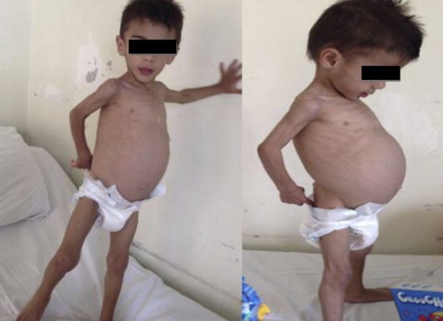
DWARFISHNESS

Slide 9
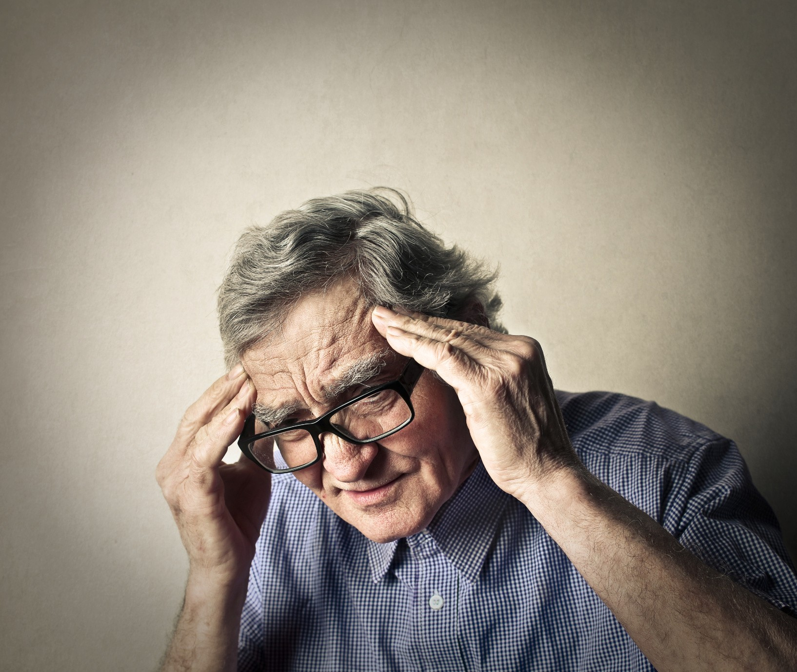
MEMORY DEFICIENT

Slide 11
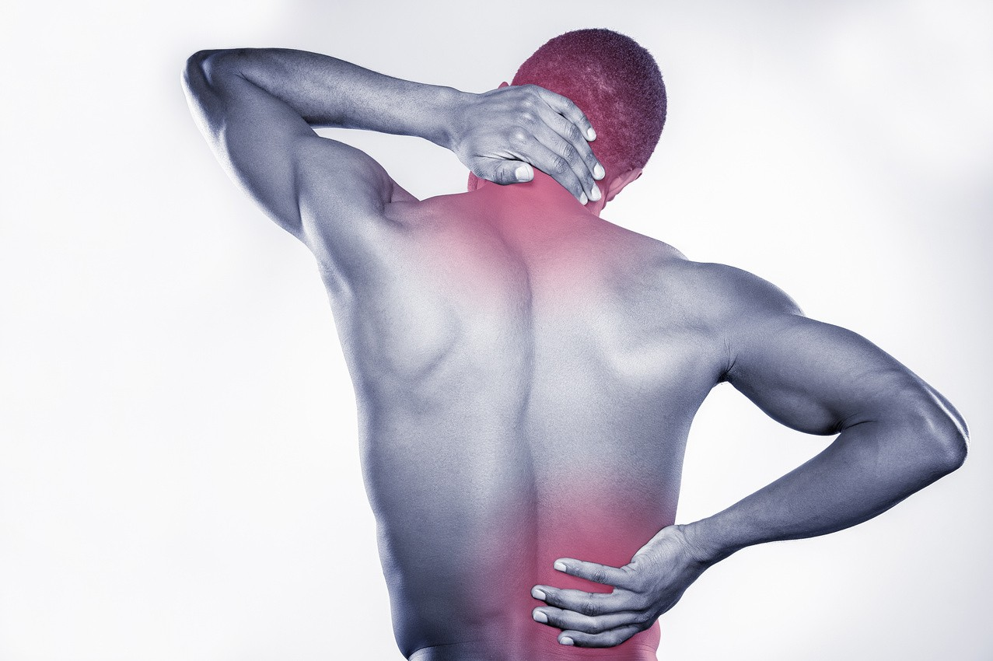
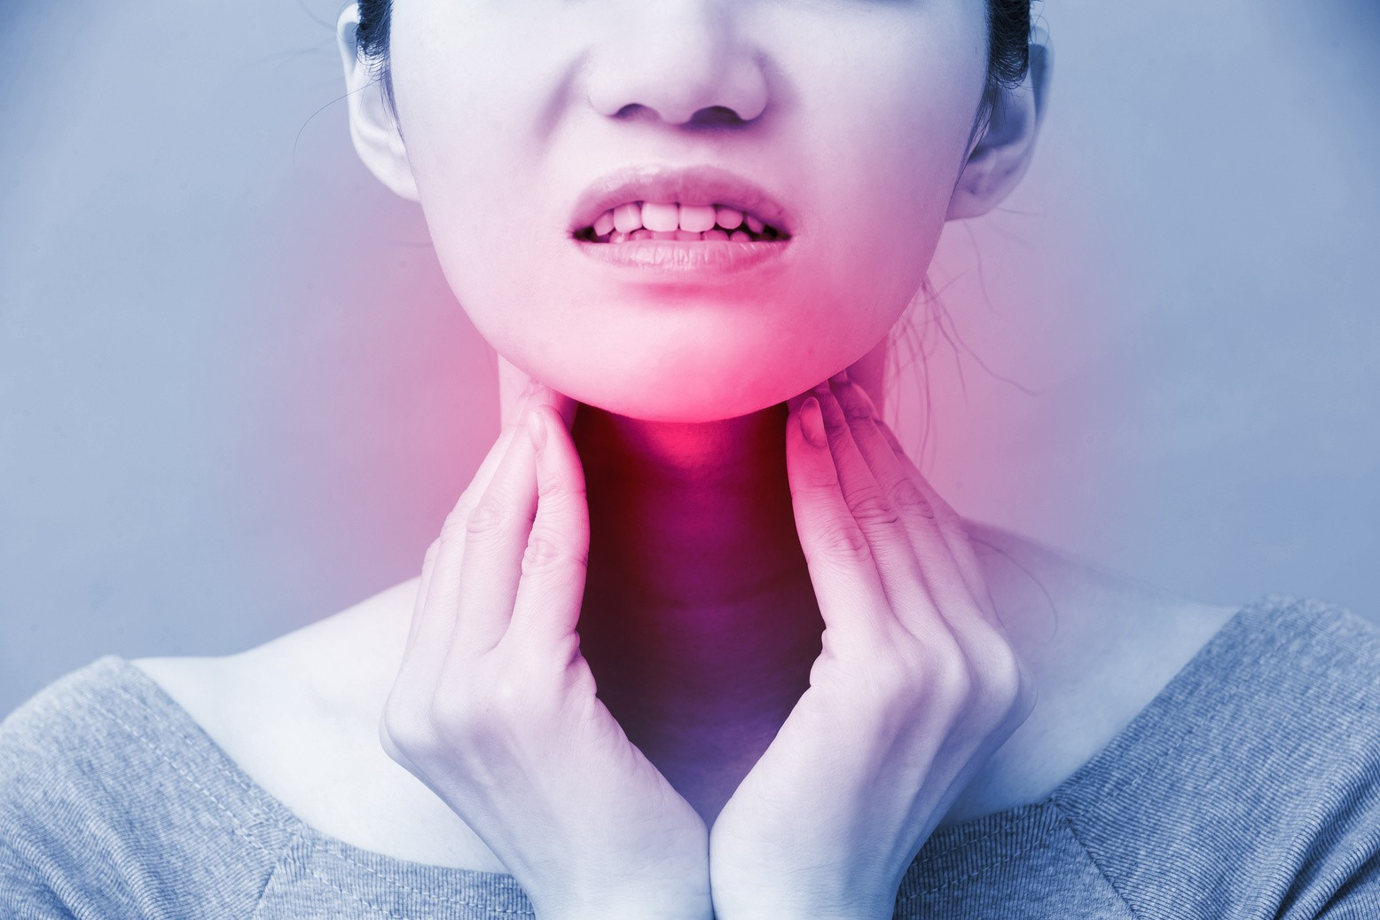
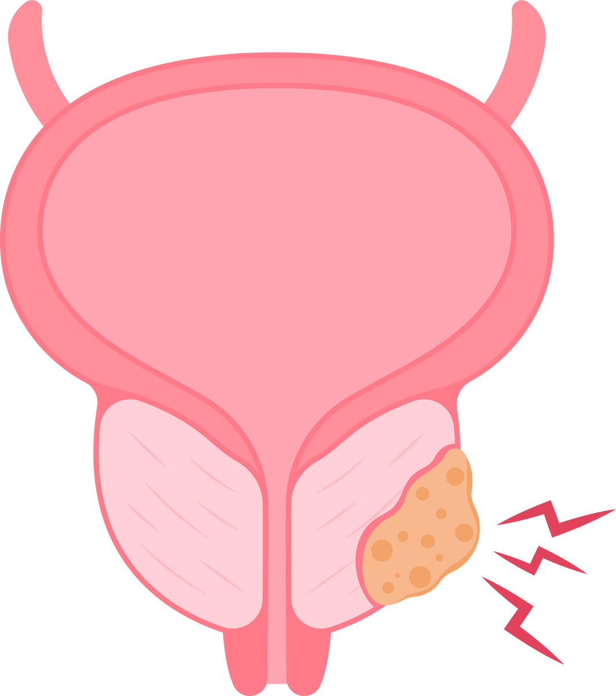
SWELLING & INDURATION

Slide 12
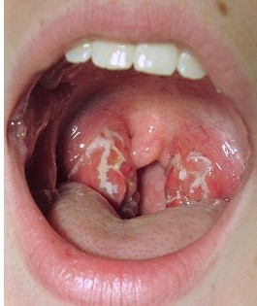
QUINSY

Slide 13
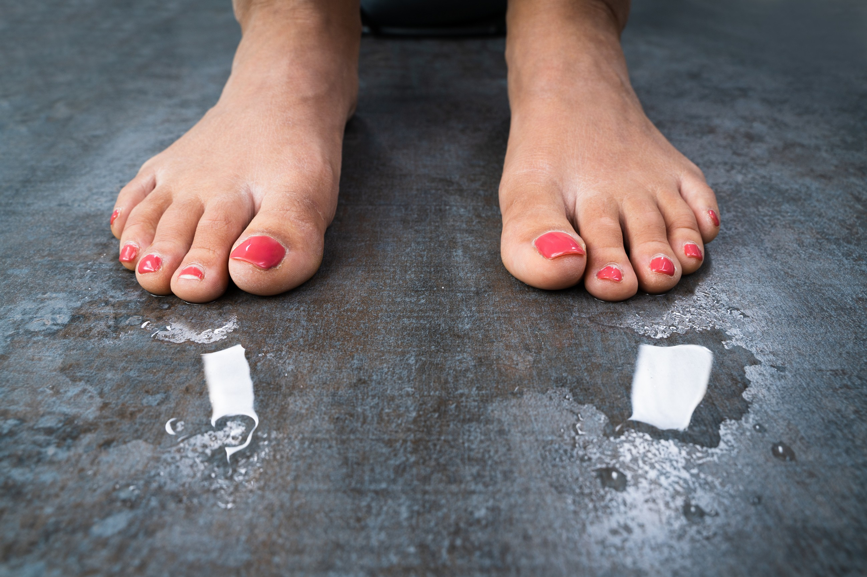
PERSPIRATION

Slide 14
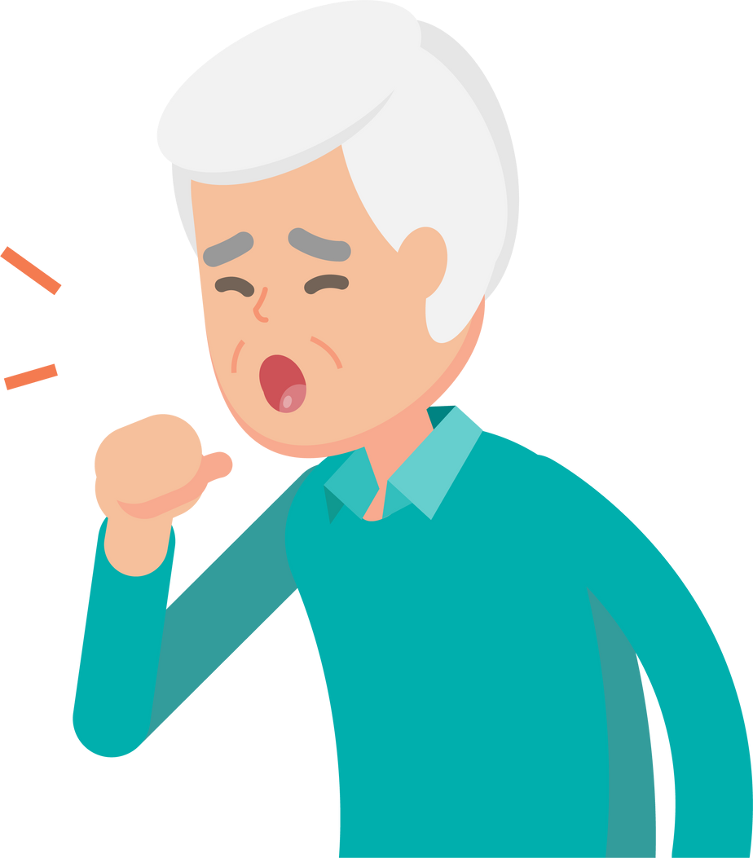
DISEASES OF OLD MEN

Slide 15
BALDNESS

Slide 16
SEMINAL EMISSIONS

Slide 17
FEMALE COMPLAINTS

Slide 18
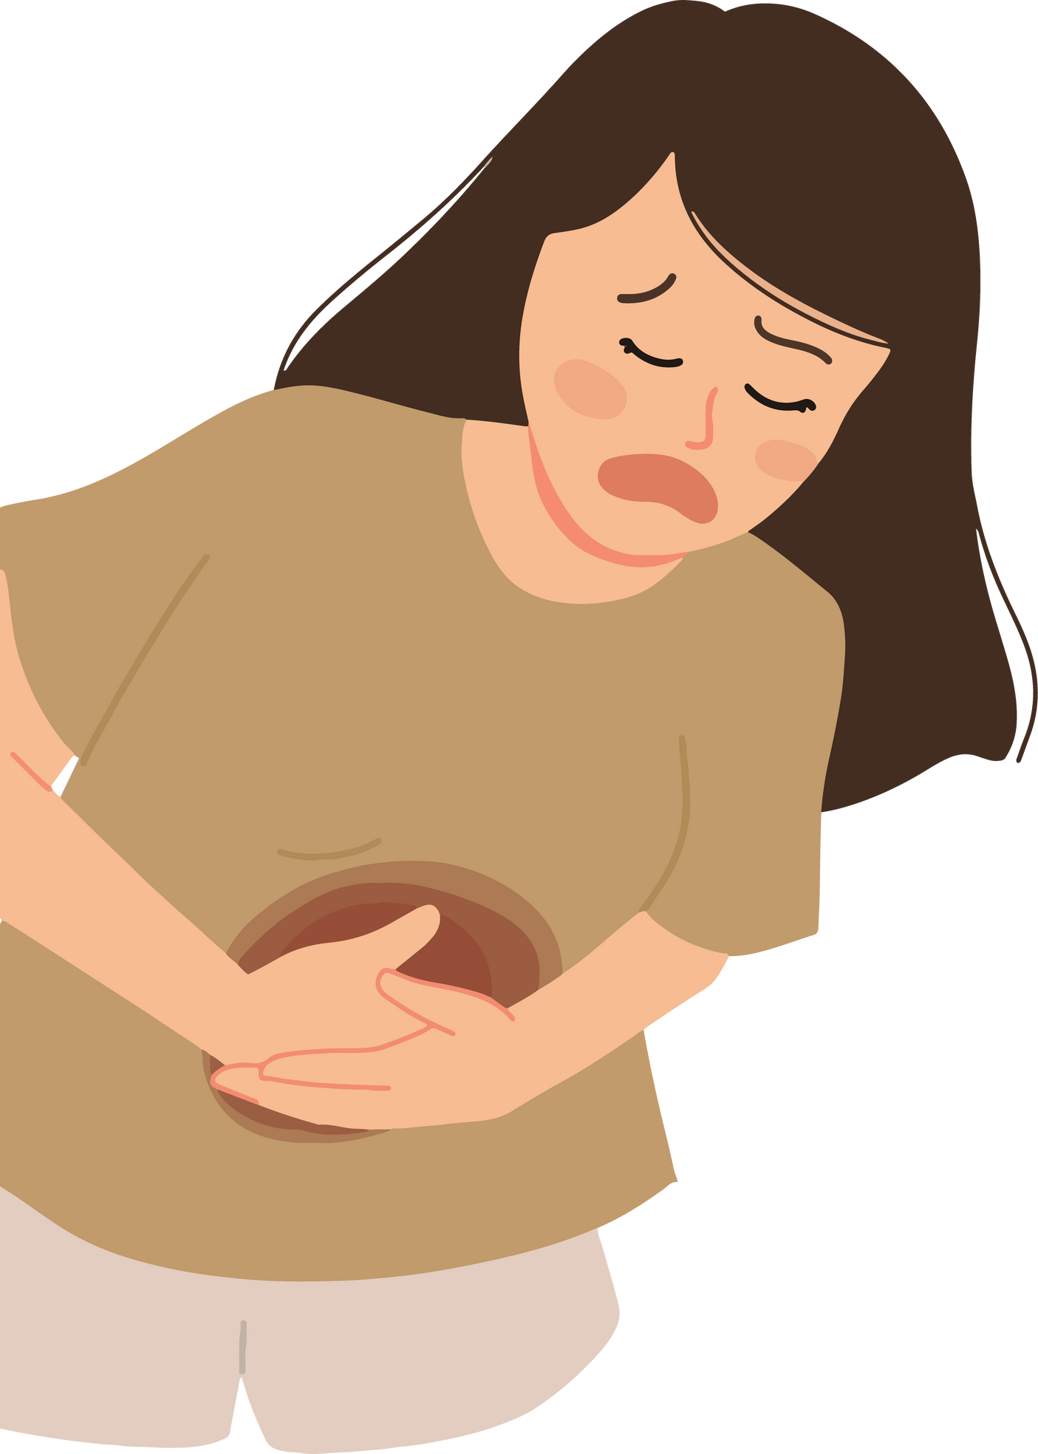
STOMACH AND ABDOMEN

Slide 19
MODALITIES
AGGRAVATION-
When thinking of his disease. (oxal. ac.) lying on painful side
after meals
washing affected parts
AMELIORATION-
When walking in open air.

