Slide 1
Disorders of the
Liver and Pancreas
Dr. Divya Gupta
BHMS, MD (Hom.)
Assistant Professor
Department of Pathology

Slide 2
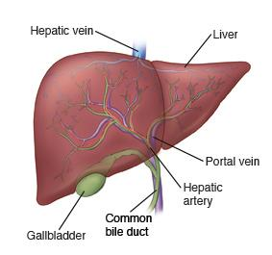
Liver

Slide 3
Liver Lobule
Hexagonal plates
Sinusoids
Triads
Bile duct branch
Arteriole
Venuole
Blood flows from periphery to
Central vein
Space of Dissé

Slide 4
Lobular Microanatomy
Hepatocytes
Canaliculi
Triad
Arteriole
Venuole
Bile Duct Branch

Slide 5
Bile Formation
Hemoglobin breakdown
Conversion in liver to water soluble form
Bilirubin
Serum levels help diagnose lever disease
Excretion in bile
Some is reabsorbed

Slide 6
Zonal Pattern of Injury
Peripheral
Middle
Central
Triadal
Limiting plate
Piecemeal necrosis

Slide 7
Liver Injury, The Basics
Lots of stuff injures the liver.
It’s the great detoxifier
Chronic injury
Fibrosis
Regeneration
Providing the underlying framework remains

Slide 8
Cholestasis
Slowed bile excretion
Intracellular
Drugs
Viral infection
By means of ducts
Drugs
Obstruction

Slide 9
Cirrhosis
Many things may lead to cirrhosis
Common features
Irreversible
Chronic inflammation
Scarring (fibrosis)
Parenchymal loss
Regenerative nodules
Altered vascularity
Symptoms
Ascites
Gynecomastia
Esophageal varices
Splenomegaly
Caput medusae

Slide 10
Cirrhosis
Many things may lead to cirrhosis
Common features
Irreversible
Chronic inflammation
Scarring (fibrosis)
Parenchymal loss
Regenerative nodules
Altered vascularity
Symptoms
Ascites
Gynecomastia
Esophageal varices
Splenomegaly
Caput medusae

Slide 11
Cirrhosis
Irreversible
Scarring
Botched regeneration
Vascular rearrangements
Caput medusae ->
Ascites ->
Low albumin
Venous portal hypertension

Slide 12
Common Etiologies
Inherited
Pigmentary
Post necrotic
Chronic viral
Nutritional

Slide 13
Cirrhosis
Stellate cell becomes real important
Normally stores vitamin A
Lymphocytes turn him into a collagen making machine

Slide 14
Sequence of Events
Liver cell injury
Cycle of chronic inflammation
Destruction of underlying architecture
Fibrosis
Attempts to regenerate
Vascular reorganization leading to shunting
Repeat cycle
Progressive
Irreversible

Slide 16
Parasitic
There are several
Schistosomiasis
Clonorchis sinensis

Slide 17
Inflammation of Liver
Very common, lots of things do it.
Toxins and drugs
Bacteria
Cholangitis
Abscesses
Viruses
EBV
CMV
Hepatic specific
Parasites
Autoimmune

Slide 18
Viral Hepatitis
Generally taken to mean hepatic specific viruses.
Histologic features common to most
Acute
Necrosis of random liver cells
Councilman bodies = bright pink dead cells
Diffuse liver cell swelling
Bile stasis
Portal (triadal) inflammation
Chronic pattern = persistence or relapse for 6 months
Chronic and acute inflammation
Piecemeal necrosis
Bridging necrosis
cirrhosis

Slide 20
Acute Viral Hepatitis

Slide 21
Chronic or Persistent Hepatitis

Slide 22
Hepatitis A
‘Infectious hepatitis’
Food handlers
Virus in stool
Seafood
Self limiting
No chronic state
No cirrhosis
No carrier state
History and serology
IgM
IgG
Maybe virus

Slide 23
Hepatitis B
‘Serum hepatitis’
Sexually transmitted
Blood borne
Longer incubation
Common in Asia
Most get over it fine
Immunologic damage
Less common
Chronic progressive
Fulminant failure and death
Cirrhosis
Chronic carrier state

Slide 24
Chronic Hepatitis B
Infrequently a person develops chronic infection with B.
Leads to cirrhosis

Slide 25
Hepatitis B Outcomes

Slide 26
Hepatitis C

Slide 27
Hepatitis C
Very high rate of persistence
Long incubation period
Cirrhosis

Slide 28
Delta Agent
Incomplete virus
Needs hepatitis B to replicate
The two together cause terrible disease.
Fulminant loss of liver
Can become infected later if you are a carrier of hepatitis B

Slide 29
Hepatitis Outcomes
Asymptomatic infection
Acute hepatitis like a bad case of the flu
Overt Jaundice
Carrier state
Fulminant liver death
Chronicity, +/- cirrhosis

Slide 30
Autoimmune Hepatitis
Women
Chronic hepatitis
No viral markers
May lead to cirrhosis

Slide 31
Abscesses
Bacterial
Parasitic
Blood borne
Ascends ducts

Slide 32
Drug and Toxin
Too many to list
Direct hepatocyte toxicity
Biliary paralysis
Conversion to a truly toxic agent

Slide 33
Reye’s Syndrome
Young kids
Follows flu
Got aspirin
Liver and brain
Fulminant liver failure

Slide 34
Alcoholic Liver Disease
Acute and chronic
Acute hepatitis
Fatty liver ->
Cirrhosis

Slide 35
Acute Alcoholic Hepatitis
Liver cell necrosis
Balloon degeneration
Neutrophils
Mallory bodies

Slide 36
Alcoholic Cirrhosis
About 15-20% of alcoholics
Micronodular pattern, so called ‘hobnails’
Increased portal pressures

Slide 37
Alcoholic and Non-Alcoholic Fatty Liver Disease
Non Alcoholic
DM
Obesity
Metabolic syndrome
Even kids

Slide 38
Other Types of Cirrhosis

Slide 39
Pigmentary
Iron
Oxidative injury
Scarring
Congenital problem with excessive absorption

Slide 40
Wilson’s Disease
Copper metabolism
Absence of transport protein
Builds up in various organs
Cirrhosis
Brain degeneration
Corneal ring

Slide 41
Alpha-1 Anti-trypsin Deficiency
Neutralizes proteases and elastases
Made in the liver
Can’t finish the process
Constipated cells fill up with partially completed anti-trypsin
Causes cell death and scarring
Emphysema

Slide 42
Intrahepatic Biliary Disease
Drug related
Bile stasis
Inflammation
Scarring
Primary conditions of the biliary tree
Autoimmune, often leading to cirrhosis
Sometimes associated with other conditions

Slide 43
Primary Biliary Cirrhosis
Women
Granulomatous destruction of medium sized bile ducts
High serum cholesterol
Xanthomas
Cirrhosis
Antimitochondrial antibodies
Sicca syndrome
Dry eyes & mouth
Scleroderma
Rheumatoid arthritis
All autoimmune in nature

Slide 44
Primary Biliary Cirrhosis

Slide 45
Primary Sclerosing Cholangitis
Concentric fibrosis of smaller bile ducts
Onionskin
Seen with ulcerative colitis
No antibodies
No other problems, like Sicca syndrome

Slide 46
Vascular Related
Congestion
Infarcts
Cirrhosis altered vascularity of liver

Slide 47
Hepatic Infarct

Slide 48
Pregnancy Related
HELLP syndrome
Hepatic enzymes
Low platelets
Eclampsia
High blood pressure
Fatty liver
May be life threatening

Slide 49
Eclampsia

Slide 50
Tumors of the Liver
Hyperplasia vs. true tumor
Estrogens
Benign vs. malignant
Primary vs. metastatic
Bowel
Lung
Kidney
Breast

Slide 51
Metastatic Cancer

Slide 52
Hepatocellular Carcinoma
Malignant hepatocytes
Associated with
Hepatitis B
Cirrhosis
May be multiple foci

Slide 53
Cholangiocarcinoma
Comes from bile duct epithelium
Adenocarcinoma
Much desmoplasia
Not associated with the stuff seen in hepatocellular cancer

Slide 54
Gallstones
Ethnicity
Age
Sex
Fatty foods
Cholesterol and mixed stones
Pigmentary stones
Obstruction
Painful
Infection

Slide 55
Gallstones

Slide 56
Cancer of Gallbladder
Chronic irritation of gallstone
Chronic cholecystitis
Presumed oxidative damage
Cancer

Slide 57
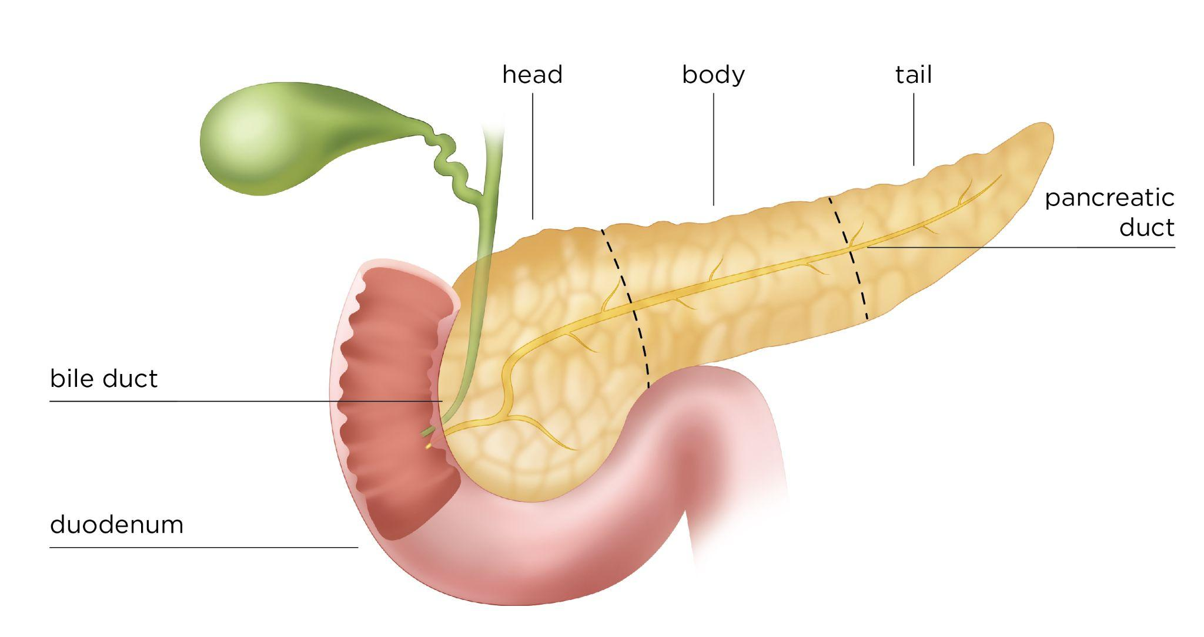
Pancreas

Slide 58
Pancreas

Slide 59
Acute Pancreatitis
Autodigestion
Acute inflammation
Enzyme activation
Fat necrosis with soaponification
Hemorrhage
Causes
Obstruction
Stone
Tumor
Alcohol
Complications
Pseudocyst
Shock

Slide 61
Acute Pancreatitis

Slide 62
Soaponification

Slide 63
Pancreatic Pseudocyst

Slide 64
Chronic Pancreatitis
Extensive fibrosis
Calcifications
Cystic fibrosis

Slide 65
Cystic Fibrosis
Inherited problem of chloride pump
Thick mucus
Clogs
Bowel
Pancreas
Fibrosis
Malabsorption
Bronchi

Slide 66
Pancreatic Cancer
Often advanced at the time of discovery.
Adenocarcinoma
From ductal epithelium
Spreads to liver
Not hormonally active
Painless jaundice

Slide 67
Islet Cell Tumors
Insulin secreting
Hypoglycemic episodes
Gastrinoma
Zollinger-Ellison
Glucagonomas
VIPomas

Slide 68
Insulin Secretion and Peripheral Utilization

Slide 69
Type I Diabetes
Lack of insulin
Trigger causes autoimmune destruction of beta cells.
Ketosis prone

Slide 70
Type I Diabetes
Trigger leads to autoimmune destruction of islets

Slide 71
Type II Diabetes
Insulin release problem
Peripheral resistance
Non-ketosis prone

Slide 72
Glycosylated Proteins
Small vessel vascular disease
This is what diabetes becomes

Slide 74
Diabetic Vascular Changes

Slide 75
Thank You

